Slide 1
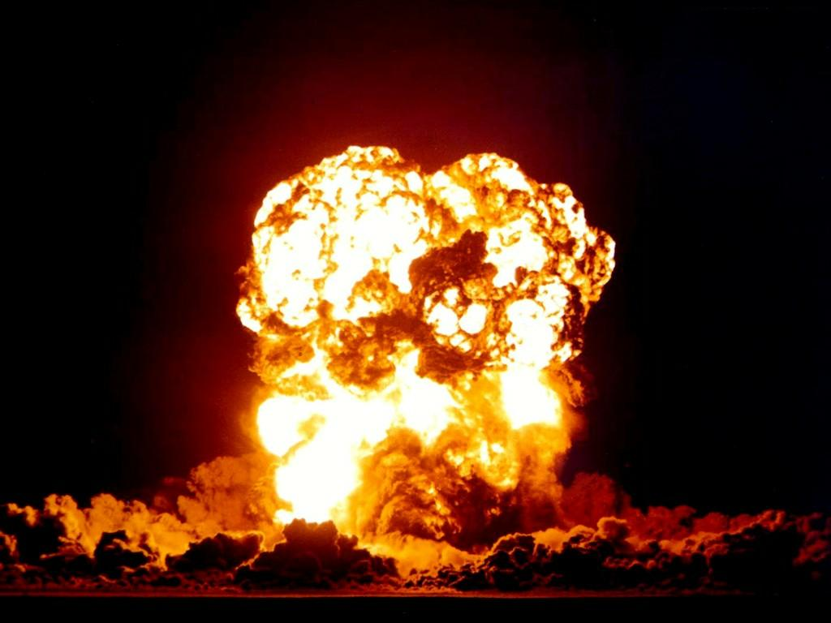
CHAOS ENGINEERING
ON A BUDGET
Heather Nakama
Senior Software Engineer
Microsoft Azure Search
Heather Nakama, QCon
11/14/17
Notes:
I assume you’re here because you have an interest in chaos engineering.
It might seem like you need a lot of resources, either time or money or dedicated engineers, to even think about getting started with chaos engineering.

Slide 2
CHAOS ENGINEERING
ON A BUDGET IS…
Notes:
I’m going to explain why chaos engineering is so effective and how understanding these principles will allow you to add chaos testing to your system for a very low cost.

Slide 3
CHAOS ENGINEERING
ON A BUDGET IS… POSSIBLE
Notes:
I’m going to explain why chaos engineering is so effective at ensuring resiliency in distributed systems and how understanding these principles will allow you to add chaos testing to your system for a very low cost.
I’m going to show that not only is chaos engineering possible on a budget, but that if you have limited time and resources, it’s even more essential because it will save you time and effort

Slide 4
CHAOS ENGINEERING
ON A BUDGET IS… ESSENTIAL
IT WILL SAVE YOU TIME AND EFFORT
Notes:
I’m going to show that not only is chaos engineering possible on a budget, but that if you have limited time and resources, it’s even more essential because it will save you time and effort
I’ll demonstrate this by describing my team’s experience with chaos engineering. I’m not a chaos or reliability engineer, I spend a very small fraction of my time on chaos engineering, but the components I’ve built have increased my productivity immeasurably

Slide 5
CHAOS
ENGINEERING
Systematic approach to building confidence in the resiliency of distributed systems through triggering chaotic operations
Notes:
First, a definition.
Key word, systematic. This must be a principled, systematic approach.

Slide 6
CHAOS
ENGINEERING
It’s not causing faults for the love of mayhem or to freak out your team members

Slide 7

CHAOS
ENGINEERING
(although that’s FUN, too)
Notes:
Although it’s fine if that’s a byproduct of the practice
Love sending maliciously innocent emails where I say “Oh hey, noticed your code breaks when this happens. Is this expected behavior?”
If you enjoy causing mayhem, you might enjoy this, but it’s not the primary benefit

Slide 8
CHAOS
ENGINEERING
Inject faults to learn about your system
Either you find bugs or you build confidence in your system’s behavior
Notes:
You’re not just breaking things for the sake of breaking things, you’re doing it to learn about your system and increase confidence in system reliability.
Every fault you inject must be for the purpose of learning something about your system
If I inject this fault, the system will be able to recover

Slide 9
THE PROBLEM WITH DISTRIBUTED SYSTEMS
Notes:
Chaos engineering has been growing in popularity over the last few years because it’s an approach that does a very good dealing with some of the problems unique to distributed systems

Slide 10
DISTRIBUTED SYSTEMS
ARE INHERENTLY CHAOTIC
Notes:
As distributed systems scale and grow more complex, they become functionally very chaotic
In theory, system state is deterministically calculable, but in practice, this quickly gets computationally infeasible

Slide 11
DISTRIBUTED SYSTEMS
ARE INHERENTLY CHAOTIC
Concretely, what does this mean?

Slide 12
PROBLEM
#1
Set of possible system states grows
EXPONENTIALLY
as sub-component count increases
Notes:
Very difficult to design for and test with traditional methods
Either the amount of work you do needs to scale exponentially as well
OR
You need to fundamentally shift your strategy
HOPEFULLY as engineers, you’re not pleased with a strategy that scales exponentially as a function of system size
Chaos engineering makes this work more achievable

Slide 13
PROBLEM
#2
Failure is NORMAL at scale
Notes:
At scale, failures with low probability become commonplace
Uneasy almost-paradox of distributed systems. We increase replication and node count to ensure higher overall system availability, but at the same time, this increases the likelihood of individual failure

Slide 14
CASE STUDY #1
TOO MANY SYSTEM STATES
Notes:
These two problems are not abstract for my team and for me.
We learned them the hard way, at the cost of unhappy engineers or unhappy customers, often with critical, severe bugs in production that resulted in sleepless nights for engineers
Hopefully you can learn from our pain and avoid these lessons
I’ll show you how my team ran into each of these problems in turn and how we used chaos engineering to mitigate them

Slide 15

AZURE SEARCH
MICROSOFT CLOUD AI PLATFORM
Notes:
Context, search-as-a-service
I work on infrastructure, meaning distributed components like our jobs workflow, elastically scaling clusters out and in, moving customer data around stateful nodes, leader election, etc.
All things that can be scary if you get them wrong

Slide 16

BEFORE
CHAOS ENGINEERING
PARANOIA ABOUT SYSTEM RELIABILITY
Notes:
And damn, 2 years ago before we released, I was scared.
Checkin velocity was slowing down right when it should have been ramping up for release
Low confidence in stability of service
Regularly finding small edge case bugs in production
Small bugs, but if I missed those I’m probably missing large bugs too
One thing I was working on was shifting data between stateful nodes, especially when scaling a cluster down, and my biggest fear was that a bug would result in our system cheerfully deleting a set of replica nodes while it contained customer data.

Slide 17
[Y]ou are doing enough testing if the following is true:
  YOU RARELY GET BUGS THAT ESCAPE INTO PRODUCTION
  YOU ARE RARELY HESITANT TO CHANGE SOME CODE FOR FEAR IT WILL CAUSE PRODUCTION BUGS
-Martin Fowler
Notes:
I knew I had gaps in my test coverage

Slide 18

[Y]ou are doing enough testing if the following is true:
  YOU RARELY GET BUGS THAT ESCAPE INTO PRODUCTION
  YOU ARE RARELY HESITANT TO CHANGE SOME CODE FOR FEAR IT WILL CAUSE PRODUCTION BUGS
-Martin Fowler
Notes:
I knew I had gaps in my test coverage

Slide 19
BEFORE
CHAOS ENGINEERING
1 HOUR OF CODE
=
3 HOURS OF VALIDATION
Notes:
And damn, 2 years ago before we released, I was scared.
Checkin velocity was slowing down right when it should have been ramping up for release
Low confidence in stability of service
Regularly finding small edge case bugs in production
Small bugs, but if I missed those I’m probably missing large bugs too
One thing I was working on was shifting data between stateful nodes, especially when scaling a cluster down, and my biggest fear was that a bug would result in our system cheerfully deleting a set of replica nodes while it contained customer data.

Slide 20

GAP IN TEST COVERAGE
RIVER OF SCARY SYSTEM BUGS
Notes:
Here’s a re-enactment of my life at that point to show how I was dealing with the situation

Slide 21
GAP IN TEST COVERAGE
UNSUSTAINABLE
HUMAN MITIGATION
RIVER OF SCARY SYSTEM BUGS
Notes:
I was a nervous wreck because I used human effort to deal with this gap in testing
Made up for it with human effort – I spent more time testing and validating changes than I did writing them and I still lacked confidence

Slide 22
TEMPORARILY SAFE CUSTOMERS
GAP IN TEST COVERAGE
UNSUSTAINABLE
HUMAN MITIGATION
RIVER OF SCARY SYSTEM BUGS
Notes:
I was a nervous wreck because I used human effort to deal with this gap in testing
Made up for it with human effort – I spent more time testing and validating changes than I did writing them and I still lacked confidence

Slide 23
PROBLEM
#1
Systems states to test had grown EXPONENTIALLY
I was attempting (and failing) to scale my effort EXPONENTIALLY
Notes:
Even at 50 customers, set of states was infeasibly large
Seriously, don’t do this. You won’t win and you’ll drive yourself crazy.
I knew this was unsustainable and something needed to change

Slide 24

AUTOMATED, RANDOM, CONTINUOUS TESTS
Test cluster in production
Notes:
I decided to automate those 3 hours of validation I was doing
I track all the operations this component runs, whether or not it succeeds, and the health of the cluster
Enabled an iterative, systematic improvement process
Deploy new code to the test cluster
Go home
Come in, cluster usually on the floor with the diagnostics agent yelling at me that the cluster is unhealthy (mutator agent won’t run operations if the cluster is broken
I check logs to see when the diagnostics agent first noticed the cluster was unhealthy and cross-reference it against the mutator agent’s log of operations
This gets me bugs, which I fix, then push the new code and start the process over again

Slide 25

AUTOMATED, RANDOM, CONTINUOUS TESTS
Test cluster in production
Random
operations
Random Mutator
Notes:
I actually wanted to create a set of pre-defined operations for this to run, I didn’t have time to come up with them, so I ended up making it random (way better idea)
I track all the operations this component runs, whether or not it succeeds, and the health of the cluster
Enabled an iterative, systematic improvement process
Deploy new code to the test cluster
Go home
Come in, cluster usually on the floor with the diagnostics agent yelling at me that the cluster is unhealthy (mutator agent won’t run operations if the cluster is broken
I check logs to see when the diagnostics agent first noticed the cluster was unhealthy and cross-reference it against the mutator agent’s log of operations
This gets me bugs, which I fix, then push the new code and start the process over again

Slide 26

AUTOMATED, RANDOM, CONTINUOUS TESTS
Test cluster in production
Regular health checks
Random
operations
Diagnostics
Random Mutator
Notes:
I track all the operations this component runs, whether or not it succeeds, and the health of the cluster
Enabled an iterative, systematic improvement process
Deploy new code to the test cluster
Go home
Come in, cluster usually on the floor with the diagnostics agent yelling at me that the cluster is unhealthy (mutator agent won’t run operations if the cluster is broken
I check logs to see when the diagnostics agent first noticed the cluster was unhealthy and cross-reference it against the mutator agent’s log of operations
This gets me bugs, which I fix, then push the new code and start the process over again
Much more systematic way to find and fix bugs. Also much less effort – Instead of that 2-3 hours of my time spent.
I was automating that 3 hours

Slide 27
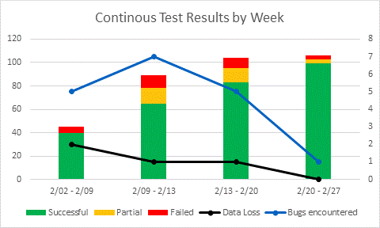
INCREDIBLY EFFECTIVE
Notes:
This is the graph I always show (with the original typo, so you know it’s real!)
Even in the first week I had it running, it found a lot of bugs
2 weeks after this we released with reasonably high confidence in system stability and good quality of life for me

Slide 28
INCREDIBLY EFFECTIVE
Runs MORE TESTS than I can
Notes:
Automated

Slide 29
INCREDIBLY EFFECTIVE
Runs MORE TESTS than I can
Finds MORE BUGS than I do
Notes:
In the first week, it found a ton of new bugs
Great at validating lack of regressions (finds the same bug multiple times)

Slide 30
INCREDIBLY EFFECTIVE
Runs MORE TESTS than I can
Finds MORE BUGS than I do
DOESN’T NEED TO SLEEP LIKE I DO
Notes:
This runs in the background 24/7 with no mental load on me.
I can go home, I can work on other features while this component is busy running tests for me.
Doubles my productivity

Slide 31
AFTER
CHAOS ENGINEERING
HIGH CONFIDENCE IN SYSTEM QUALITY
Notes:
I can’t emphasize enough how much this little randomized component has saved me time, while also providing peace of mind

Slide 32
3 WEEKS OF WORK PRODUCED 3 YEARS OF TESTS
Notes:
Still going today and saving me every week

Slide 33
[Y]ou are doing enough testing if the following is true:
  YOU RARELY GET BUGS THAT ESCAPE INTO PRODUCTION
  YOU ARE RARELY HESITANT TO CHANGE SOME CODE FOR FEAR IT WILL CAUSE PRODUCTION BUGS
-Martin Fowler
Notes:
I knew I had gaps in my test coverage

Slide 34

[Y]ou are doing enough testing if the following is true:
  YOU RARELY GET BUGS THAT ESCAPE INTO PRODUCTION
  YOU ARE RARELY HESITANT TO CHANGE SOME CODE FOR FEAR IT WILL CAUSE PRODUCTION BUGS
-Martin Fowler
Notes:
I knew I had gaps in my test coverage

Slide 35
WHY IS RANDOMNESS SO EFFECTIVE?

Slide 36

CONFIDENCE IN SYSTEM HEALTH
Testing explores the n dimensional space described by the set of all possible system states and operations
x
y
Notes:
Traditional testing precisely defines subsets and validates them

Slide 37

CONFIDENCE IN SYSTEM HEALTH
Testing explores the n dimensional space described by the set of all possible system states and operations
x
y

Slide 38
CONFIDENCE IN SYSTEM HEALTH
Testing explores the n dimensional space described by the set of all possible system states and operations
x
y

Slide 39
CONFIDENCE IN SYSTEM HEALTH
Testing explores the n dimensional space described by the set of all possible system states and operations
x
y

Slide 40
CONFIDENCE IN SYSTEM HEALTH
As system complexity increases, the states and operations that must potentially be tested increase exponentially
Curse of dimensionality
x
z
y
Notes:
Breaks down in distributed systems
Reducing the test set can be very difficult because distributed systems are so complex
So many more inputs to system state
External services (network, database, etc)
Individual nodes have so much more statE
Even if you do manage to precisely define distributed system state through tests, it’s a losing battle because the system is always changing as you deploy code and as external services deploy code
Your tests quickly become out of date

Slide 41
TOO MANY system states to test
(And correctly reducing the test set is too expensive)

Slide 42
TOO MANY system states to test
(And correctly reducing the test set is too expensive)
WE STILL WANT CONFIDENCE IN SYSTEM RELIABILITY
Notes:
I was attempting to

Slide 43
RANDOMNESS
Reduces test set in an evenly distributed way that avoids engineer bias and blind spots
Generating test cases is very CHEAP, enabling more tests to be run
x
z
y

Slide 44
MONTE CARLO
APPROACH TO SYSTEM CONFIDENCE
Question | What’s the probability that my system will encounter a bug?
Prohibitively expensive approach | Pre-defining system states and operations through engineer effort and validating them
Cheaper approximation | Validating system health at regular intervals
Sample set | Randomly generated system states + transient failures from running in production
Notes:
Problem = what percentage of the code contains bugs? How confident are we in our prediction?
(easier than traditional monte carlo methods because I don’t actually care about an accurate percentage, I just want 0% or not 0%)
Computationally infeasible approach = deterministically validating pre-defined subsets of system state and operations
Random sampling = mutator agent moves the system through states and operations, diagnostics agent takes samples at regular intervals

Slide 45
MONTE CARLO
APPROACH TO SYSTEM CONFIDENCE
Question | What’s the probability that my system will encounter a bug?
Prohibitively expensive approach | Pre-defining system states and operations through engineer effort and validating them
Cheaper approximation | Validating system health at regular intervals
“TRADITIONAL”
CHAOS ENGINEERING
Sample set
Customer-generated system states from running in production
Notes:
Problem = what percentage of the code contains bugs? How confident are we in our prediction?
(easier than traditional monte carlo methods because I don’t actually care about an accurate percentage, I just want 0% or not 0%)
Computationally infeasible approach = deterministically validating pre-defined subsets of system state and operations
Random sampling = mutator agent moves the system through states and operations, diagnostics agent takes samples at regular intervals

Slide 46

TELEMETRY is essential
WITHOUT IT, YOU’RE NOT LEARNING ANYTHING ABOUT YOUR SYSTEM
x
z
y

Slide 47
DIGRESSION:
MACHINE LEARNING AND AUTOMATED
MITIGATION

Slide 48
CASE STUDY #2
FAILURE IS INEVITABLE AT SCALE
Notes:
So using this Monte Carlo approach, I’m able to test a set of system states that’s larger than I could on my own, and more cheaply than I could
This randomized agent is freeing up my time while increasing my confidence in the health of the system
But something happened that made me realize that I still had gaps in test coverage, and this is where the second problem of distributed systems comes in.

Slide 49
LEARNING LESSONS THE HARD WAY
THE 2 AM PHONE CALL
Notes:
Every time I talk about learning lessons the hard way, I mean that I was very unhappy

Slide 50
LEARNING LESSONS THE HARD WAY
Secondary failures caused by a bug in ERROR RECOVERY LOGIC

Slide 51
LEARNING LESSONS THE HARD WAY
Resulted in multiple engineers fixing clusters by hand ALL NIGHT

Slide 52
LEARNING LESSONS THE HARD WAY
Resulted in multiple engineers fixing clusters by hand ALL NIGHT
(including my boss ☹)
Notes:
I was VERY strongly motivated to ensure this never happened again
So after I apologized to everyone, I started investigating

Slide 53
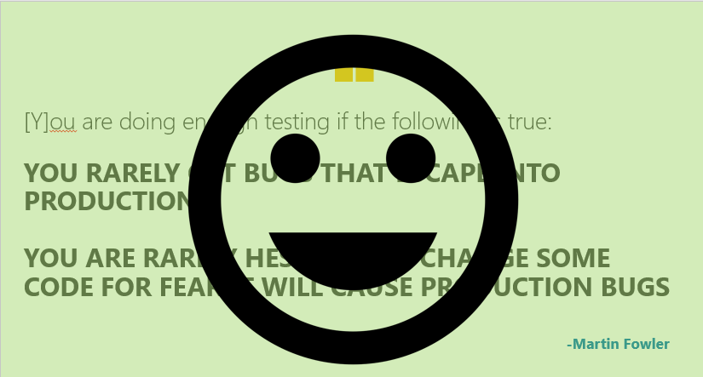
WHAT HAPPENED!?

Slide 54
HOW CAN YOU TRUST ERROR RECOVERY CODE IF IT NEVER RUNS?
Notes:
If you build confidence in your system by successfully executing possible system states,
Don’t you want confidence in error handling logic as well?
I realized that I had neglected to include failure states in the set of randomized states I provided for my chaos component to sample from.
This was a huge mistake because…

Slide 55
POSSIBLE SYSTEM STATES
Notes:
If you build confidence in your system by successfully executing possible system states,
Don’t you want confidence in error handling logic as well?
I realized that I had neglected to include failure states in the set of randomized states I provided for my chaos component to sample from.
This was a huge mistake because…

Slide 56
STATES NOT TESTED
STATES TESTED BY CHAOS COMPONENT
Notes:
If you build confidence in your system by successfully executing possible system states,
Don’t you want confidence in error handling logic as well?
I realized that I had neglected to include failure states in the set of randomized states I provided for my chaos component to sample from.
This was a huge mistake because…

Slide 57
FAILURE STATES
STATES TESTED BY CHAOS COMPONENT
Notes:
If you build confidence in your system by successfully executing possible system states,
Don’t you want confidence in error handling logic as well?
I realized that I had neglected to include failure states in the set of randomized states I provided for my chaos component to sample from.
This was a huge mistake because…

Slide 58
PROBLEM
#2
Failure is INEVITABLE at scale
Notes:
This had hit us with a big bug, but I realized that some of the little bugs we had seen were caused by this as well.

Slide 59
PROBLEM
#2
Failure is INEVITABLE at scale
But not DETERMINISTICALLY
Notes:
This had hit us with a big bug, but I realized that some of the little bugs we had seen were caused by this as well.
(Yeah, I said we RARELY got errors in production, well, the past few had been caused by this blind spot)

Slide 60
PROBLEM
#2
Failure is INEVITABLE at scale
But not DETERMINISTICALLY
(And not reliably within a sprint cycle)
Notes:
This had hit us with a big bug, but I realized that some of the little bugs we had seen were caused by this as well.
Some errors really are rare. They will eventually happen… but not on a 1 week sprint cycle
If we get “lucky”, they happen a lot during the week, and then we have high confidence that our error recovery logic works.
But if we are “unlucky” and these failures don’t happen during a week, then we have no idea if our error recovery code works.
It’s even worse for the truly rare errors because they’re almost guaranteed not to happen

Slide 61
Promote FAILURE to a
FIRST-CLASS member of the system
Notes:
Failure is normal

Slide 62
AUTOMATED, RANDOM, CONTINUOUS TESTS
Test cluster in production
Regular health checks
Random
operations
Diagnostics
Random Mutator

Slide 63

AUTOMATED, RANDOM, CONTINUOUS TESTS
Test cluster in production
Regular health checks
Random
operations
Fault injection
Diagnostics
Chaos Monkey
Random Mutator

Slide 64

SEARCH CHAOS MONKEY
I don’t want to get woken up at 2am again ☹
Notes:
How do you know your error recovery logic works if you never run it?
Also, does it work with a combination of failures?
Works great – I turned it off during the summer and 2 pretty serious customer impacting bugs escaped out into prod
TODO: Add slide for this. “Inadvertent A/B testing”

Slide 65

SEARCH CHAOS MONKEY
I validated 10 times this week that you won’t!
I don’t want to get woken up at 2am again ☹
Security blanket of high confidence in system health
Notes:
How do you know your error recovery logic works if you never run it?
Also, does it work with a combination of failures?
Works great – I turned it off during the summer and 2 pretty serious customer impacting bugs escaped out into prod
TODO: Add slide for this. “Inadvertent A/B testing”

Slide 66
SEARCH CHAOS MONKEY
Trigger random faults regularly
Restart VMs
Restart processes
Simulate network connection loss
Crash VMs
Notes:
How do you know your error recovery logic works if you never run it?
Also, does it work with a combination of failures?
Works great – I turned it off during the summer and 2 pretty serious customer impacting bugs escaped out into prod
TODO: Add slide for this. “Inadvertent A/B testing”

Slide 67
A/B TESTING
Notes:
How do you know it works?

Slide 68
INADVERTENT A/B TESTING
Notes:
Well at least I know it works

Slide 69
INADVERTENT A/B TESTING
(I turned off the Chaos Monkey and 2 SEVERE BUGS escaped into production)
Notes:
Well at least I know it works
Oh god, I also woke up my boss this time too

Slide 70
INADVERTENT A/B TESTING
(I turned off the Chaos Monkey and 2 SEVERE BUGS escaped into production)
(causing my boss to get called at 4am ☹☹☹)
Notes:
Well at least I know it works
Oh god, I also woke up my boss this time too
As they say, this is a Strong Signal that the Chaos Monkey is effective

Slide 71
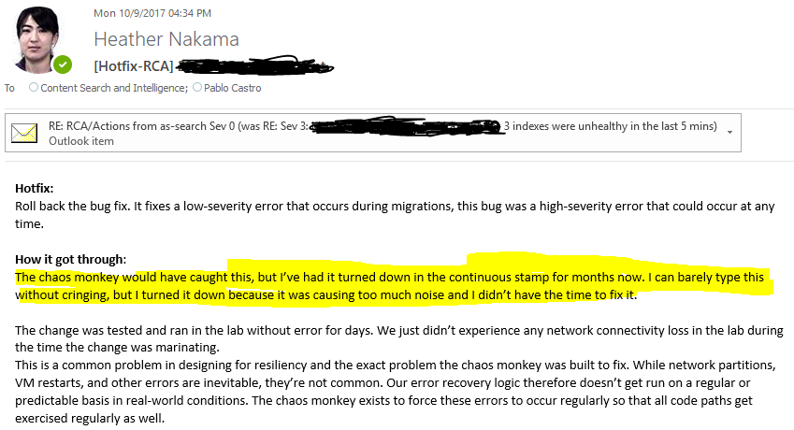
(RCA of shame)
Notes:
As we say, this is a very strong signal that the chaos monkey works
So… you’re welcome for validating this works
(we’ll see if my boss buys that)

Slide 72
SUMMARY

Slide 73
CHAOS ENGINEERING HAS INCREASED MY CONFIDENCE IN THE RELIABILITY OF MY CODE WHILE COSTING LESS IN TIME AND RESOURCES
Heather Nakama, QCon
11/14/17
Notes:
Chaos engineering has been a huge time saver for me and for my team

Slide 74
CHAOS ENGINEERING
PROVIDES HIGH CONFIDENCE AT LOW COST
Heather Nakama, QCon
11/14/17
Notes:
I assume you’re here because you have an interest in chaos engineering.
It might seem like you need a lot of resources, either time or money or dedicated engineers, to even think about getting started with chaos engineering.

Slide 75
DISTRIBUTED SYSTEMS ARE CHAOTIC AND REQUIRE CHAOTIC TESTING METHODS
MONTE CARLO-STYLE RANDOM SAMPLING IS A CHEAP WAY TO GAIN CONFIDENCE ABOUT SYSTEM HEALTH
…AS LONG AS YOU INCLUDE FAILURE IN YOUR SAMPLE SET
Heather Nakama, QCon
11/14/17

Slide 76
Art by Designed by Vexels.com
AZURE SEARCH
Inside Azure Search: Chaos Engineering
A Startup At Microsoft
HEATHER NAKAMA
Distributed systems
Chaos engineering
Self-healing systems through machine learning
Biologically inspired systems
Heather Nakama, QCon
11/14/17

Slide 77
QUESTIONS?
Heather Nakama, QCon
11/14/17

