Slide 1
Capacity Planning for
Crypto Mania

Slide 2
Capacity Planning for Crypto Mania
Notes:
In May of 2017, if you tried to visit coinbase.com to purchase cryptocurrency or check your balance you likely experienced a page similar to this one.
Prices were spiking
Our systems were crumbling around us
You might have even thought that we’d simply disappeared with your money and turned off the lights.

Slide 3
Notes:
We began to see stories come out like this one
These types of stories hurt - we had been heads down at the company building this ecosystem for the past several years

Slide 4
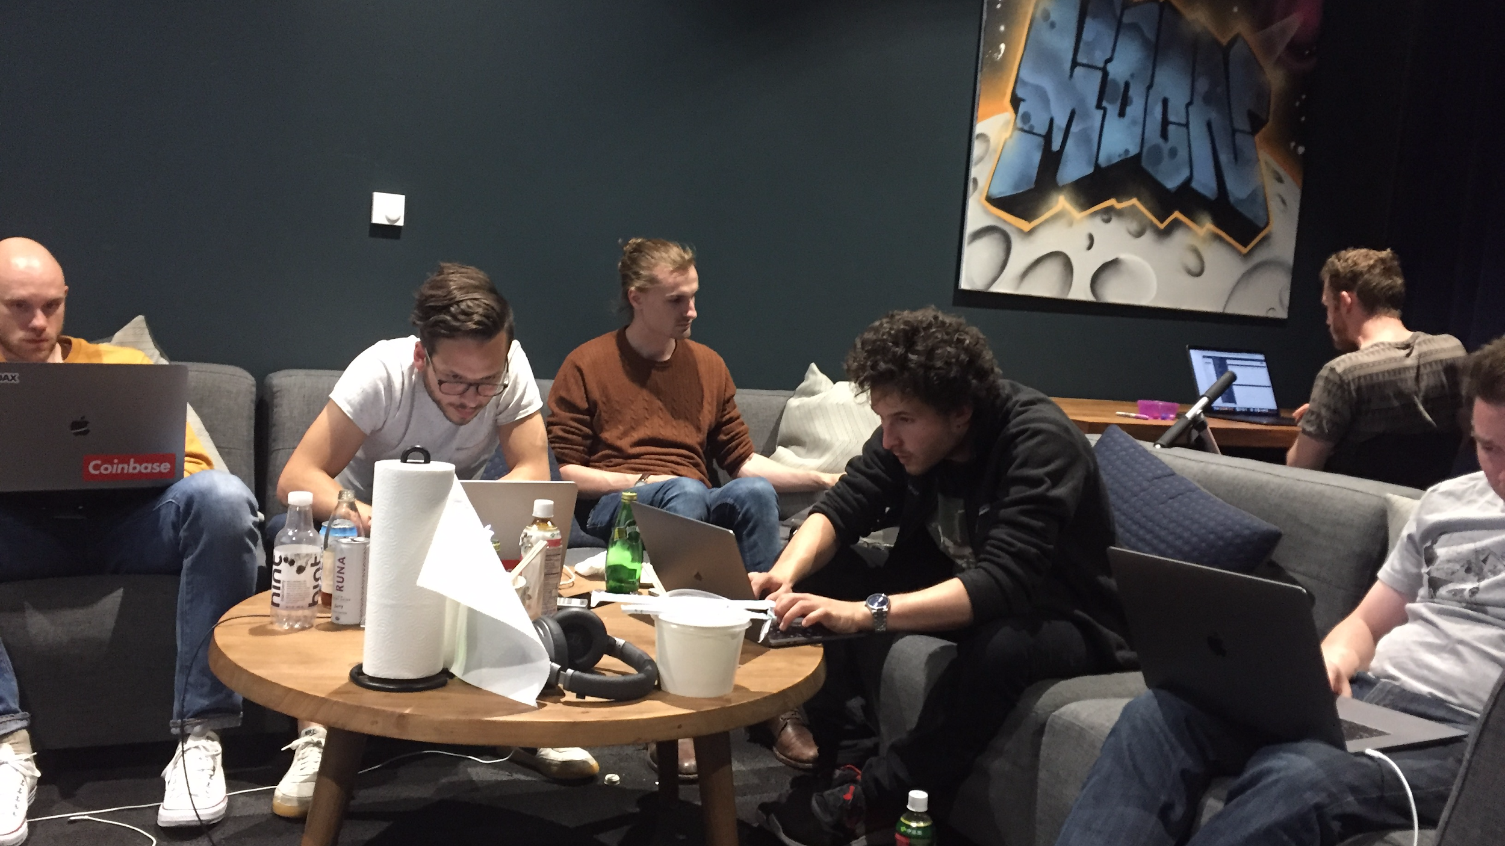
Notes:
Team of bleary eyed engineers at the end of a long day of being down
NYT article
This day was an inflection point for us
If we didn’t get our act together quickly, coinbase wasn’t going to survive.
JORDAN

Slide 5
Capacity Planning for
Crypto Mania
Notes:
how coinbase got its groove back (how we turned that story around)
This talk is called “Capacity Planning for Crypto Mania”
we’re going to present some of the things we learned while scaling coinbase to support a 20x increase in traffic over the course of a few months.
We made some mistakes, learned some lessons, and had the privilege of solving some fun challenges.
Our tools and systems had to mature quickly.
We’ll walk through the story of coinbase starting from that dark day last year calling out some insights as we go, then we’ll get into what we’re doing now to be better prepared for the future.

Slide 6
Luke Demi
Reliability Team
Jordan Sitkin
Reliability Team
Notes:
we are just two of the folks who were involved in the wild ride the last year

Slide 7
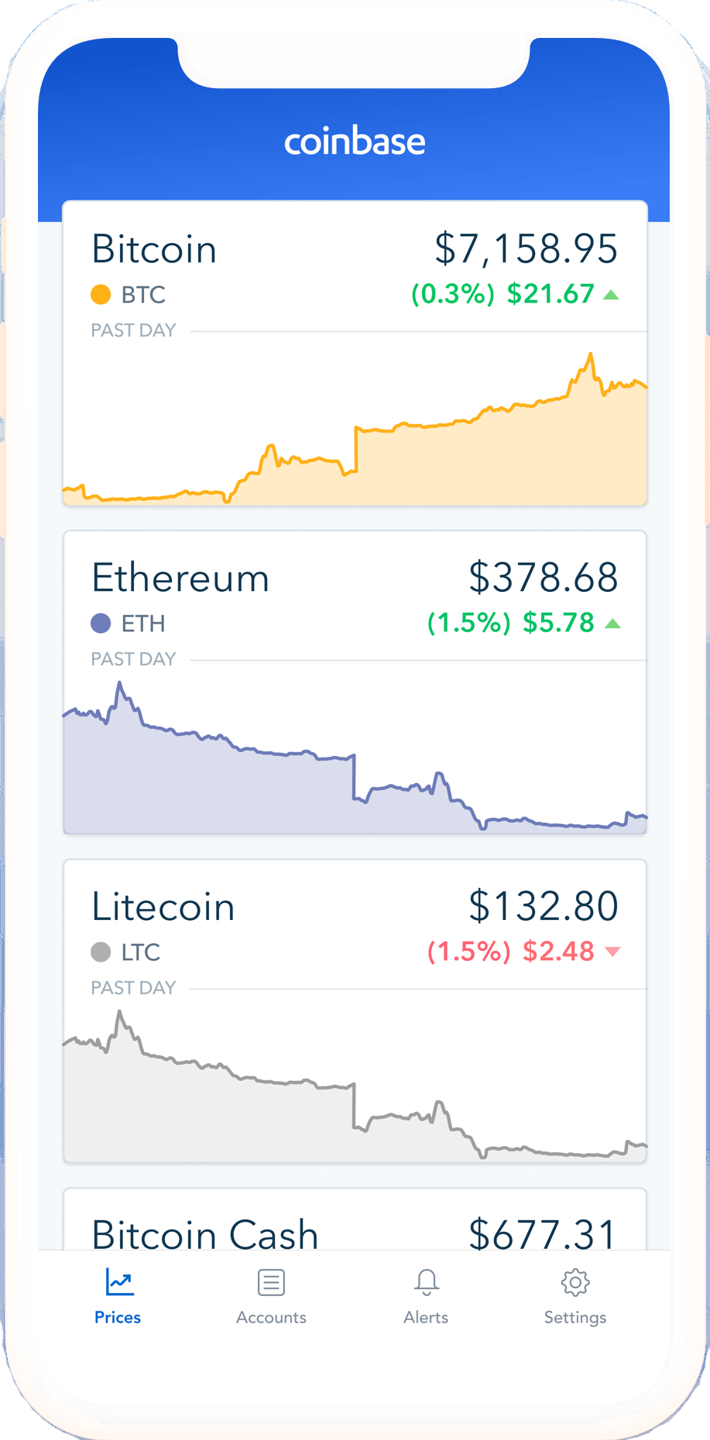
Buy and sell digital currency
Coinbase is the easiest and most trusted place to buy, sell, and manage your digital currency.
Notes:
easiest and most trusted place to buy, sell, and manage digital currency
this is a picture of our mobile app
and this is how most people think about coinbase, but over the past year...

Slide 8
Commerce
Prime
Pro
Custody
Wallet
Notes:
… we’ve grown into so much more
Constellation of brands and products around the coinbase name

Slide 9
Notes:
using rails as our primary web framework
and heavily reliant on mongoDB
we’re built on aws

Slide 10
The most important tool for
capacity planning is load testing.
Notes:
Although title is capacity planning, we’re going to spend most of our time talking about load testing
Hope to convince you of 2 things

Slide 11
The most important tool for
capacity planning is capacity testing.
Notes:
Although this is a capacity planning talk, we’re going to spend most of our time talking about load testing
Hope to convince you of 2 things

Slide 12
The most important tool for
capacity planning is stress testing.
Notes:
Although this is a capacity planning talk, we’re going to spend most of our time talking about load testing
Hope to convince you of 2 things

Slide 13
The most important tool for
capacity planning is volume testing.
Notes:
Whatever you call it, goal is being able to simulate and study the kind of failures you experience in production

Slide 14
Perfect parity with production is not a requirement for a good load testing system.

Slide 15
Analyze
Load Test
Instrument & Improve
The Capacity Cycle
Notes:
The Capacity Cycle
This is going to be a theme throughout the talk
We’re going to share experience through this lens

Slide 16
2016
2017
THE WAKEUP CALL
THE HOLY GRAIL
THE FUTURE
2017
2018
YOLO LOAD TESTING
LOAD TESTING REDUX
Notes:
LUKE
“let’s add a little bit more context to that story”
charts incoming

Slide 17
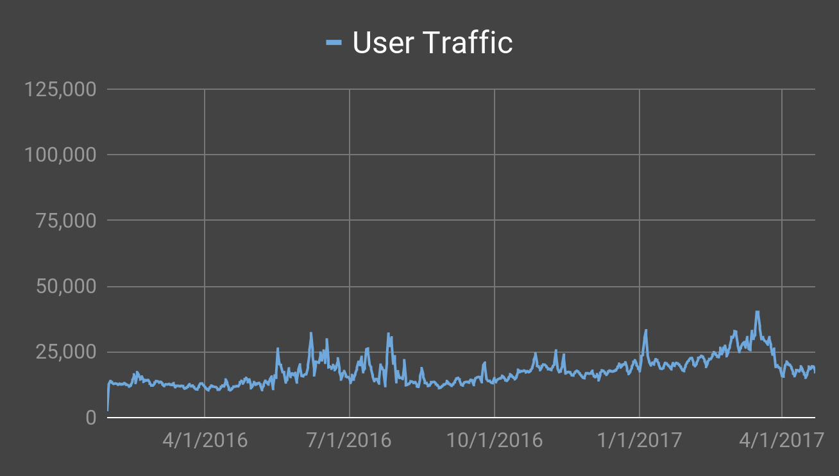
Backend RPM
Notes:
Shown here: early 2016
Up until this point we were entirely focused on building features. Cryptocurrency had yet to really hit the mainstream so overnight 10x increases in traffic did not feel like a real possibility.
Until that day last year we had identified our ceiling at around 100k RPM.

Slide 18
Backend RPM
Notes:
about 100k is where we thought things would start to break down
This red line would be GREAT
Profitability... the crypto moon!

Slide 19
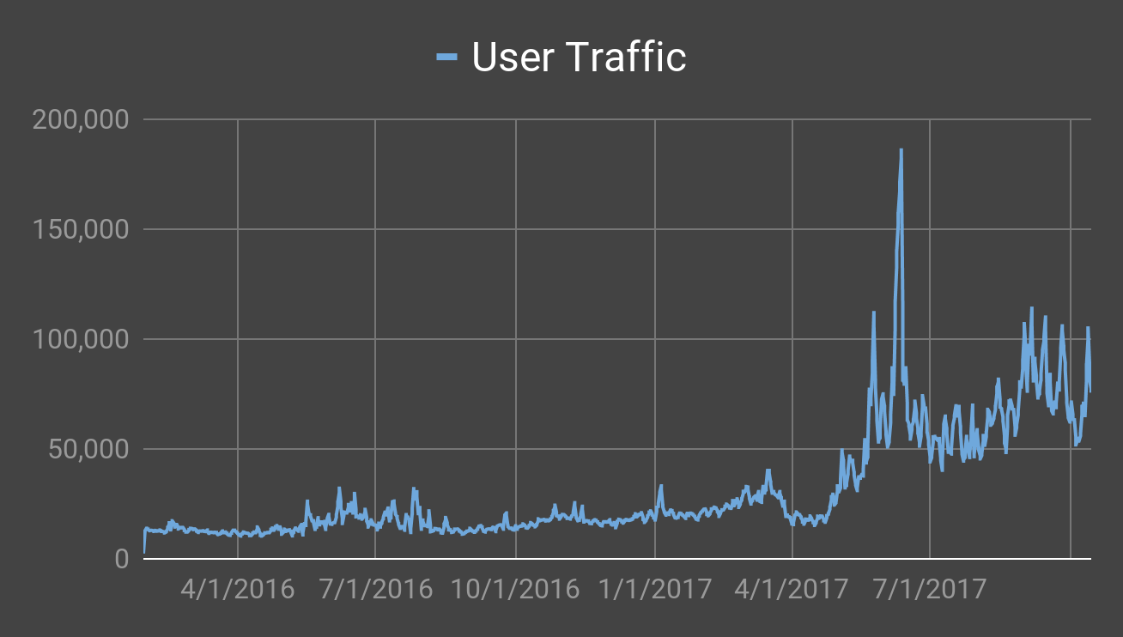
Backend RPM
Notes:
Then our “dreams” came true
sustained days above the red line

Slide 20
Backend RPM
Notes:
making the news for all the wrong reasons
felt like such a big deal to be mentioned, bizarre
What was blowing up?

Slide 21
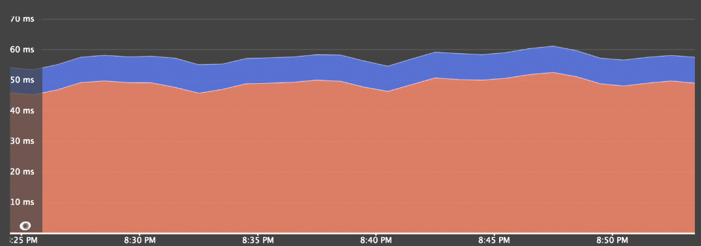
Web Service Time Breakdown
Notes:
this is what we usually saw
explain it far more here

Slide 22
Web Service Time Breakdown
Notes:
… and this was the chart we saw (explain)
We took this graph at face value because it was the only instrumentation we had at the time
We were forced to believe that both of these systems were experiencing equivalent slowdowns.

Slide 23
Web Service Time Breakdown
Notes:
But this chart was wrong
and we weren’t doing enough to
it led us down several major rabbit holes
we spent days adjusting memory parameters in our rails app
adjusting kernel tuning parameters
useful:
falling back to just upgrading mongoDB clusters

Slide 24
Instrument &
Improve
Analyze
Load Test
The Wakeup Call
Notes:
the reason I bring this up, this is an example of where we did not follow the cycle
we didn’t yet have this road map

Slide 25
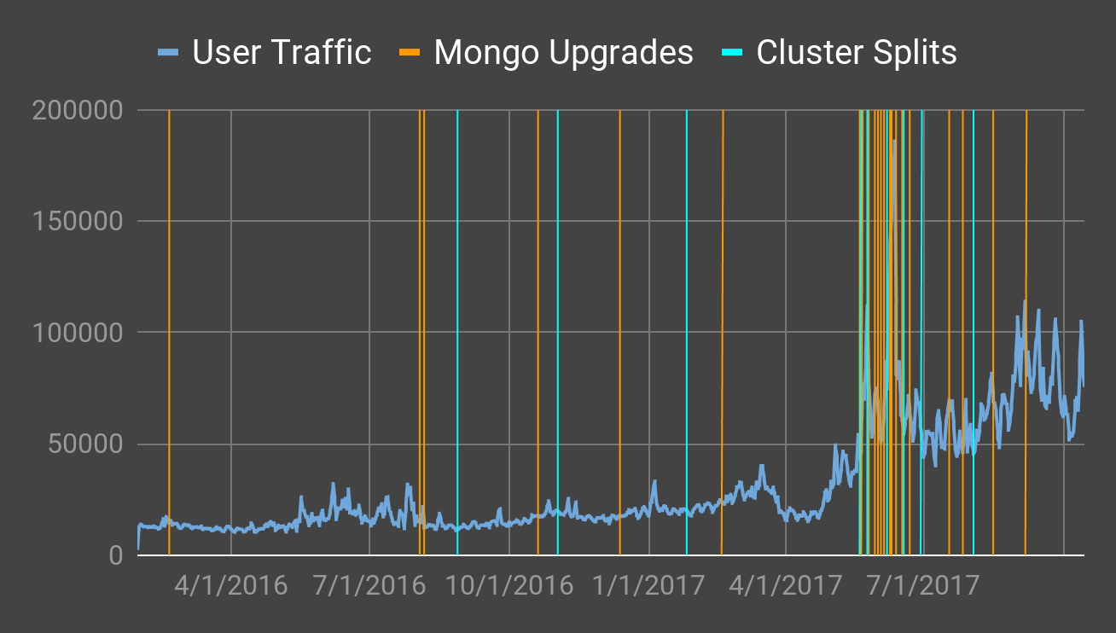
User Traffic Upgrades Cluster Splits
Notes:
in the end we got out of the situation by brute force rather than really solving anything…
if we wanted to be able to withstand more load, we’d need a better approach.

Slide 26
Lesson: Good instrumentation will surface your problems. Bad instrumentation will obscure them.
Notes:
The origin of the instrument/analyze
this taught us the VALUE of instrument and analyze during the cycle

Slide 27
2016
2017
THE WAKEUP CALL
THE HOLY GRAIL
THE FUTURE
2017
2018
YOLO LOAD TESTING
LOAD TESTING REDUX
Notes:
JORDAN
Back to our timeline – it’s the middle of 2017

Slide 28
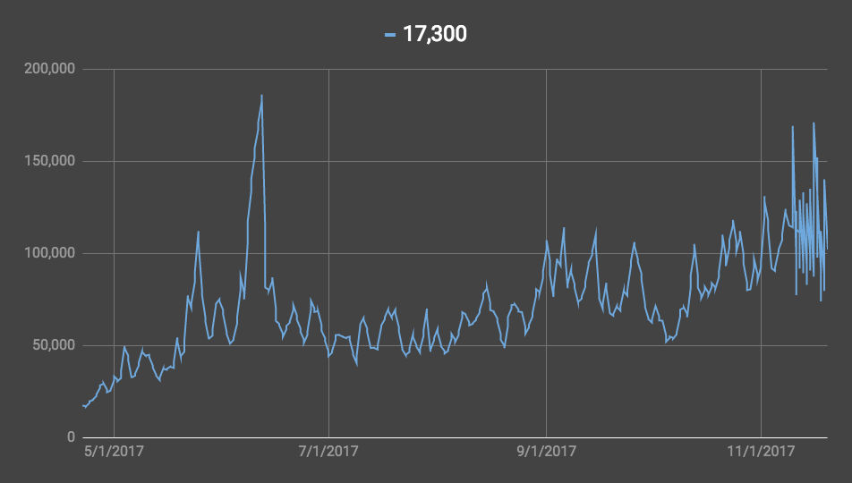
Backend RPM
Notes:
Traffic is higher than before, but we are handling it
too focused on perfection of current - not enough on capacity planning
We wasted time diving into every 500 served from our system
still worried about the future

Slide 29
Analyze
Load Test
Instrument & Improve
YOLO Load Testing
Notes:
We call our first foray “YOLO Load Testing”
Testing IN DEVELOPMENT
We weren’t sure where to start so we just dove in

Slide 30
The Pillars of Realistic Load Testing
Notes:
It was only later on that we broke this down, but I want to introduce this concept of 3 categories of realism
It helps to think about your load testing setup from 3 perspectives
Each of these can be addressed separately and may not each have the same importance in getting good results

Slide 31
The Pillars of Realistic Load Testing
DATA
Shape of the data
How many rows of each type?
How are they distributed?
Are all user segments captured?

Slide 32
The Pillars of Realistic Load Testing
DATA
TRAFFIC
Shape of the data
How many rows of each type?
How are they distributed?
Are all user segments captured?
Pattern of requests
How many requests?
To which endpoints?
By which user groups?
How much does it vary?

Slide 33
The Pillars of Realistic Load Testing
DATA
TRAFFIC
SYSTEMS
Shape of the data
How many rows of each type?
How are they distributed?
Are all user segments captured?
Pattern of requests
How many requests?
To which endpoints?
By which user groups?
How much does it vary?
Topology of the system
How many servers?
Which instance sizes?
How are they connected?

Slide 34
LOCUST.IO
Notes:
We started with locust.io. It was the easiest way to get a distributed load test going.
Write user flows in python.
Run them across many nodes to perform distributed load tests.
Control the load by setting rate at which simulated users are added to the pool

Slide 36
Notes:
As I mentioned, we didn’t yet have this perspective
This was our first attempt.
It was little more than a toy
Wasn’t delivering the types of results we needed.
Despite some problems, it helped us better understand what a good load testing system looks and feels like.

Slide 37
We knew that our data and systems did not match production.
We suspected that our traffic was not realistic.
Notes:
To summarize exactly what was wrong with it:

Slide 38
This system never took on a central role because we didn’t trust it.
Notes:
(this also became irrelevant because…)

Slide 39
2016
2017
THE WAKEUP CALL
THE HOLY GRAIL
THE FUTURE
2017
2018
YOLO LOAD TESTING
LOAD TESTING REDUX
Notes:
LUKE “late 2017” “october 2017”
crypto finally became mainstream
texts from mom
TOP OF APP STORE INCOMING

Slide 40
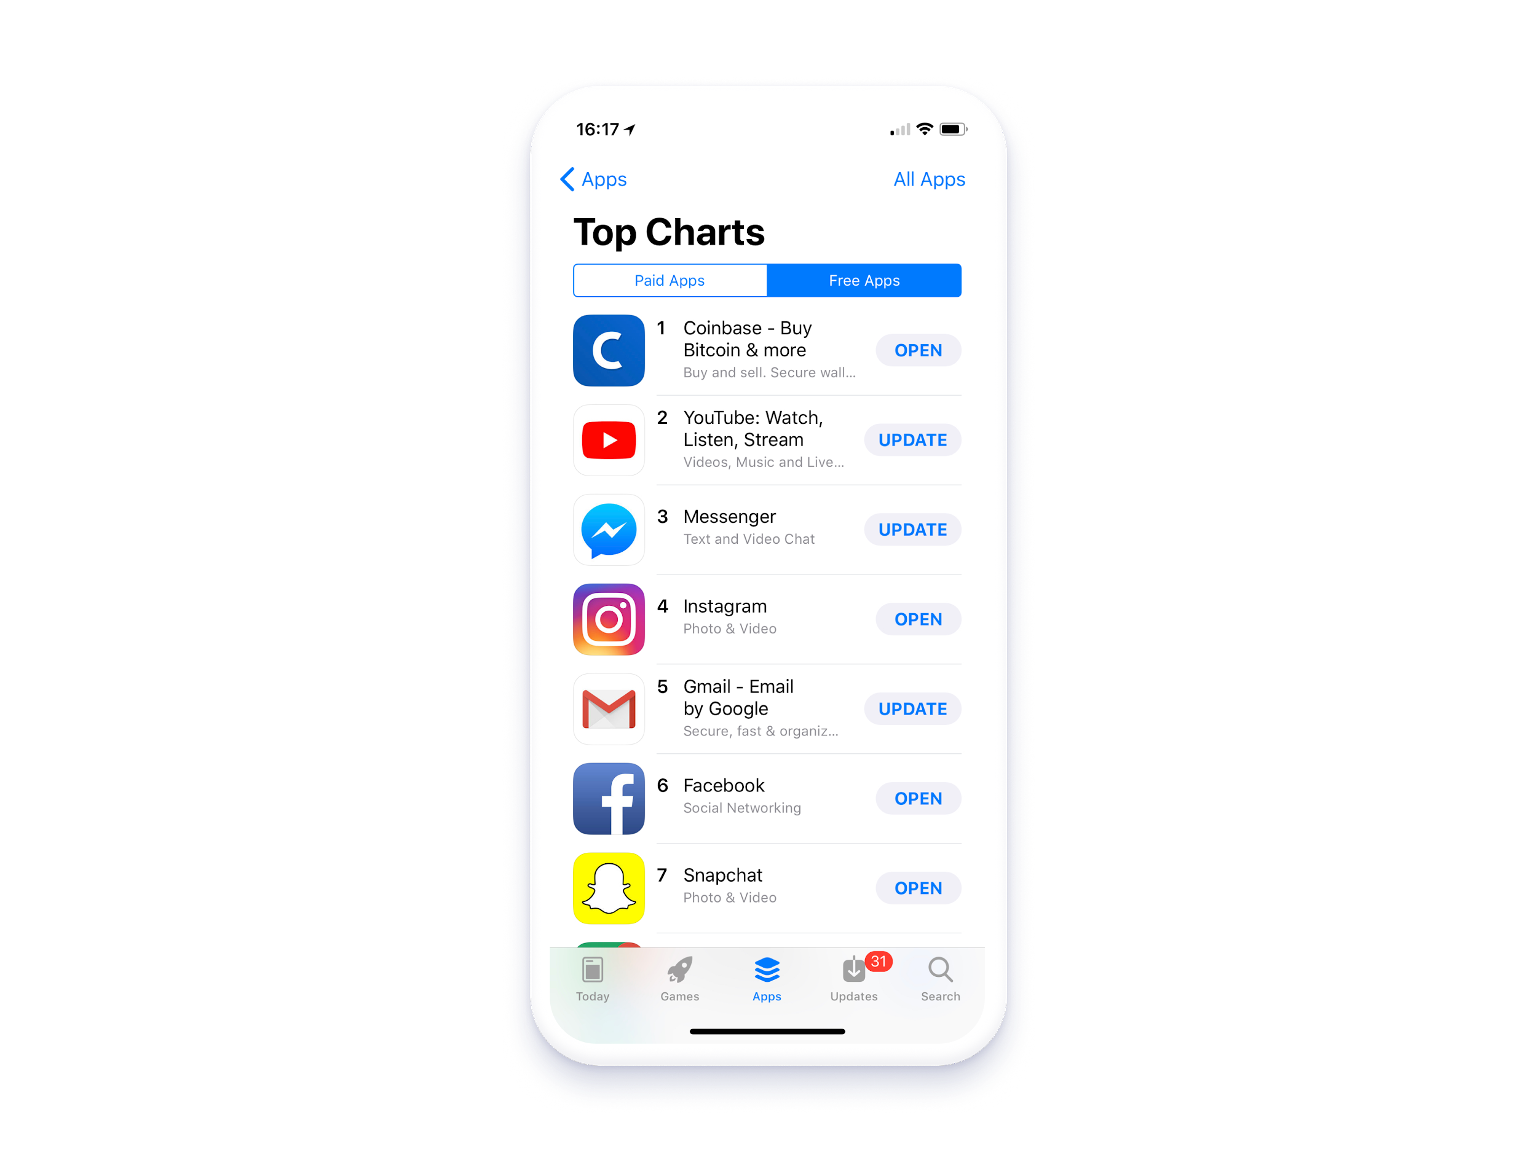
Notes:
This includes being the overall no #1 app in the app store. This is a real screenshot :)

Slide 41
Notes:
This includes being the overall no #1 app in the app store. This is a real screenshot :)

Slide 42
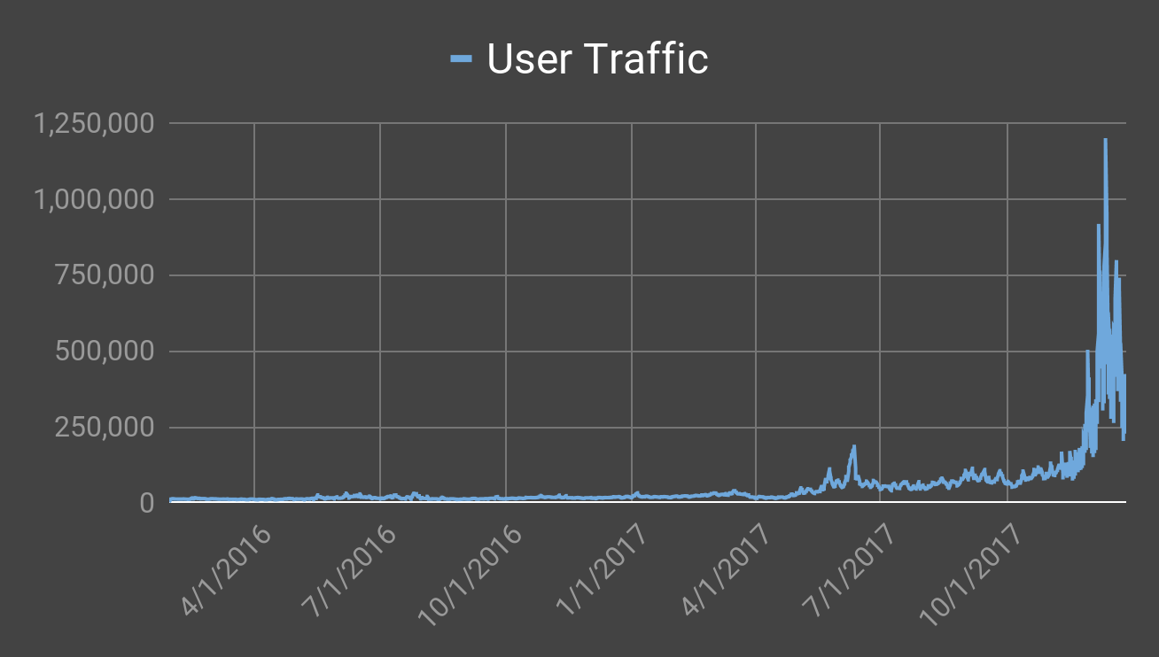
Backend RPM

Slide 43
Backend RPM
Notes:
For comparison, this is the earlier spike

Slide 44
Analyze
Load Test
Instrument & Improve
The Holy Grail
Notes:
Before, we were running blind, however now we had clarity.
HARD IMPROVEMENTS
users cluster…. used memcache as an identity cache query caching improvements up and down the stack … THEN
load dropped by 90%
why are there so many of this request pattern?
our client mobile apps we doubling up certain API requests

Slide 45
Lesson: Faster feedback means faster progress.
Notes:
every time you go around the cycle is a chance to make an improvement
the more times you go around the more times you can make improvement

Slide 46
2016
2017
THE WAKEUP CALL
THE HOLY GRAIL
THE FUTURE
2017
2018
YOLOAD TESTING
LOAD TESTING REDUX
Notes:
JORDAN
hitting all time highs less frequently
“you might have thought we were relieved”
“traffic began to look something like the price of bitcoin”

Slide 47
Analyze
Load Test
Instrument & Improve
Notes:
we got addicted to this fast feedback cycle - it was super productive
[arrow fades away]

Slide 48
Analyze
Instrument & Improve
Notes:
We launch new currencies, see spikes in traffic
We need to be able to see realistic load in test

Slide 49
Capture & playback of production traffic
Notes:
Not confident in prev synthetic approach
Can we just use real data?
We could get correct indicators based on real data
We felt sure that MongoDB was most sensitive piece
It’s not a good idea to test certain things in isolation
But the DB is fine because...

Slide 50
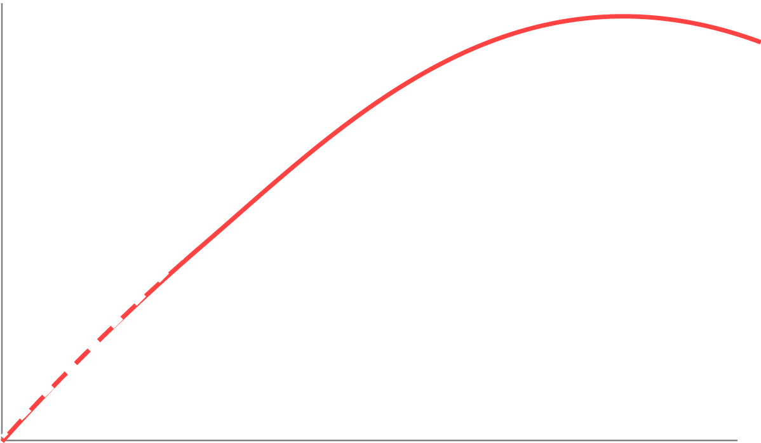
Neil Gunther’s Universal Scalability Law
Throughput
Load
Notes:
USL is way of describing how system topologies scale
dotted line = no shared resources, Red line = with shared resources
Throughput and load have a perfect linear relationship w/ no shared
The part that matters here: shared resources mean contention.
DB is a shared resource
As load increases, this contention all but guarantees that these shared resources will be your scaling bottlenecks
This is why it's almost always load on the DB that takes you down

Slide 51
Mongoreplay Cannon

Slide 52
Notes:
This worked out great
We’re now able to recreate very realistic failures at DB
We use this to right-size our clusters
So what about the rest of the system?
LUKE

Slide 53
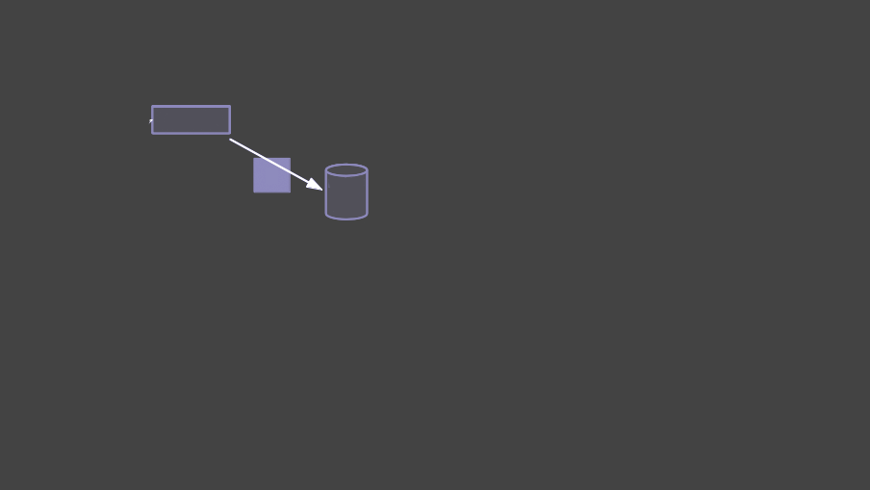
RAILS
Notes:
Capture / playback only works well for things you can test in isolation.
… but we needed to test the relationships/boundaries
we had a good capture playback story we went down that path of trying to apply it to the full system

Slide 54
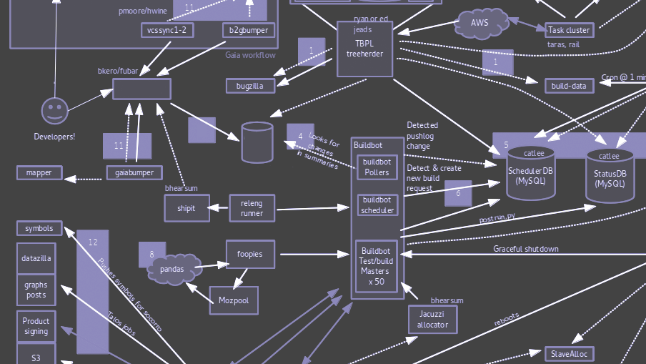
RAILS
Notes:
there are all these other potential failures lurking throughout this big system.
we needed to be sure that one of these failures wouldn’t bring us down at an inopportune moment

Slide 55
Capture / playback
Synthetic requests generated with real request data
Naive simple user flows
TRAFFIC
Notes:
START FROM THE BOTTOM
there’s a spectrum of options - all totally fine
The most realistic way to emulate traffic in production is to capture raw HTTP traffic and play it back
But we don’t capture post bodies (nor would we like to)

Slide 56
Test in production
“Scrubbed” production data
Synthetically generated data based on real production patterns
Development environment seed scripts
DATA
Notes:
“moving up the ladder inspires confidence”
Data is users, transactions, accounts
if we’re going for realism, the best possible way is to just copy production data (like mongo replay)
OUR UNIQUE CONSTRAINTS
but mongo replay was safely isolated
but running real load tests in production can’t touch user data
and we can’t use production data outside the production environment

Slide 57
Test in production
Production parity testing environment
Simplified development environment
SYSTEMS
Notes:
there’s a spectrum of options - all totally fine
Again, the most Systems for a load test are the actual systems we run in production
but the downstream effects are real
and running an exact copy of production in another environment is cost prohibitive

Slide 58
A bold new approach
Notes:
We’re a blockchain company? There has to be a way blockchain can solve these issues!

Slide 59
LOAD
TESTING
COIN
Notes:
Just kidding, we’re going to return to synthetic traffic

Slide 60
JUST KIDDING
LOAD
TESTING
COIN
DO NOT BUY THIS
Notes:
Just kidding, we’re going to return to synthetic traffic

Slide 61
We revisited synthetic traffic generation.
Notes:
we decided to to see how much we could improve our synthetic traffic generation strategy
JORDAN

Slide 62
The Capacity Cycle
in Practice

Slide 63
The Setup
Data: Create seed data using spec factories
Traffic: Test a single, simplified user flow
Systems: Based on a dev environment
10 app nodes with ELB, no background workers
Single MongoDB cluster
Single Redis node, single memcached node
Notes:
To get started quickly, we scoped this

Slide 64
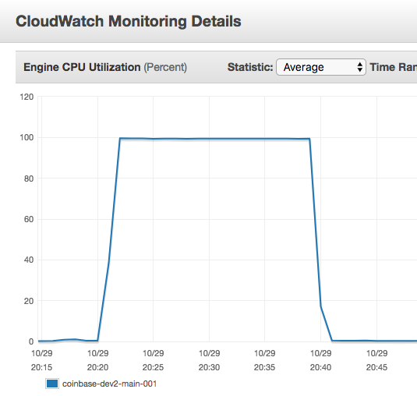
Take 1
Test: Steady 502s at 400 RPS
Analysis: Redis CPU is fully utilized
In production we run multiple clusters to isolate workloads, this test environment only had one.
Improve: Make systems more realistic by breaking out redis clusters in test env.

Slide 65
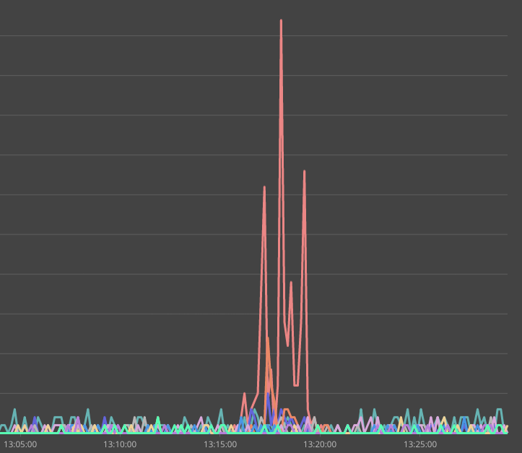
Take 2
Redis CPU Utilization
Test: Steady 502s at 400 RPS again
Analysis: One of the redis clusters was still at 100% CPU
Whoops, we forgot to disable a tracing tool that’s not enabled in production!
Improve: Make systems more realistic by disabling the tracing tool.

Slide 66
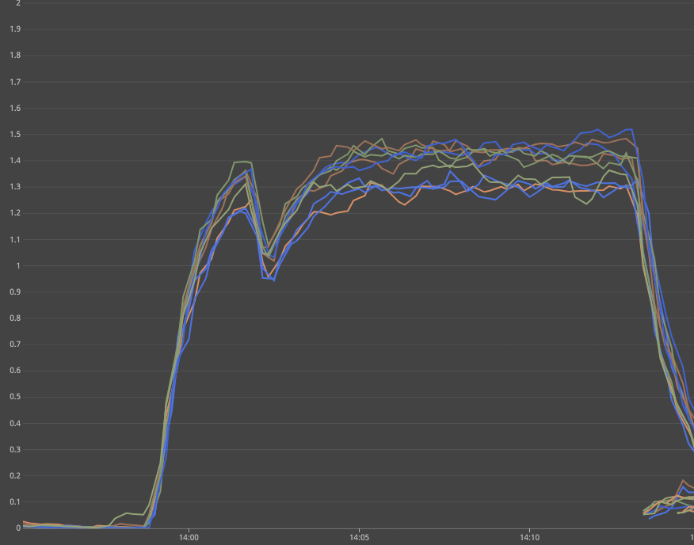
Take 3
App node system.load
Test: 502s start around 850 RPS
Analysis: Comparing traces and stats show evenly distributed response times from all backing services.
High system.load on app nodes.
Improve: Make systems more realistic by doubling app nodes.

Slide 67
Take 4
Test: 502s start around 1500 RPS
Analysis: CPU on MongoDB high.
There is a single expensive query that is normally performant in production.
Improve: Make data more realistic by resetting db between each test run.
mloginfo --queries

Slide 68
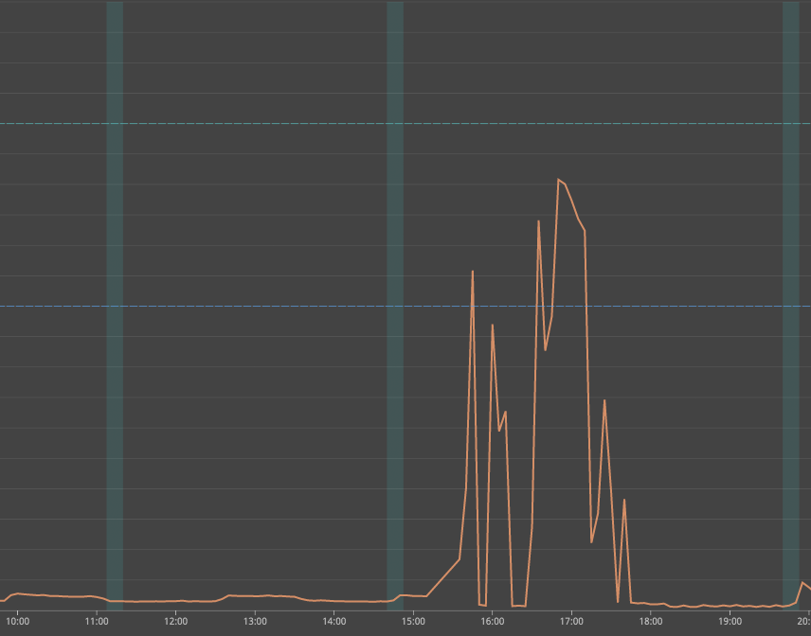
Take 5
memcached response time
Test: 502s start around 1,400 RPS
Analysis: CPU stats on MongoDB are fine.
Traces show slowness in memcached responses.
It’s on a single t2.micro!
Improve: Make systems more realistic by increasing instance size for memcached.

Slide 69
Take 6
Test: 502s start around 1,750 RPS. Not bad!
Analysis: CPU stats on MongoDB are OK.
Compared logs of an actual user session with load test and noted that we are missing some important API usage.
Improve: Make traffic more realistic. Use production logs to create a better user script.

Slide 70
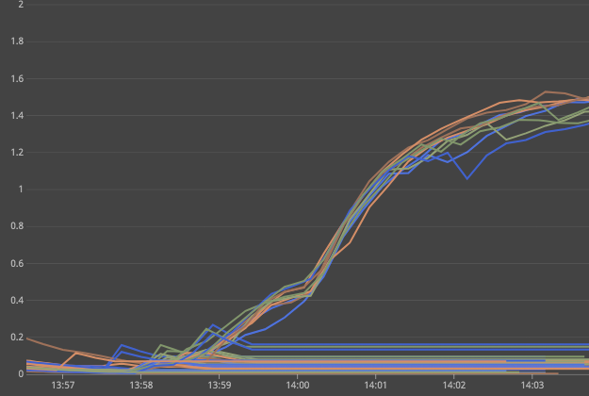
Take 7
App node system.load
Test: 502s start around 700 RPS.
Analysis: Once again, Mongo CPU is OK.
CPU on web nodes is maxed out.
An event tracking operation is doing inefficient processing.
Improve: We uncovered a real production bottleneck! Fix the app code and repeat the test.
Notes:
We could have doubled app nodes again, but that would have taken us away from production

Slide 71
… and so on
Notes:
Before this exercise, we had a long list of potential performance issues
This process gets us into a flow where the most crucial one pops out
We uncovered a real production bottleneck, fixed it, and kept going
Next step would be to keep making the user flows and data more realistic
I hope that demonstrates how this cycle guides us (feedback loop)
Now that we’re here, we have bigger plans
[lesson slide incoming]

Slide 72
Lesson: When pursuing a realistic load testing environment, the journey can be as valuable as the destination.

Slide 73
2016
2017
THE WAKEUP CALL
THE HOLY GRAIL
THE FUTURE
2017
2018
YOLO LOAD TESTING
LOAD TESTING REDUX
Notes:
LUKE
that takes us up to the present day
( using it for preparing for currency launches )
we’re continuing to increase realism
so that we can gain more confidence
the cycle is continuing to guide us
duct tape incoming

Slide 74
Notes:
right now this is part of jordan and my workflow
but we want to keep it sticky
a repeatable, ongoing element
we want to create this fast feedback look for everyone
lessons incoming

Slide 75
obvious vs less obvious
lessons/best practices?
Lessons
Good instrumentation will surface your problems. Bad instrumentation will obscure them.
Faster feedback means faster progress.
When pursuing a realistic load testing environment, the journey can be as valuable as the destination.

Slide 76
Questions!
@dustmason @luke_demi_
coinbase.com/careers
C
Notes:
We ended up learning the hard the value of capacity planning
Hopefully this talk allows you to avoid repeating some of those mistakes yourself.
We’re really interested to hear more about how other teams are load testing, so please reach out to us on twitter or catch up to us at the conference

