Slide 1
Empathy:
A Keystone Habit
Paul Tevis
@ptevis
AppFolio

Slide 2
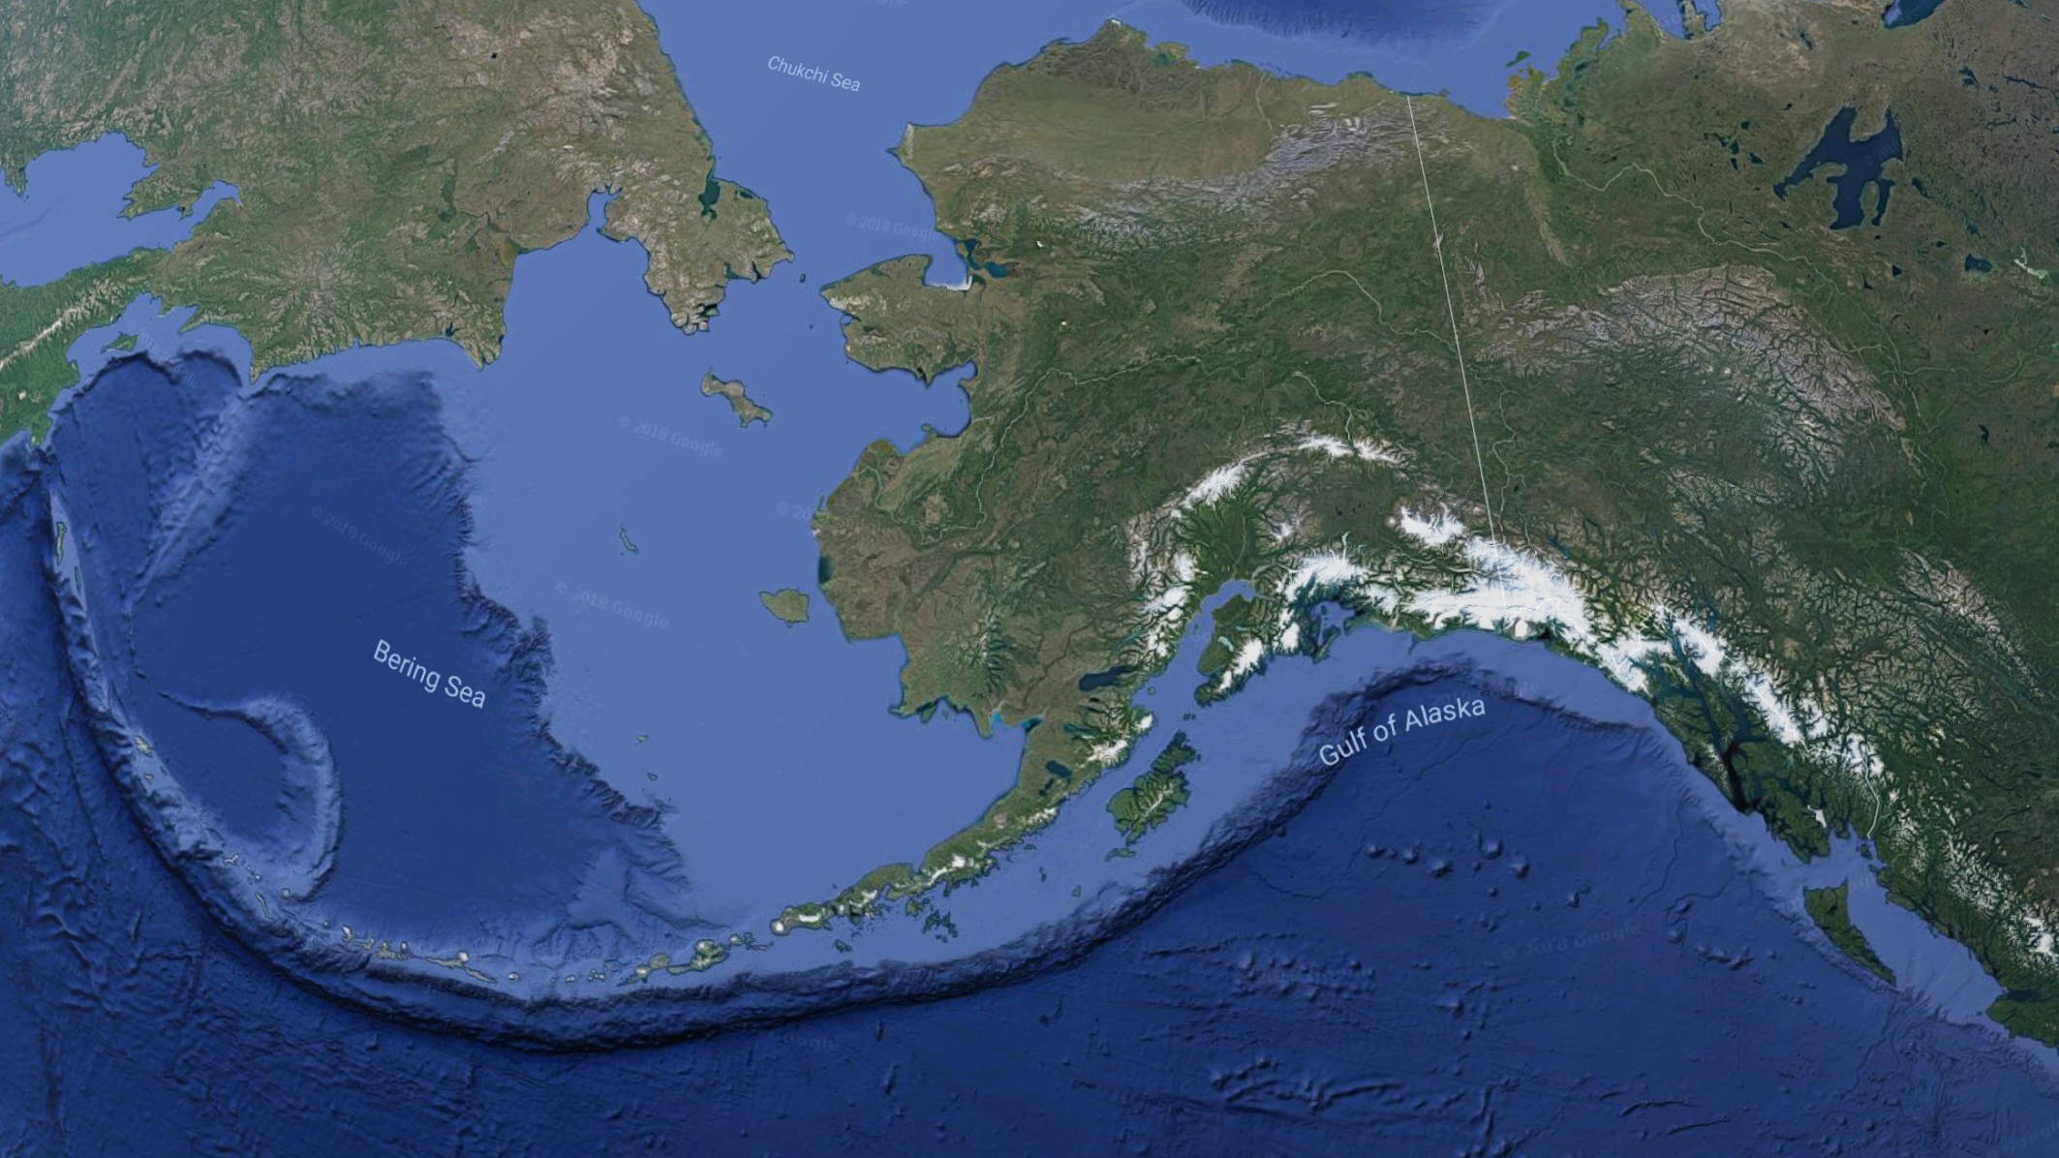

Slide 4
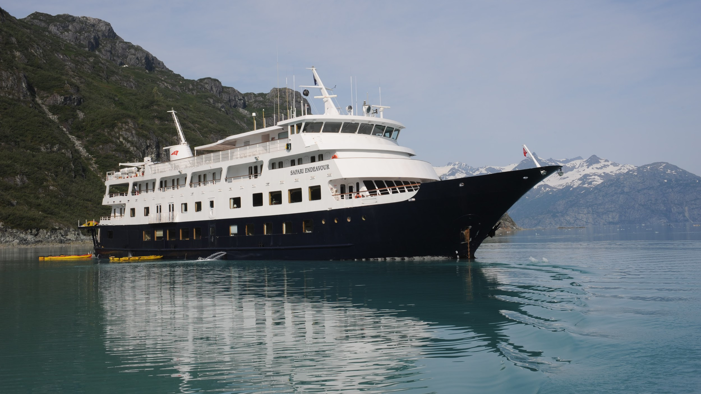

Slide 5
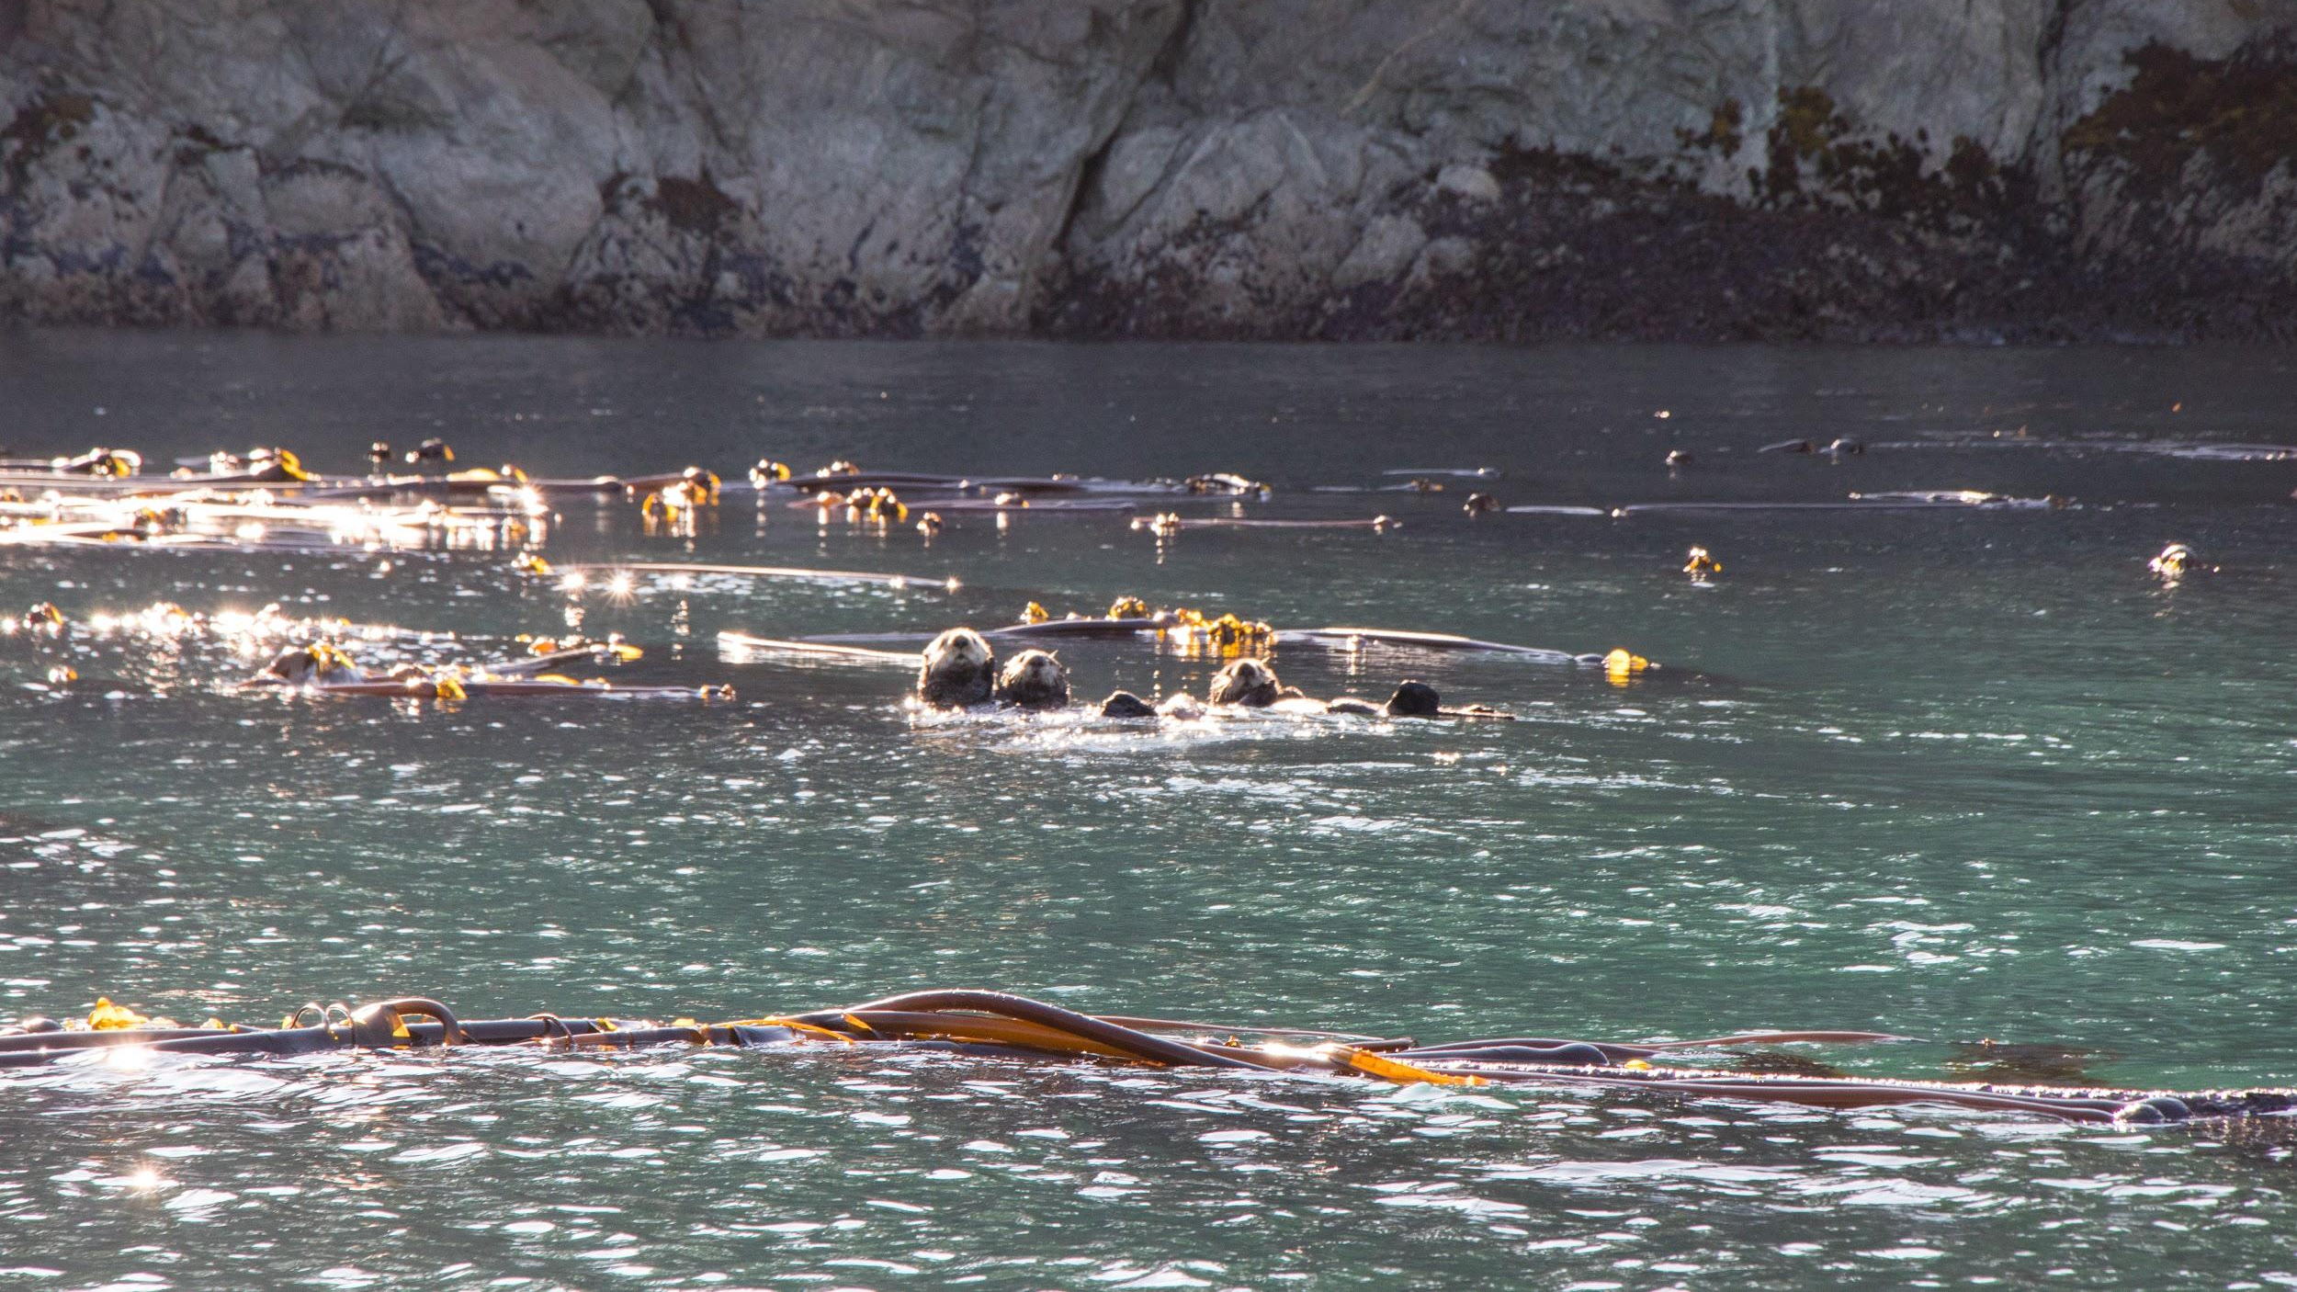

Slide 8
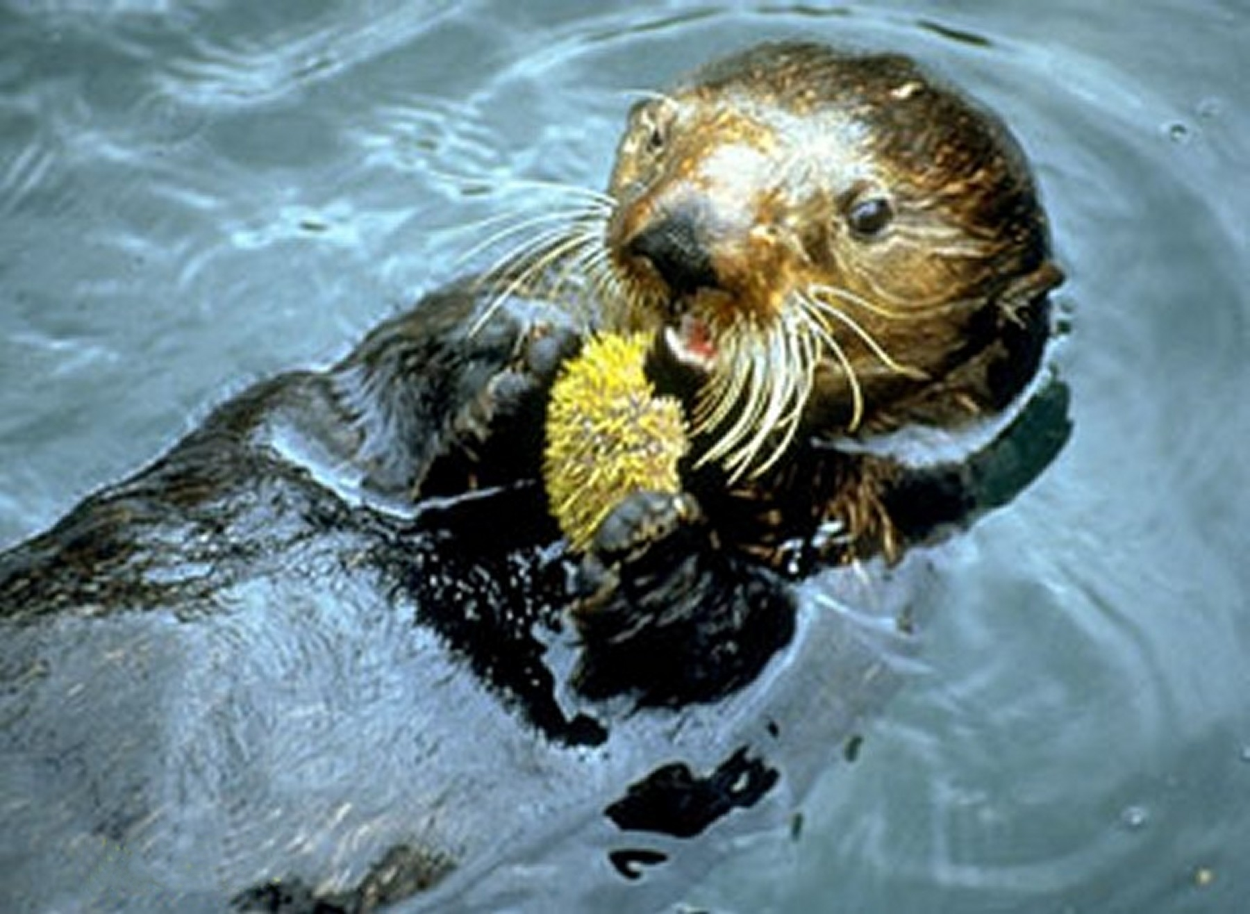

Slide 10
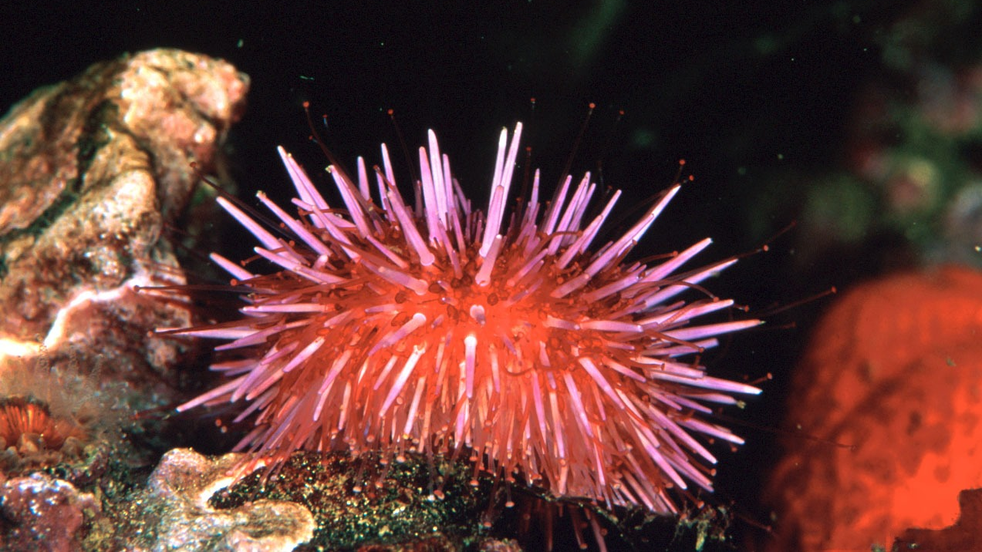

Slide 11
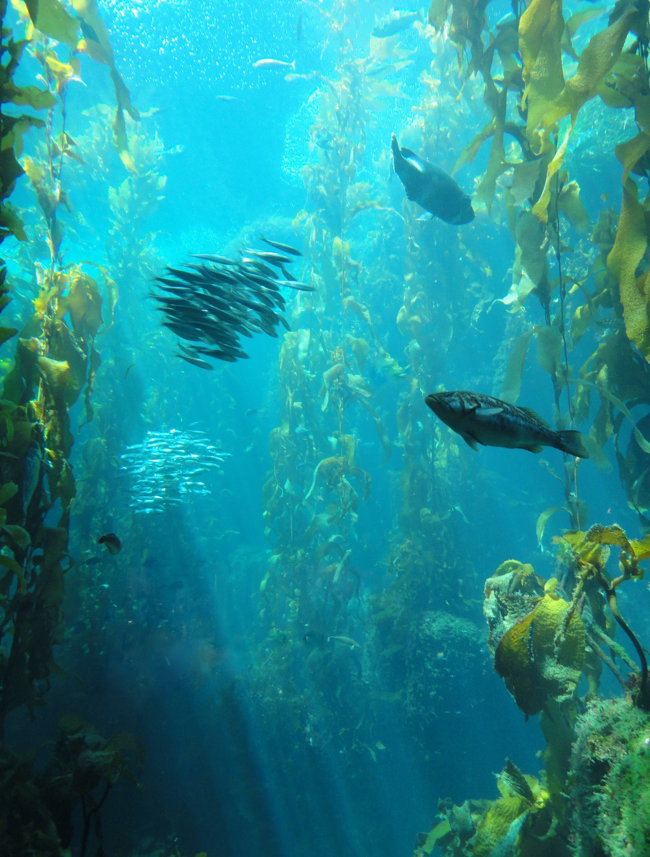

Slide 12
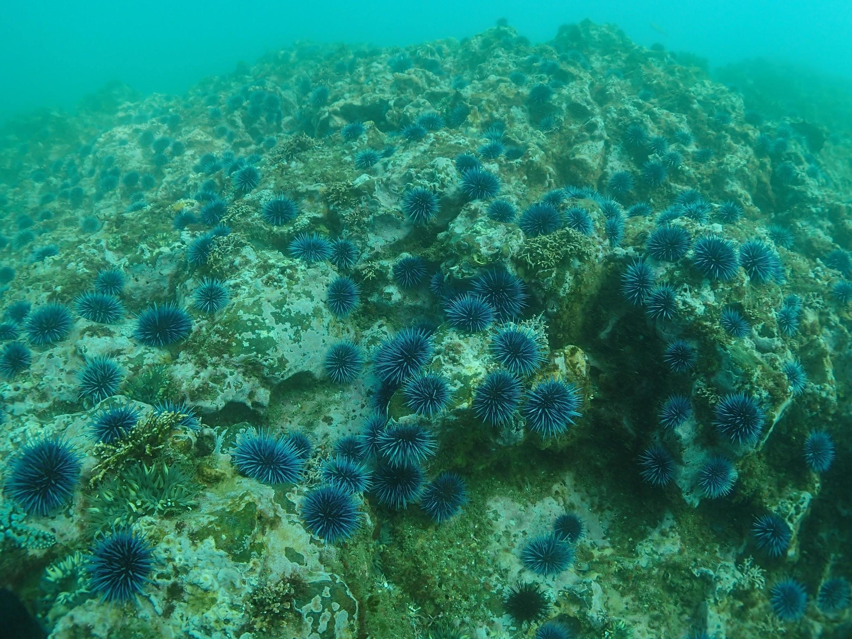

Slide 15
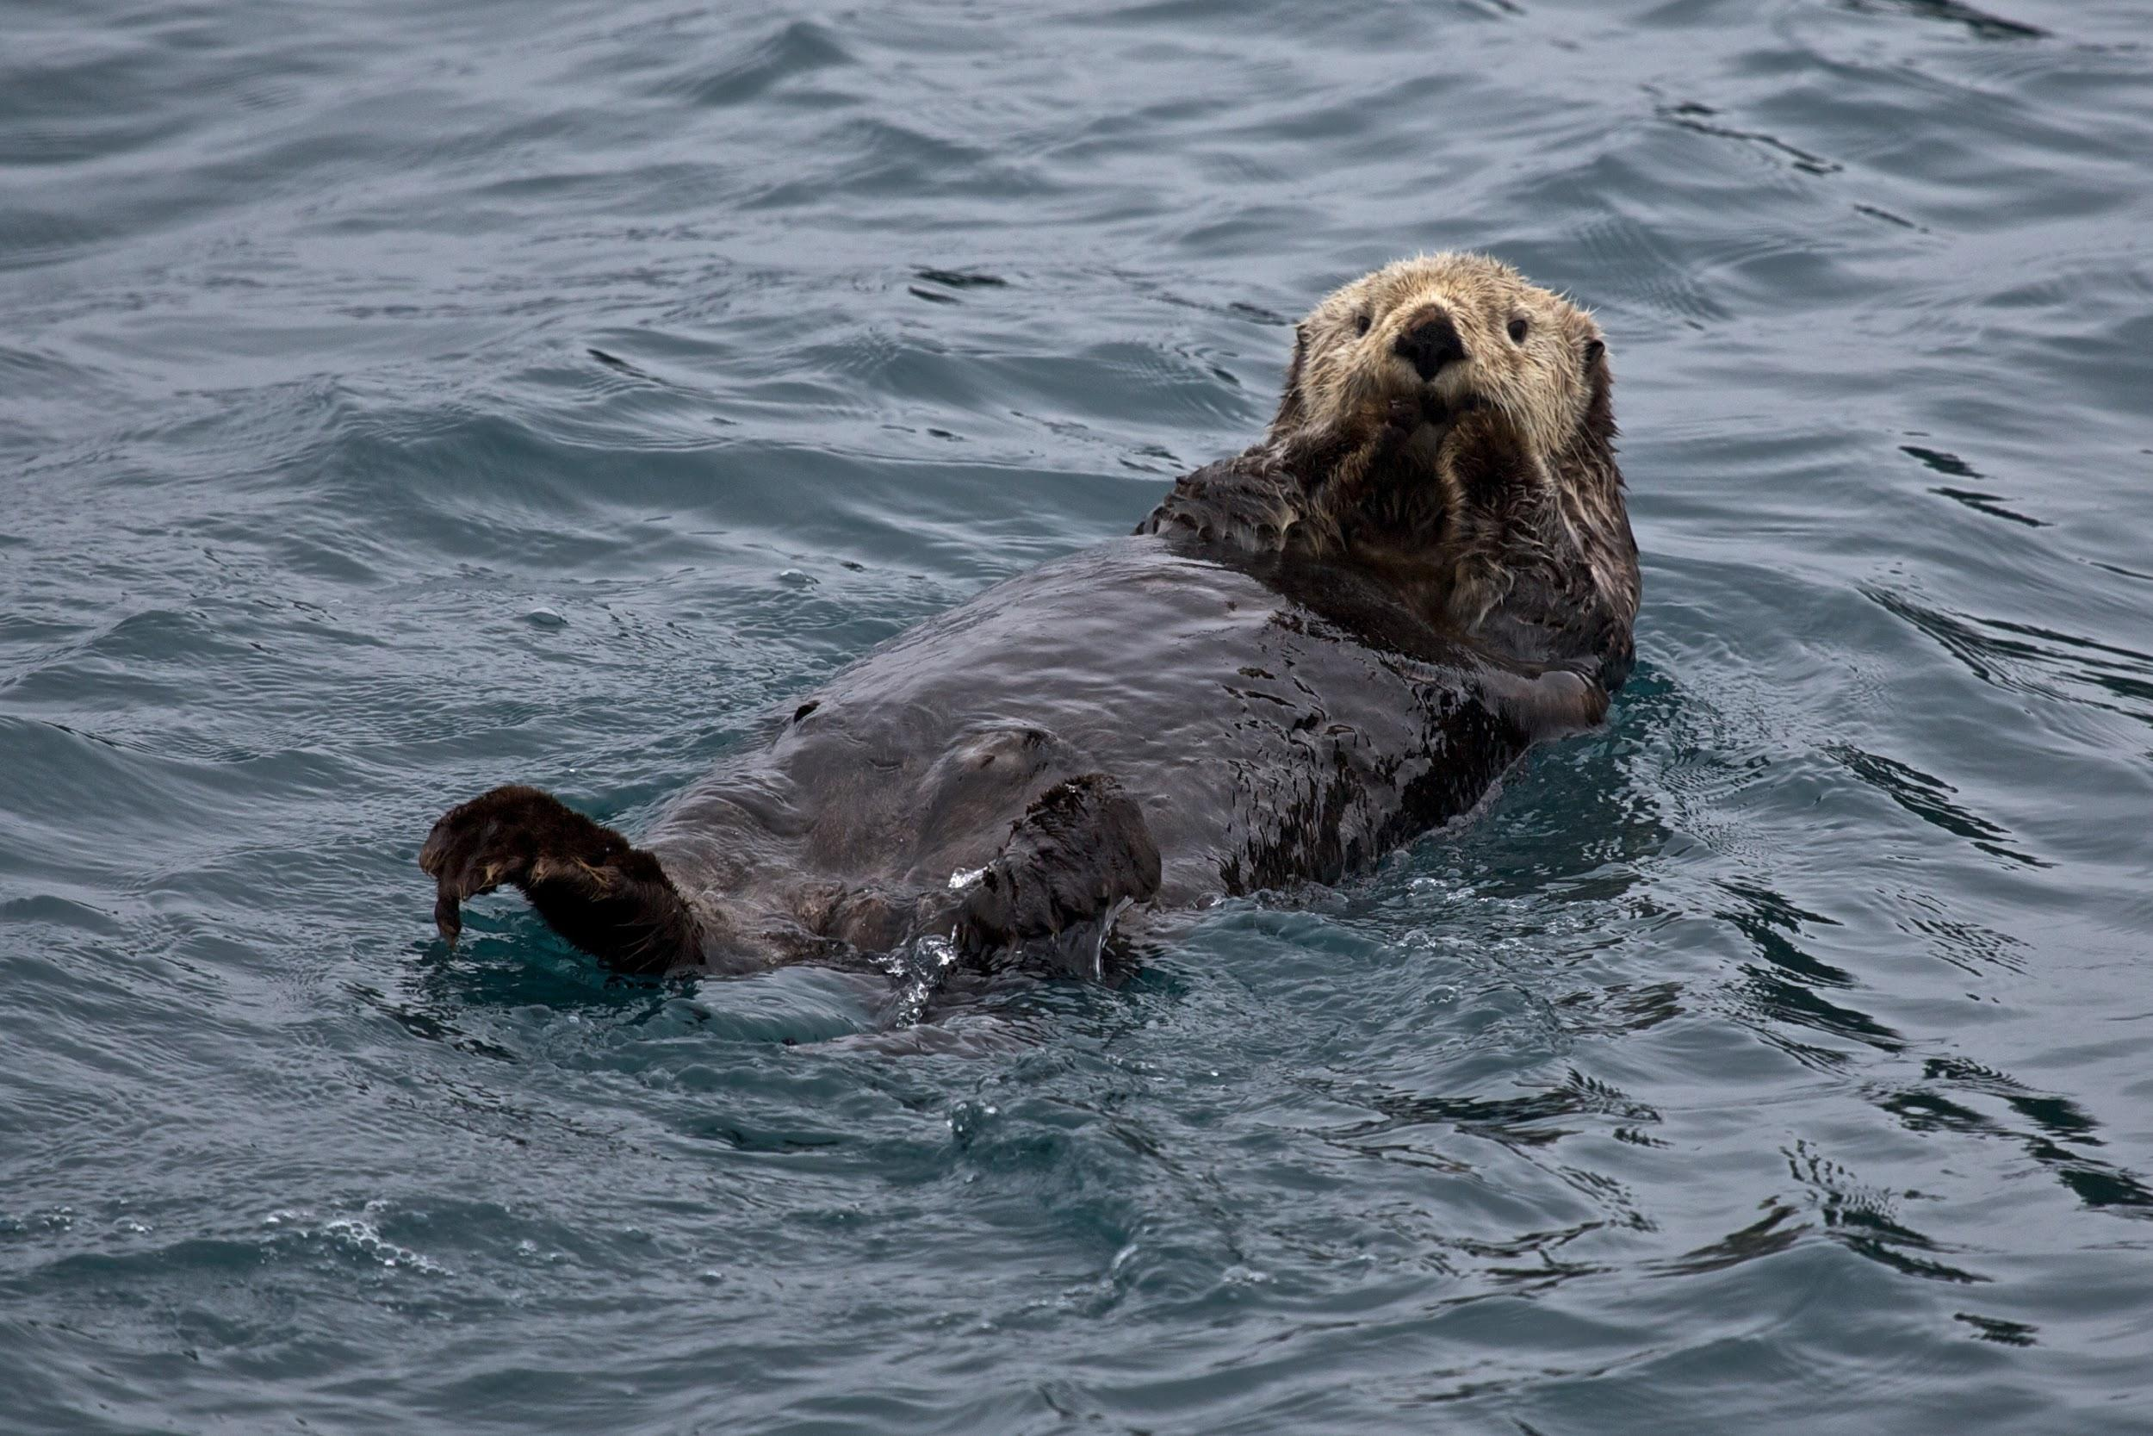

Slide 16
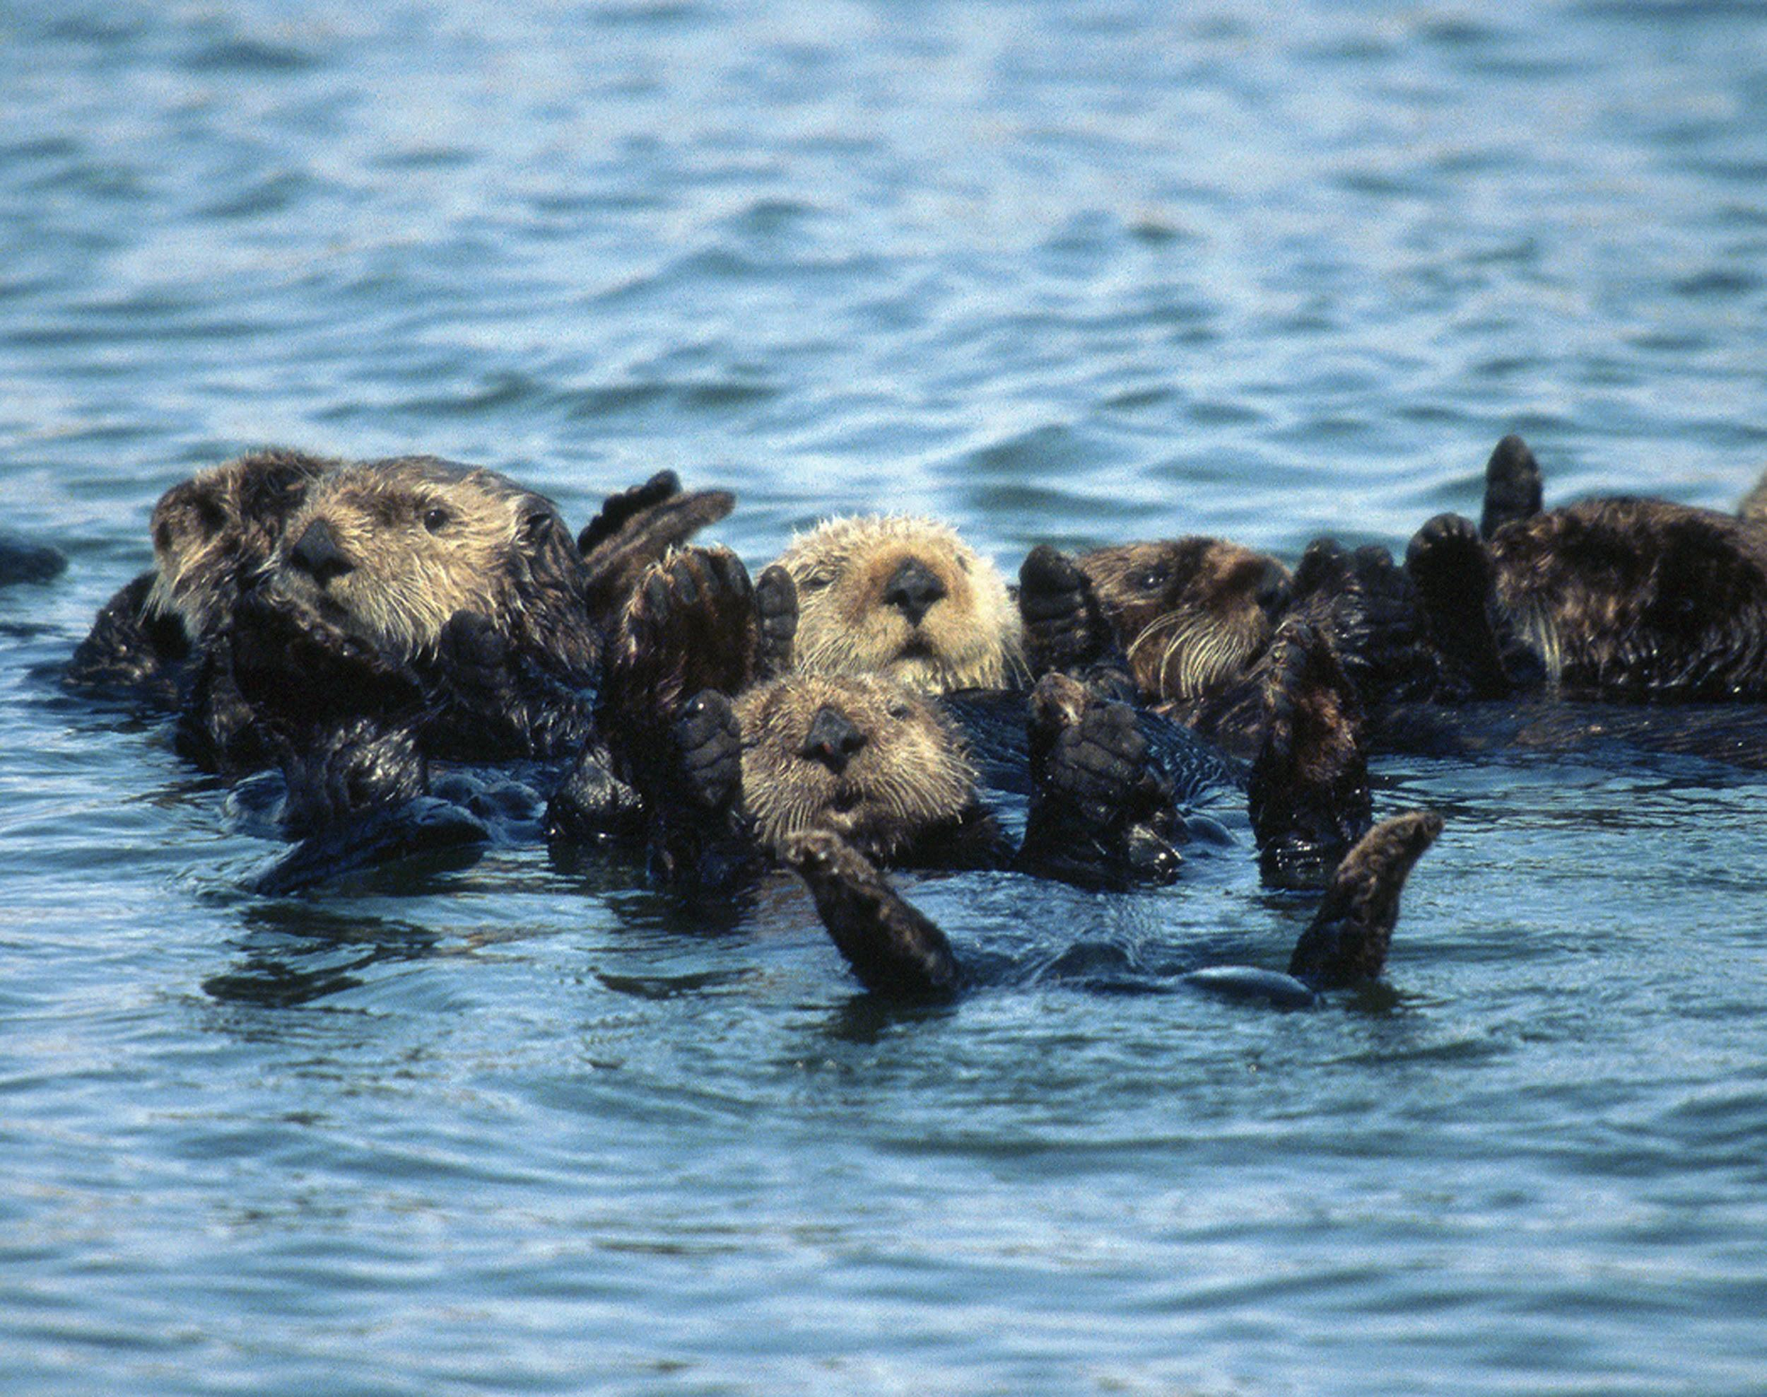

Slide 17
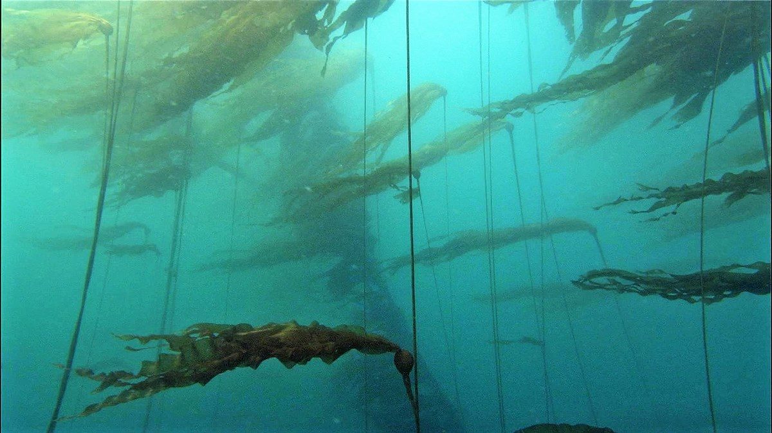

Slide 18
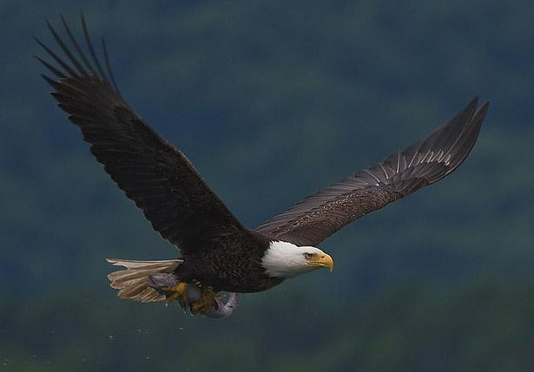

Slide 19
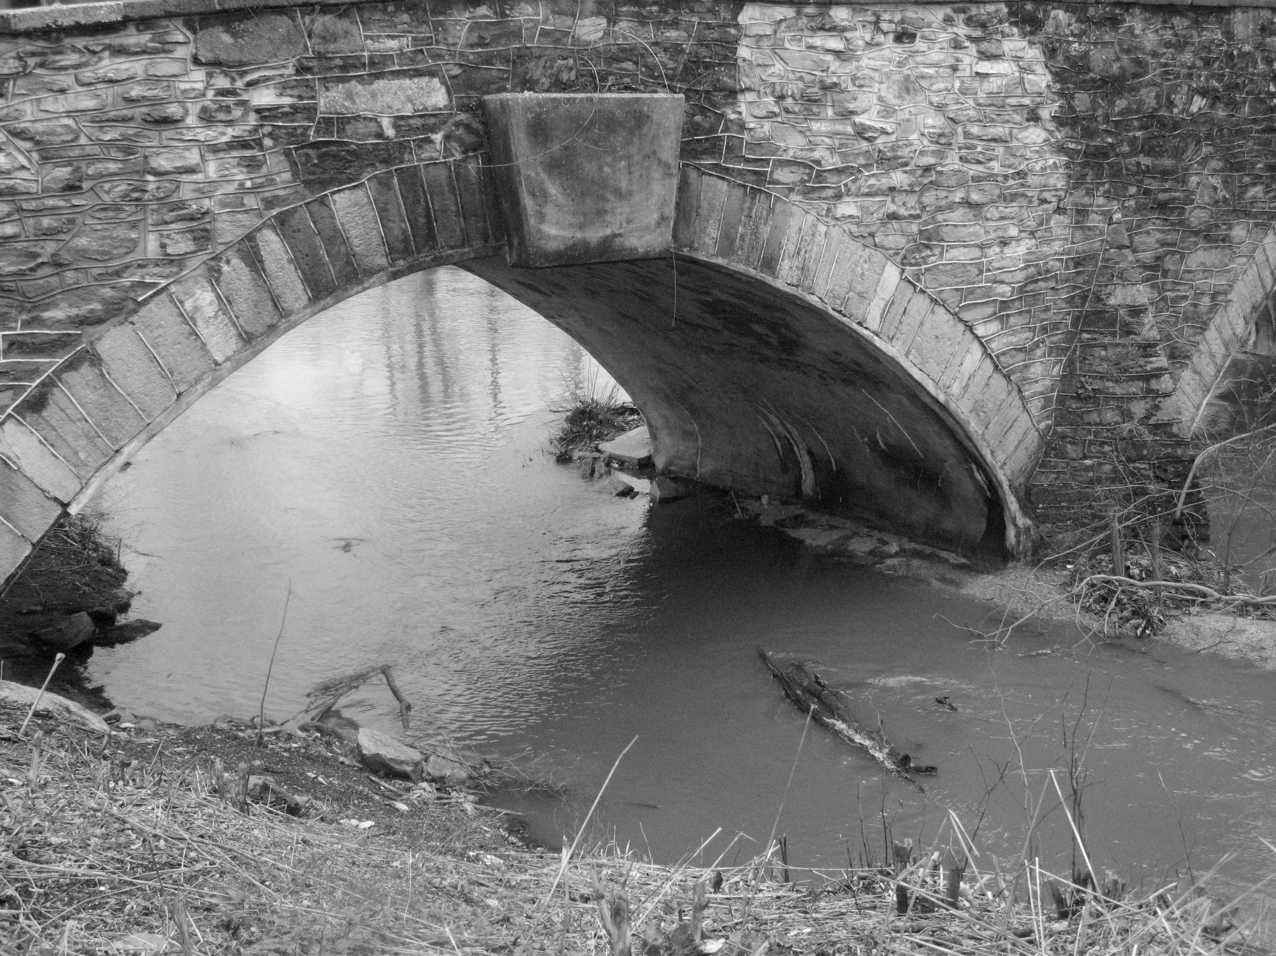

Slide 20
“A keystone species is an organism that helps define an entire ecosystem. Without its keystone species, the ecosystem would be dramatically different or cease to exist altogether.”
National Geographic Society

Slide 21
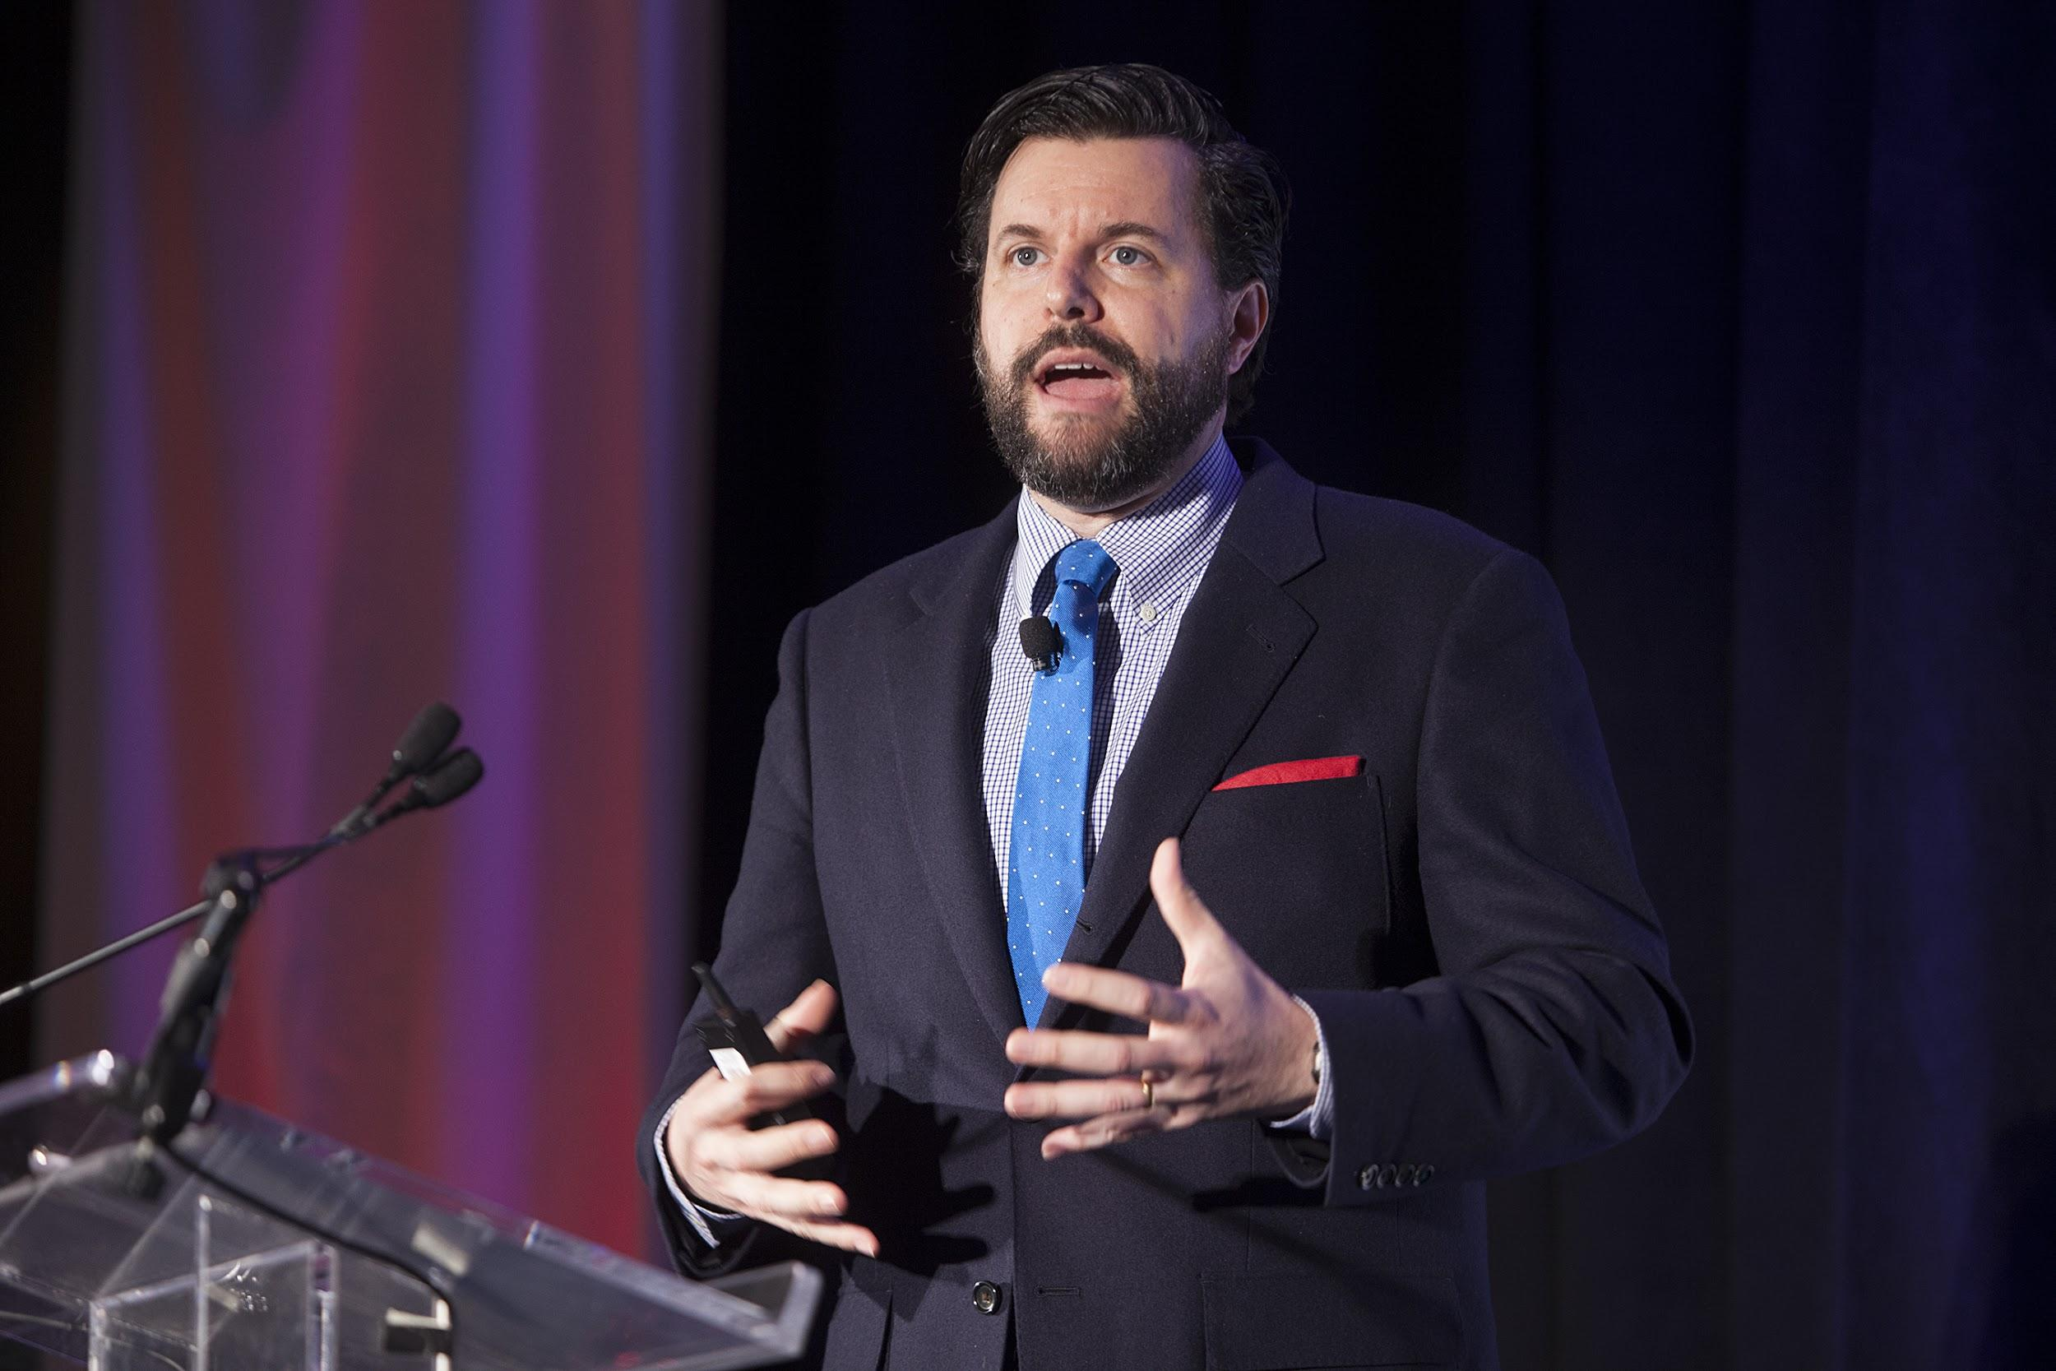

Slide 22
Empathy is a Keystone Habit
Paul Tevis
@ptevis
AppFolio

Slide 23
The presence or absence of empathy determines whether or not a human ecosystem can flourish

Slide 24
Developing the habit of empathy can make you a keystone contributor in your organization

Slide 25
Understanding Empathy
Understanding Yourself
Understanding Others
Understanding Each Other

Slide 26
Seven things you can try

Slide 27
Two disclaimers

Slide 28
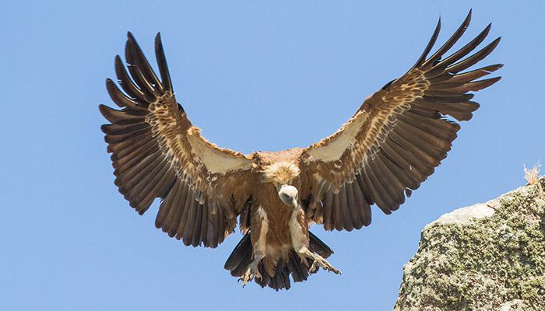

Slide 29
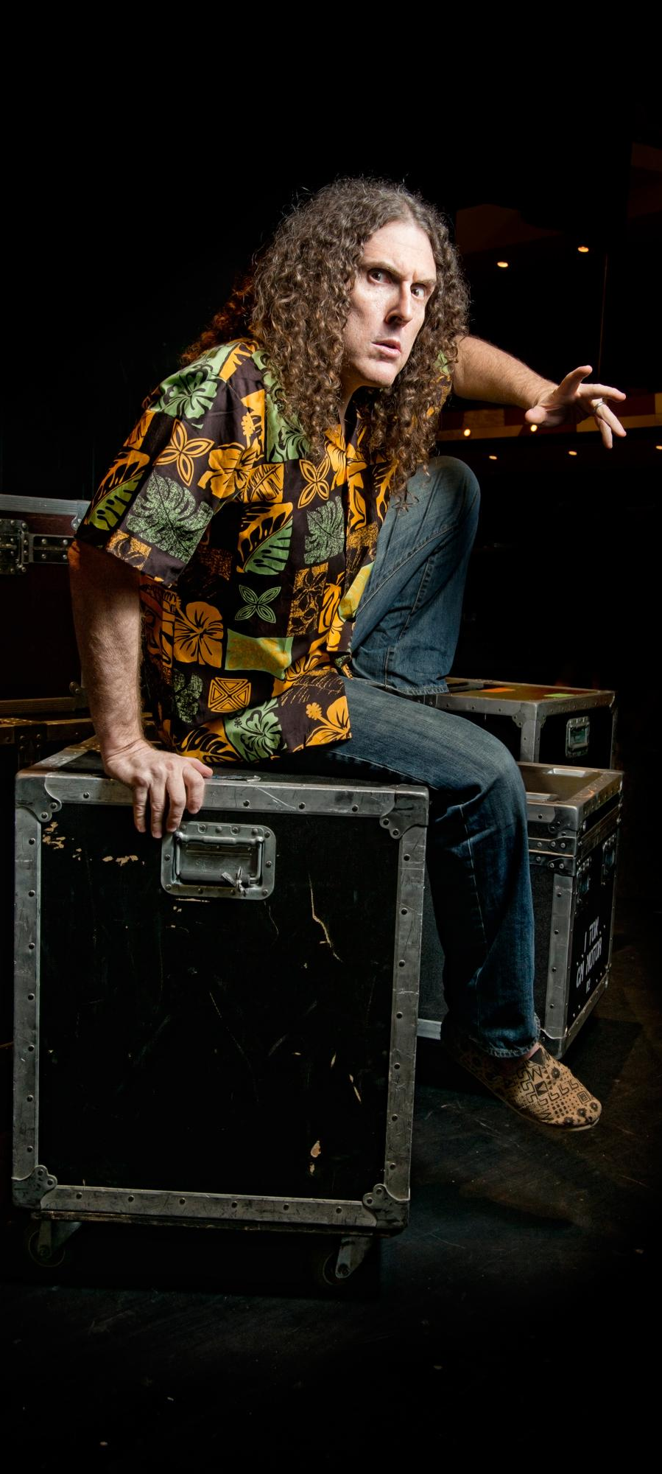
“Well, now I’m dropping names almost constantly.
That’s what Kanye West keeps telling me...”
Weird Al Yankovic,
“Tacky”

Slide 30
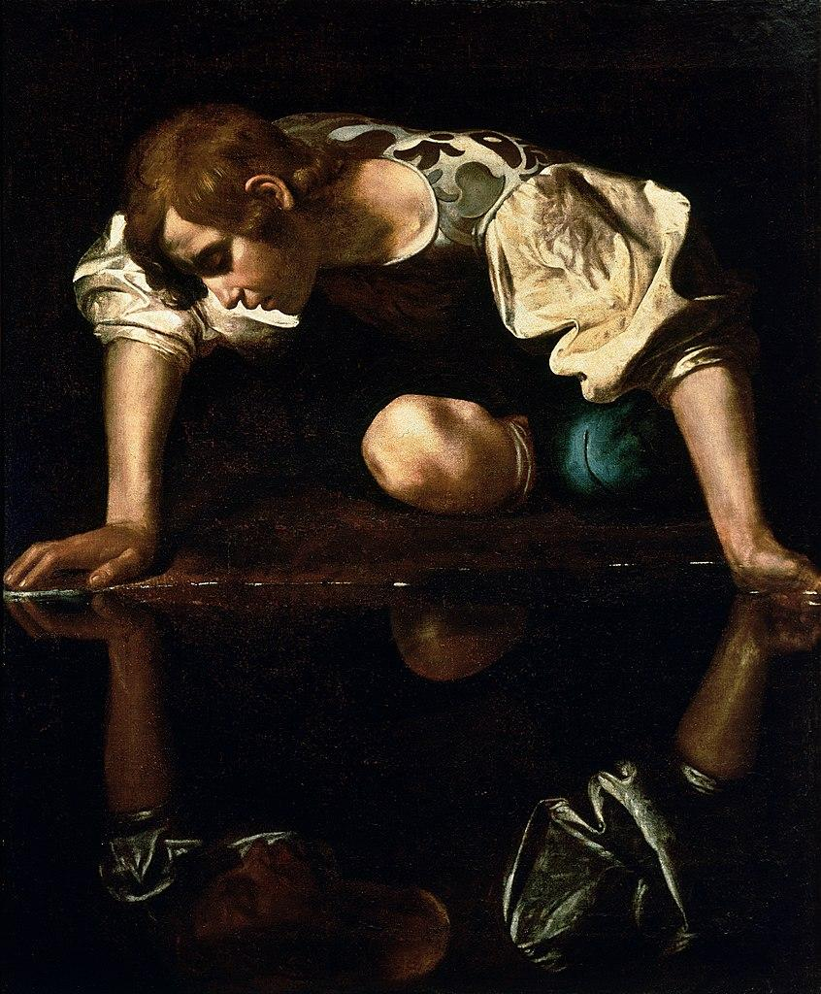

Slide 31
Understanding Empathy

Slide 32
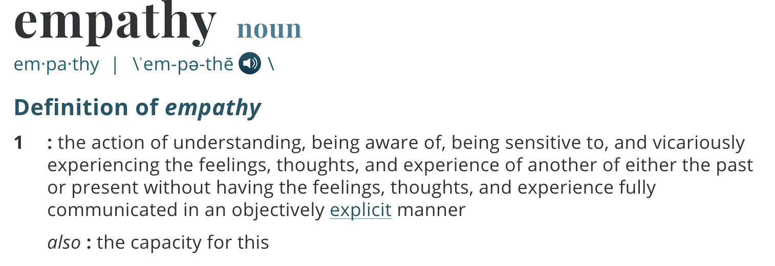
Merriam-Webster

Slide 33
Perspective-Taking

Slide 34
Raise your hand if your job would be easier if you were better at...
building trust.

Slide 35
Raise your hand if your job would be easier if you were better at...
influencing others.

Slide 36
Raise your hand if your job would be easier if you were better at...
enabling collaboration.

Slide 37
Raise your hand if your job would be easier if you were better at...
working with conflict.

Slide 38
Research has shown that perspective-taking helps with:
Creativity
Interpersonal conflict
Bias and stereotype reduction
Relationships & social bonds

Slide 39
Work happens within the container of relationships

Slide 40
Understanding Yourself

Slide 41
Self-awareness is the first step towards understanding others

Slide 43
Personality Assessments
DISC
Predictive Index
StrengthsFinder
Riso-Hudson Enneagram Type Indicator

Slide 44
The F-word

Slide 45
Feelings

Slide 46
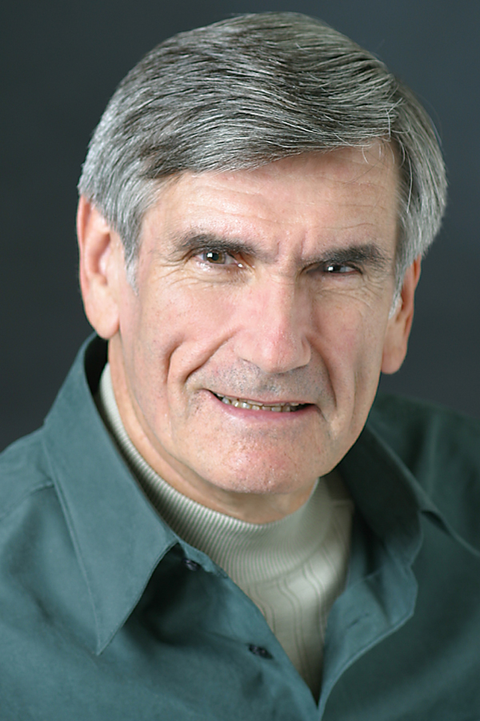
Tip #1:
Treat Feelings as Data
Dr. Marshall Rosenberg

Slide 47
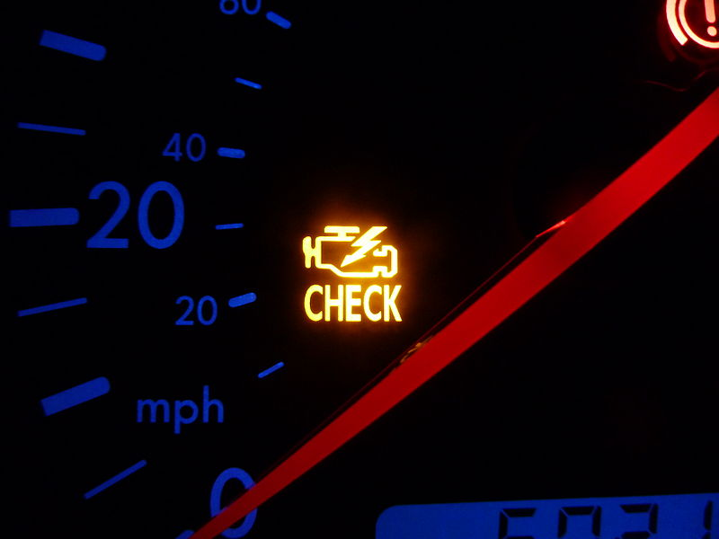

Slide 48
What am I observing?

Slide 49
What feeling am I experiencing?

Slide 50
What need of mine is/isn’t being met right now that gives rise to that feeling?

Slide 51
What might I do to help meet it?

Slide 52
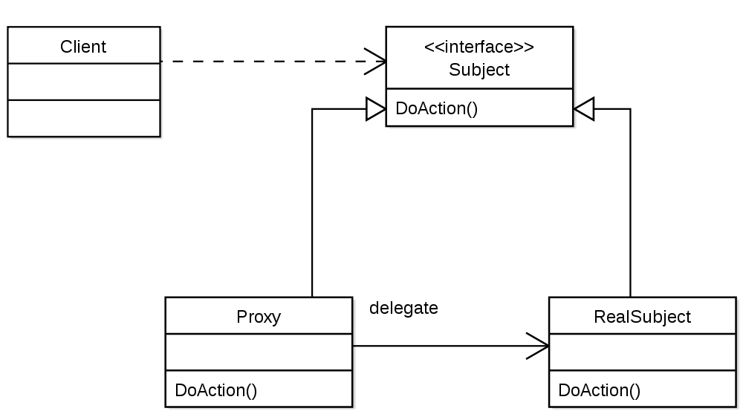

Slide 53
Understanding Others

Slide 54
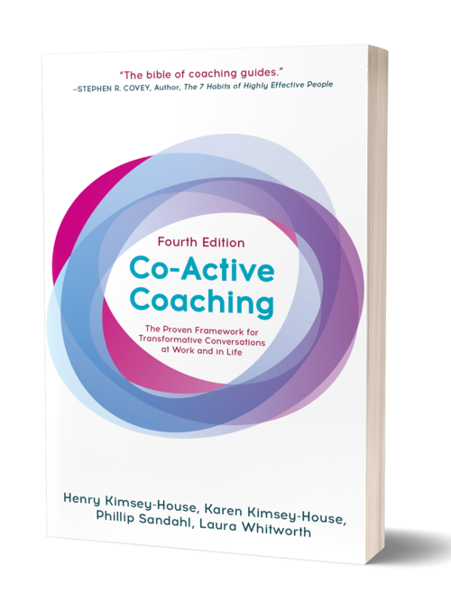
Tip #2: Listen at Level 2
(at least)

Slide 55
Levels of Listening

Slide 56
Levels of Listening
Internal Listening (Self)

Slide 57
Levels of Listening
Internal Listening (Self)
Focused Listening (Other)

Slide 58
Levels of Listening
Internal Listening (Self)
Focused Listening (Other)
Global Listening (Context)

Slide 59
Empathic Presence

Slide 60
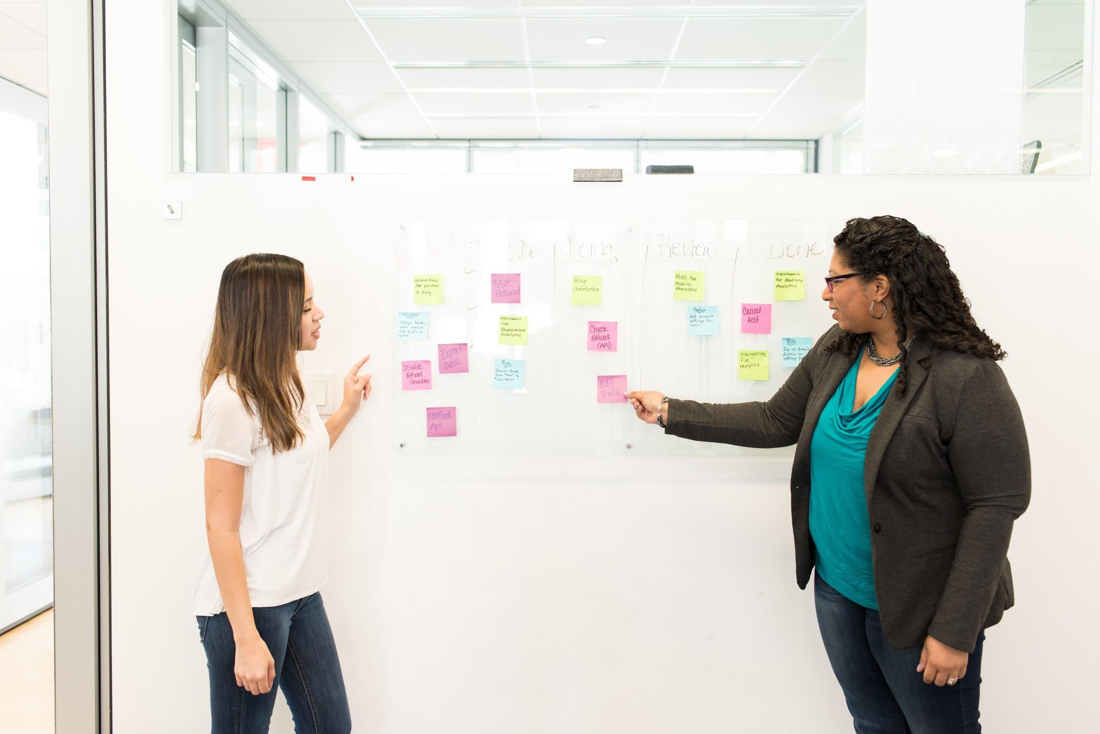

Slide 61
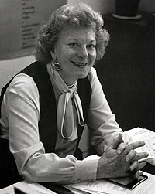
Tip #3: Notice Your Judgements
Dr. Virginia Satir

Slide 62
Satir Interaction Model
Intake
Meaning
Significance
Response

Slide 63
Satir Interaction Model (Simplified)
What did I just see or hear?

Slide 64
Satir Interaction Model (Simplified)
What did I just see or hear?
What did that mean?

Slide 65
Satir Interaction Model (Simplified)
What did I just see or hear?
What did that mean?
How do I feel about that?

Slide 66
Satir Interaction Model (Simplified)
What did I just see or hear?
What did that mean?
How do I feel about that?
What will do I now?

Slide 67
Satir Interaction Model (Simplified)
What did I just see or hear?
What did that mean?
How do I feel about that?
What will do I now?

Slide 68
What story am I telling myself about what I just saw or heard?

Slide 69
Tip #4:
Ask
WTF?

Slide 70
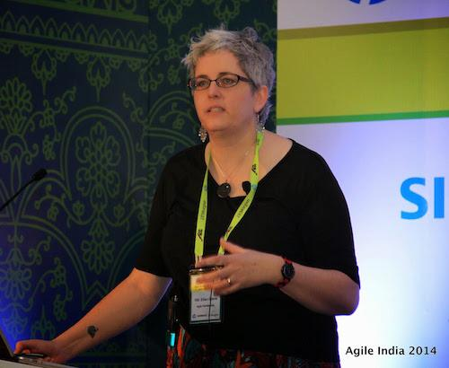
Tip #4:
Ask
Where’s
That
From?
Ellen Grove

Slide 71
Fundamental Attribution Error

Slide 72
My actions are a reflection of my circumstances.
Your actions are a reflection of your character.

Slide 73
Understanding
Each Other

Slide 74
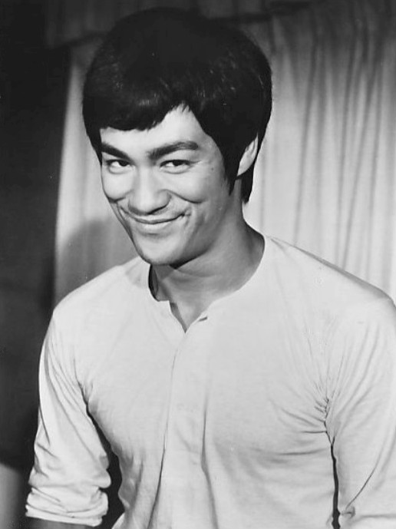
Tip #5:
Help Others Empty Their Cup
Lee Jun-fan
(Bruce Lee)

Slide 75
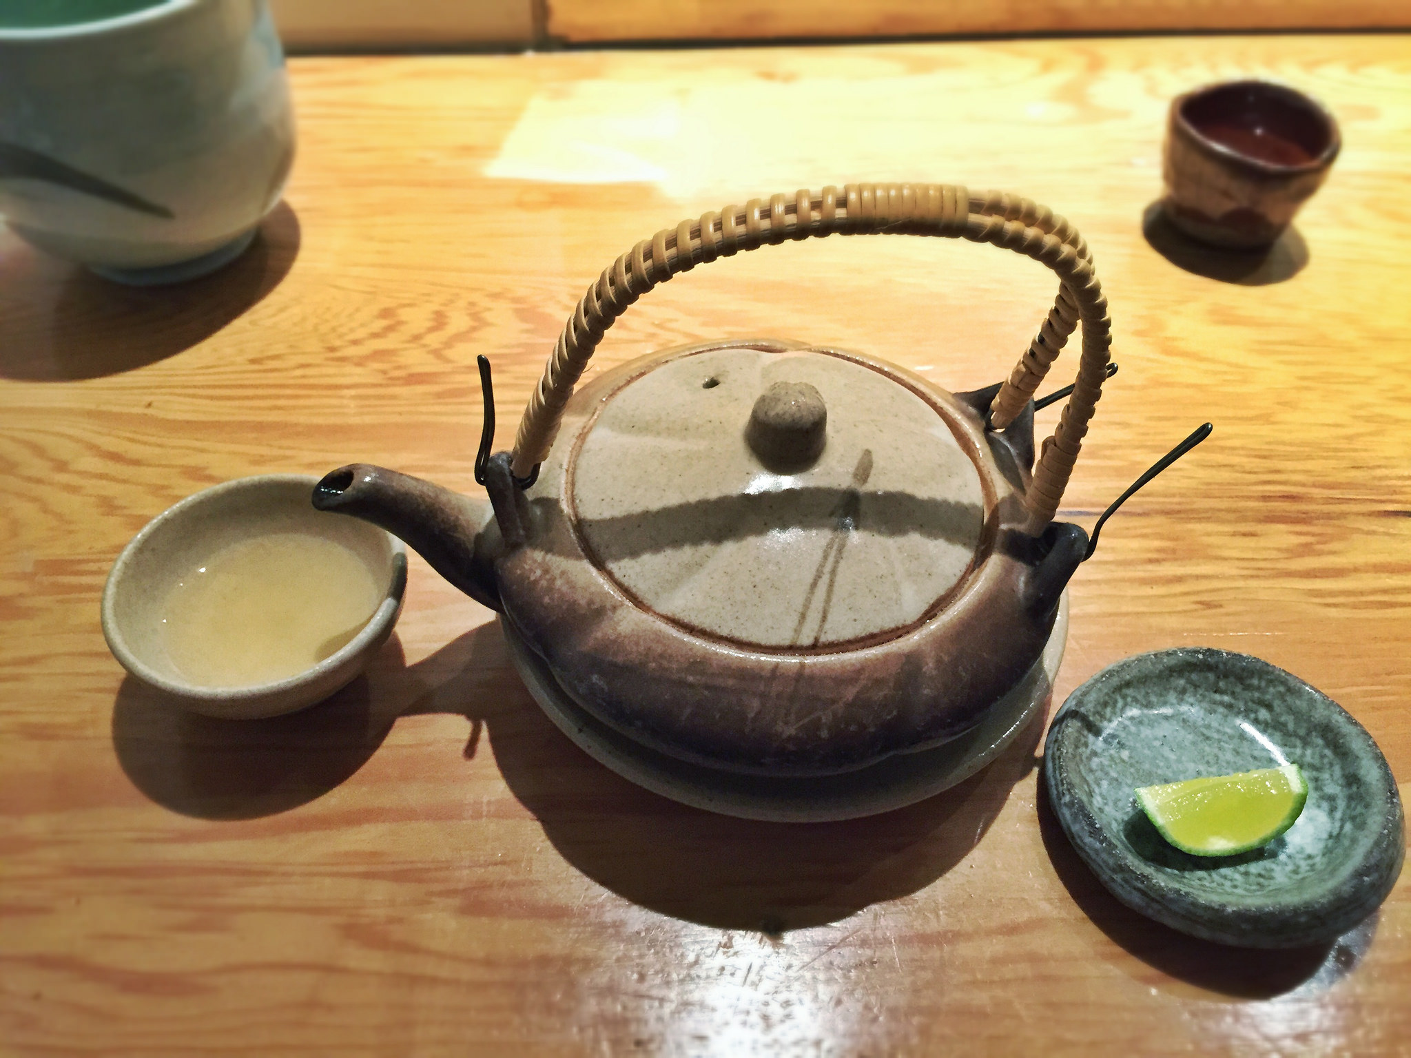

Slide 76
Knowing that their ideas are understood by someone else helps the other person to empty their cup.

Slide 77
Reflective Listening

Slide 78
Advanced move: You can ask for help emptying your own cup.

Slide 79
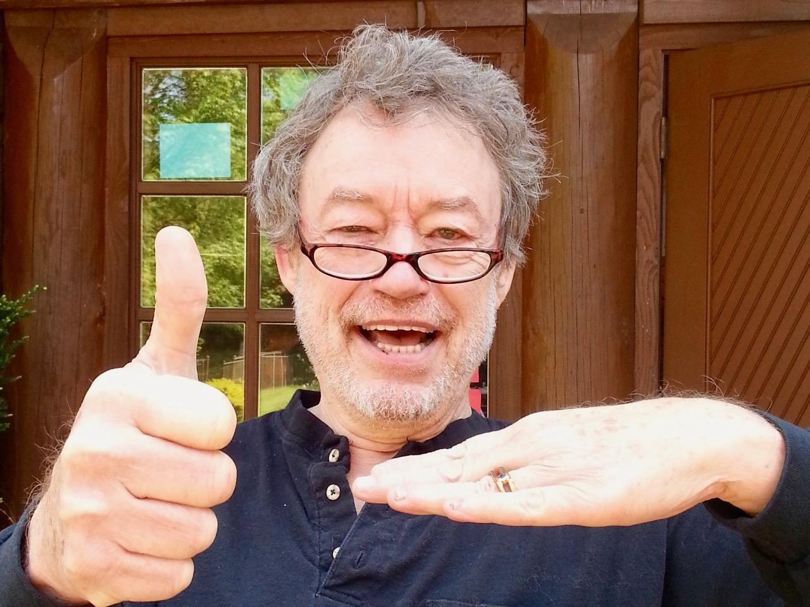
Tip #6:
Know & Disclose
Jim McCarthy

Slide 80
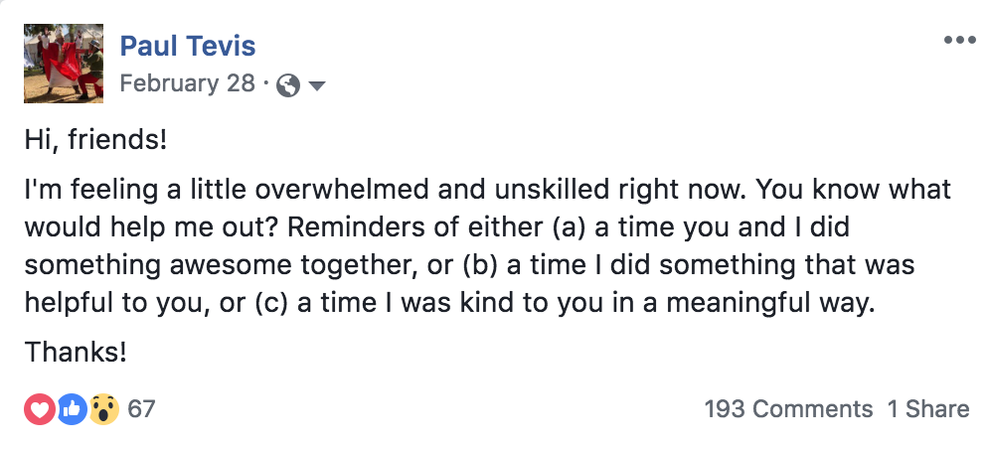

Slide 83
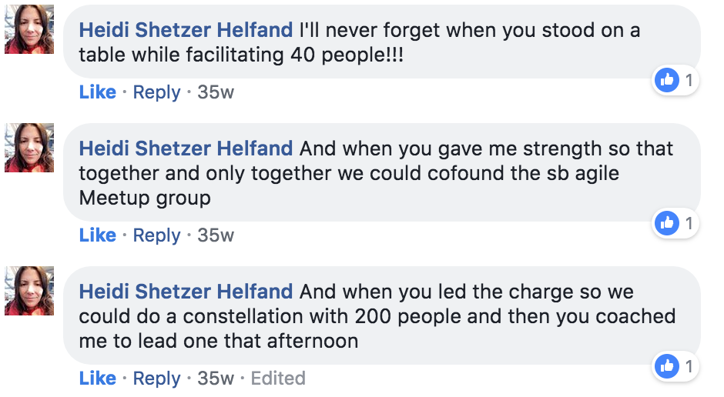

Slide 87
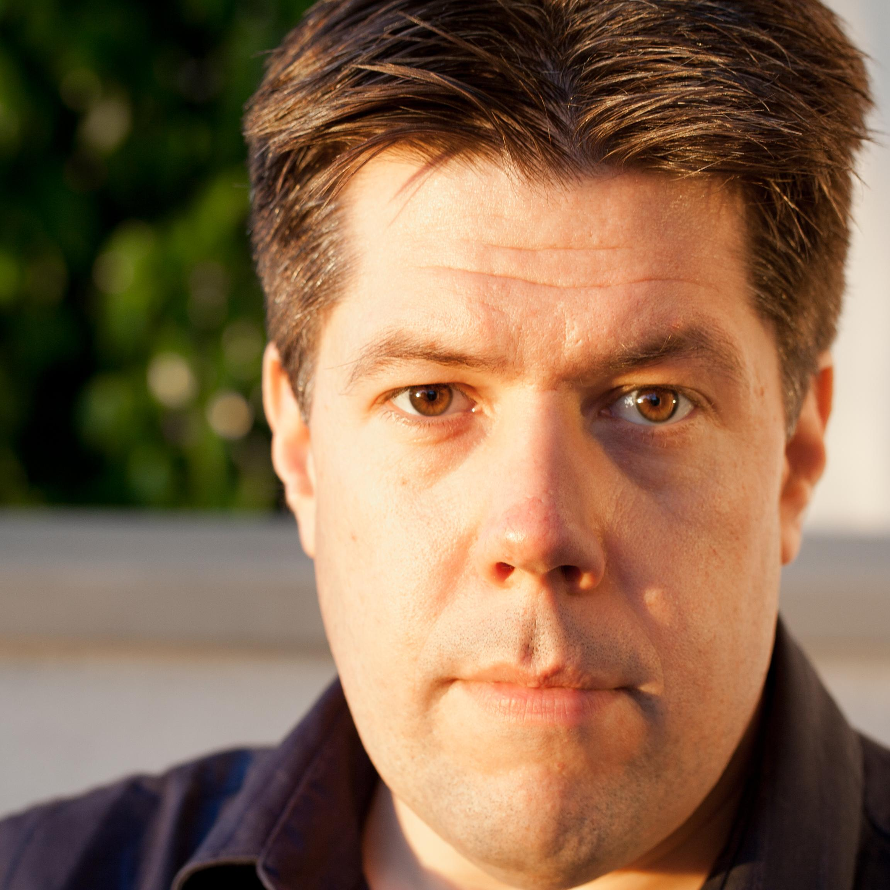
Tip #7:
Ask for Reactions
Me?

Slide 88
When things get tricky, slow down and help with the processing.

Slide 89
Ways to ask for reactions:

Slide 90
Ways to ask for reactions:
How was it to hear that?

Slide 91
Ways to ask for reactions:
How was it to hear that?
How does that land with you?

Slide 92
Ways to ask for reactions:
How was it to hear that?
How does that land with you?
What does that bring up for you?

Slide 93
Ways to ask for reactions:
How was it to hear that?
How does that land with you?
What does that bring up for you?
I’m wondering if that was hard to hear...

Slide 94
Understanding Empathy
Understanding Yourself
Understanding Others
Understanding Each Other

Slide 95
Treat Feelings as Data
Listen at Level 2 (At least)
Notice Your Judgements
Ask “Where’s That From?”
Help Others Empty Their Cup
Know & Disclose
Ask for Reactions

Slide 96
These things are simple.
That doesn’t mean they’re easy.

Slide 98
This presentation is released under a Creative Commons Attribution-ShareAlike 4.0 license. Many of the images are in the public domain. The following images are used under a CC license which requires attribution:
https://commons.wikimedia.org/wiki/File:Safari_Endeavour.jpg (Wolfgang Kähler)
https://commons.wikimedia.org/wiki/File:Urchin.jpg (Ratha Grimes)
https://commons.wikimedia.org/wiki/File:2010-bald-eagle-with-fish.jpg (Yathin S Krishnappa)
https://www.flickr.com/photos/kitpfish/3419118775 (KitAy)
https://en.wikipedia.org/wiki/Charles_Duhigg#/media/File:Charles_Duhigg_at_the_Leading_Through_Excellence_summit_in_2013.jpg (Ohio State University Center for Operational Excellence)
https://commons.wikimedia.org/wiki/File:THE_LIFE_OF_VULTURE.jpg (Ayush1025)
https://en.wikipedia.org/wiki/File:Kyle-cassidy-weird-al-yankovic.jpg (Kyle Cassidy)
https://commons.wikimedia.org/wiki/File:Marshall_Rosenberg.jpg (Beth Banning)
https://commons.wikimedia.org/wiki/File:Proxy_pattern_diagram.svg (TravisHein)
https://www.flickr.com/photos/68147320@N02/15514029317 (T.Tseng)
https://commons.wikimedia.org/wiki/File:Jim_McCarthy.jpg (Rkasper)

