Slide 1
From Threat Hunting to Crowd Defense
Richard ZHAO
CTO, SVP Research, NSFOCUS
San Francisco, Nov.15 2017

Slide 2

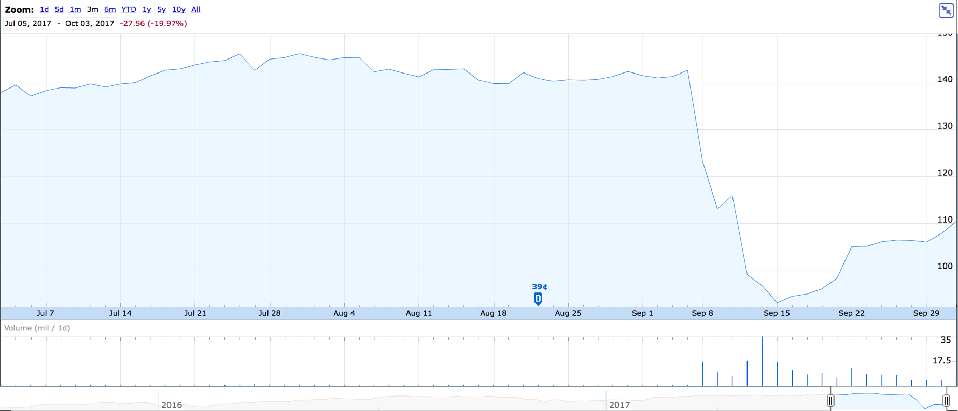
Apache Struts CVE-2017-5638 (S02-045)
In early March, the Department of Homeland Security sent Equifax and other companies an alert about a critical vulnerability in software that Equifax used in an online portal for recording customer disputes.
The company sent out an internal email requesting that its technical staff fix the software, but “an individual did not ensure communication got to the right person to manually patch the application,” Mr. Smith told the subcommittee.
That was compounded by a technical error: The scanning software that Equifax used to detect vulnerabilities failed to find the unpatched hole, he said.
https://www.nytimes.com/2017/10/03/business/equifax-congress-data-breach.html
Notes:
Hello, everyone. I like to start my session with this incident, or call it a disaster. It might be the TOP 1 security incident in the whole year, if no bigger one burst to compete for this position. Equifax, as a $18B company (before the incident, now $14B), 9000+ employees, the security operations team, I guess, should be a strong and mature one, though I am not familiar with them. How was this big company was breached by a security vulnerability? I like walk through what happened at March…

Slide 3
Timeline of Equifax breach
2017-03-10:
Equifax compromised via struts exploit.
2017-04-xx:
Oracle releases quarterly bundle of patches, including the Struts patch
2017-07-29:
Equifax discovers they have been compromised
2017-03-06: Apache announces struts2 bug
2017-03-07:
PoC exploit released to public
2017-03-13:
30 webshells installed
2017-06-30:
Equifax patched their struts installs
2017-07-30:
Equifax evicts the elite hackers and their 30 webshells
Credit: http://lists.immunityinc.com/pipermail/dailydave/2017-September/001421.html?utm_content=buffer728aa&utm_medium=social&utm_source=twitter.com&utm_campaign=buffer
Notes:
The story began from a famous web application framework - Apache Struts2. It’s famous because that every other months there are often security vulnerabilities disclosed. Starting S2-001 at 2007, the newest vulnerability is S2-053. But you know, starting from S2-045 which murdered Equifax, there have been 9 new at this year so far. OK, S2-045 was announced by Apache at March 6th. Then followed by a PoC exploit released to the public.
There are many points that I got confused when I read through the reports on this disaster. Firstly, why the security operation team missed the prime time window for rescue. Just send out a message, to a wrong person, and unfortunately the scanner failed to find the vulnerable Struts2 out… It sounds not like a serious security operation, at least not for a high risk security response. I believe, it has been a well accepted common knowledge - Struts2 are vulnerable…. What lead Equifax security operations team to a wrong prioritization?
2017-08-01: Equifax CFO sells $1mm stock, US President of Information sells $600k stock, President of Workforce Solutions sells $250k stock [3]
2017-09-05: FireEye registers the Equifax domain name as part of a broader PR damage control move, which Equifax will do everything it can to sabotage
2017-09-07: Equifax mentions that maybe there might have been some sort of hack or something but definitely not a big deal unless you're an American adult with a credit record. 2017-09-08: Equifax offers an opportunity to sign away your right to sue Equifax in exchange for waiting a week and getting yet another year of free credit reporting. (If you don’t already have 3-5 years of free credit reporting by now, are you even using the Internet??) [4]
2017-09-11: FireEye (owner of Mandiant, who did the IR + PR for Equifax) quietly pulls the case study white paper about how FireEye 0day protection technology is keeping Equifax safe from unknown threats and "up to 29 webshells”

Slide 4
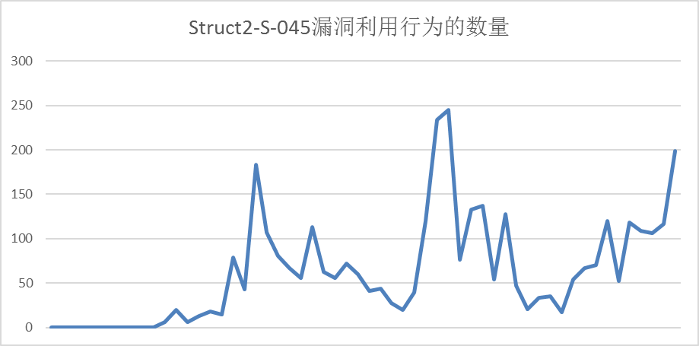
Win your adversaries. It’s a race
Struts2 S2-045 Attack Numbers Detected during Mar.7 -Mar.9
10
10
H M Attacks Detected
9PM-10PM DAY2
2nd Spike: 245
8
13
H M Prevention Ready
4AM-5AM DAY 1
1st Spike: 183
4
53
H M Vulnerability Detection Ready
Attack Defense Ready
First Attack Detected
Alert
Scanning/Testing
09:53
14:46
18:06
20:03
Data Source: NSFOCUS Security Cloud and Threat Intelligence Center, covering websites under protection: 458
Notes:
It’s early morning of a Tuesday. Given the severity of the vulnerability, we triggered the highest level security response process. All the related engineers were organized to analyze, develop, test, and release, monitor, etc. Reading the chart, we spent 4 hours and 53 minutes to finished the vulnerability detection, i.e. plugins for the scanners, prevention ready at 8H13m, i.e. rulesets for IPS and WAF. Those plugins and rulesets were pushed to the update systems and then to the security appliances with automatic update turned on. The first attack was detected at 10H10M. The first attack spike was at about 24hours after the vulnerability disclosed. Then 2nd spike came 30 hours later, at Mar. 9

Slide 5
Anything beyond 35 IP Addresses?
Mandiant, the FireEye unit that Equifax called in to investigate the breach, said it has detected about 35 IP addresses the attackers used to access the company's network. The hackers' identity remains unknown. Mandiant has been unable to attribute the breach to any hacking groups it currently tracks, and the tools, tactics, and procedures used in the hack don't overlap with those seen in previous Mandiant investigations.
https://arstechnica.com/information-technology/2017/09/massive-equifax-hack-reportedly-started-4-months-before-it-was-detected/
Notes:
The attackers, according to the WSJ, eventually entered the command "Whoami," giving them the capability to determine the user account they had compromised. It was likely the beginning of months of painstaking hacking as the attackers attempted to escalate their privileges and intrude further into the Equifax network. Sometime between May and late July, the hackers accessed files that contained Equifax credentials and "performed database queries that provided access to documents and sensitive information stored in databases in an Equifax legacy environment," the report said. Eventually, the attackers accessed "numerous database tables in several databases."
The attackers also managed to set up about 30 Web shells that allowed them to remotely enter the same sorts of powerful commands available to high-privilege Equifax administrators. The hidden pages would remain even after the vulnerable Struts applications on the network were patched. As it turned out, Equifax didn't fix the flaw until July 30.
Mandiant, the FireEye unit that Equifax called in to investigate the breach, said it has detected about 35 IP addresses the attackers used to access the company's network. The hackers' identity remains unknown. Mandiant has been unable to attribute the breach to any hacking groups it currently tracks, and the tools, tactics, and procedures used in the hack don't overlap with those seen in previous Mandiant investigations.

Slide 6
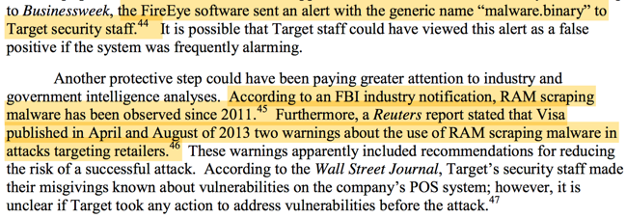

Why happened again after target？
Willingness？
Resource/
Domain Knowledge?
Intelligence/Prioritization?
Source: https://blogs.gartner.com/jay-heiser/2017/10/05/outrunthebear/
Data Source: A “Kill Chain” Analysis of the 2013 Target Data Breach
Notes:
It seems a little bit similar to what happened to Target at end of 2013. Both of them got threat notification from authorities in advance, i.e. the security operations team know the threat coming. They got the intelligence, but didn’t get intelligence actionable enough, or failed to triage correctly. After the Equifax incidents, I read this fun essay at Gartner’s blog. You can‘t outrun the security bear, particularly when you are protecting a poorly designed information security from security perspective. What you can do is outrun your peers, i.e. the hackers may be busy reaping the low hanging fruit, so that you can have more time to fix. That sounds a little bit impotent, cruel. But it delivers wisdom.

Slide 7
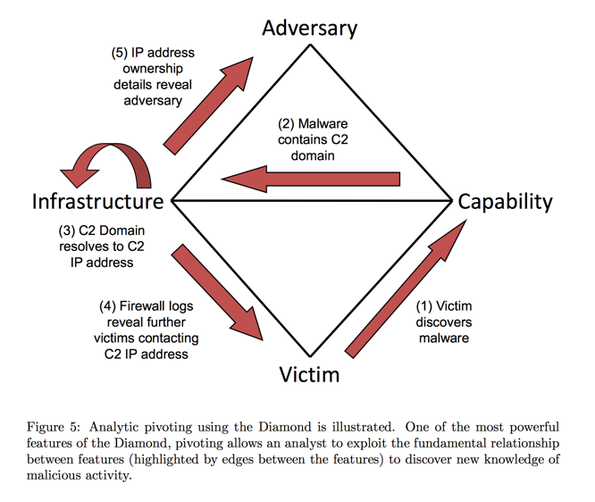
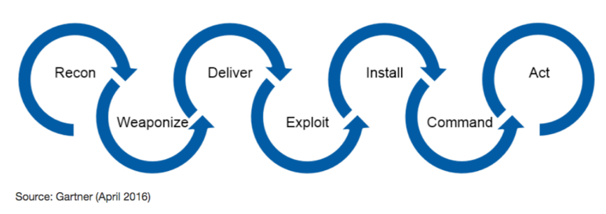
The Game of Offense and Defense
…
Diamond
Offense
Diamond
Defense
CKC
PDR
No 100% security, i.e. defense will always fail at some day, some points
Defense must be capable to
  contain some local failures while keep the control of the whole
  defend in depth, i.e. avoid “checkmate in one”
  have visibility and “global” view
Timeliness, timeliness, timeless…
CKC: Cyber Kill Chain
PDR: Protect, Detect, Respond
Notes:
There are a number of famous security and/or threat models to guide the defense side, e.g. PDR, protection, detection, response, e.g. Cyber Kill Chain, it classifies the threat activities into seven phases, referencing this model, defense side can map the threat activities and corresponding controls/countermeasures to phases, so that the defense can avoid being “checkmate in one”, it also help visualize and understand the threat actors, bring better visibility to defense side. CKC also help design and build the inference engine which I will touch later in this session.

Slide 8
Strategy for different battlefields
Untargeted Offense:: no special verticals and regions
>> Focus on sea volume (huge N ) and automation (lower C)
Untargeted Defense:: Commercial off the shelf products or open source stacks
>> Focus on probability and statistics, weakening the automation and repeatability of offenders
Targeted Offense:: Customized “evasion” against “detection” of the target, i.e. “unknown” threats
>> Customization means higher cost
>> Rapid assembly with some level reuse…
Offense
Defense
Untargeted
B1
Targeted Defense:: Some sort of ”dark tech” beyond offense’s radar
>> Deception, Tokenization、Honey…
>> Fight with dimensions…
B2
B3
Targeted
B4
Notes:
For better description of the offense defense game, we categorize the threats into untargeted and targeted.

Slide 9
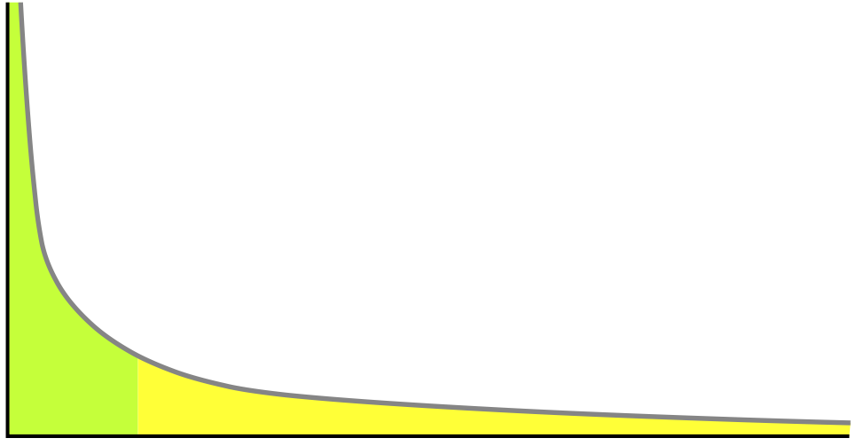

Security inside the long tail
Advanced/Targeted
Offenders
Value of target /
Magnitude of damage
TH/TI/UEBA/MDR/…:
Unknown attack types, unknown quantities, and mostly targeting internal core assets/business/personnel
Traditional Detection:
Known attack types, large quantities, and mostly targeting exposures of peripheral systems
Average/Repeat Offenders
TH: Threat Hunting
TI: Threat Intelligence
UEBA: User Entity Behavior Analytics
MDR: Managed Detection and Response
Attack surface/vectors
Notes:
To fight against advanced targeted unknown threats, a couple of advanced weapons were invented, including the threat hunting, UEBA, threat intel, MDR, etc. Let me walk thought those advanced technologies very briefly.

Slide 10
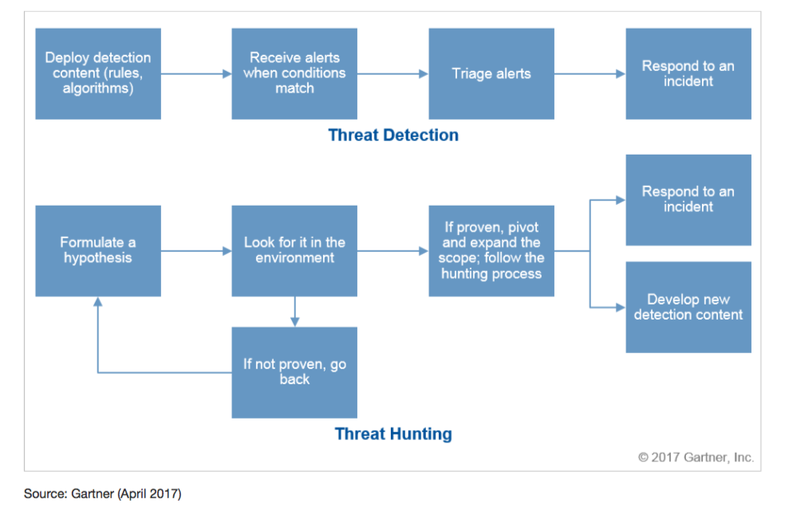
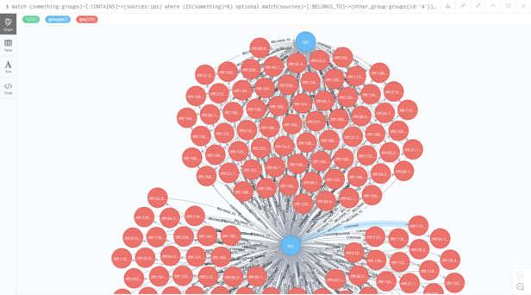
Threat Hunting is to pursue unknown
Threat Hunting:: the process of proactively and iteratively searching through networks to detect and isolate advanced threats that evade existing security solutions.
Typically, TH, starting from a hypothesis, is commissioned to search advanced, targeted, unknown threats, which may be analytics-driven, or situational-awareness driven, or intelligence-driven.
Credit: Dr. Anton Chuvakin, How to Hunt for Security Threats, April 2017
Source: https://en.wikipedia.org/wiki/Cyber_threat_hunting
Notes:
Threat hunting becomes hotter in the context of unknown threats. The logic is let’s hunt the unknown proactively before they can hurt us. The hunters formulate some hypothesis based on threat intelligence, or situational awareness or some analytics results. For an example, you get to know there already has been an exploit/POC in the wild which uses a C2, ie. Command and control infrastructure. So the hunters may develop a search job in the SIEM or ES system to double check if there were some traffic records with this C2, meanwhile hunters may deploy a specific IDS rule to monitor the potential traffic to this C2.
The upper
The trick is how to formulate the hypothesis, properly, logically, and doable economically. Then to make it more practical, hunters make DIY rules and deploy them to detect and analyze the results to see if something was hunted. So the detection mechanism and means are more fundamental. Let’s firstly investigate how the modern detection systems work.

Slide 11
Before going deeper TH/TI/UEBA, let’s look into detection in practice
TI/Reputation
Lowest cost
Real time
Known files/IP/C2/URL
(black or white)
Signature
Detection
Engines work collaboratively
Shellcode/
Static Check
Almost real time
Check attack payload (more IOCs)
Virtual Exec.
Sandboxing
Resource extensive
Time delay
Notes:
Before we going deeper into threat hunting, threat intel, and UEBA, we‘d better examine more details how the current detection mechanisms work. The logic is the a threat has been detectable technically, there is no need to “hunt”. You just need to check the detection results, following the event/incident processes.

Slide 12
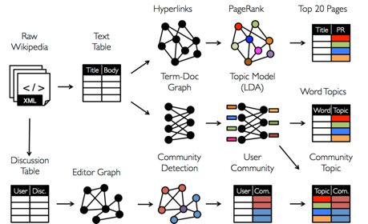
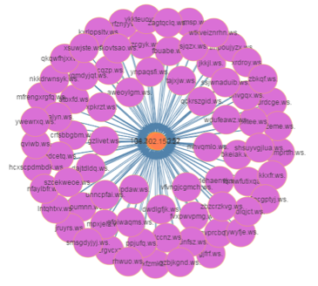
Application Cost/efficiency matters
Notes:
In the past years, many people talk about that signatures are bad, only machine learning, behavior anomaly detection are good. That’s not true. Actually, signature based detection are still the most efficient way to detect threats, known and some sort of unknown. What has changed is the way to generate the signatures and algorithms. That‘s mostly the machine learning and artificial intelligence are deployed in the real practice. Another path in parallel is to employ ML/AI to generate threat intel and apply them into this ML/AI empowered detection system for ongoing operations. Also the human expertise are added to refine the results, removing the false positives, false negatives, and finally the rulesets and algorithms with “secret recipe” are released. From the screen, they are the real numbers for our WAF - web application firewall, with the built-in ML engine, 10 times better than the “traditional ones”.

Slide 13
Threat Intelligence
IS USED to
Strategic TI
Situational Development
Hacker/Actors
（skill, intention, goal, plan)
Operational TI
TTP
(Tactic, Technique, Procedure)
Campaign
（goal, loss）
Real Time Blocking
Security Operations
Threat Research & Hunting
Attack Pattern
Infrastructure
（ip, domain, url, botnet,…）
Event
Tactical TI
Process
Malware
Tool
Vuln.
IOC
(Indicator of Compromise)
COA
(Course of Action)

Slide 14
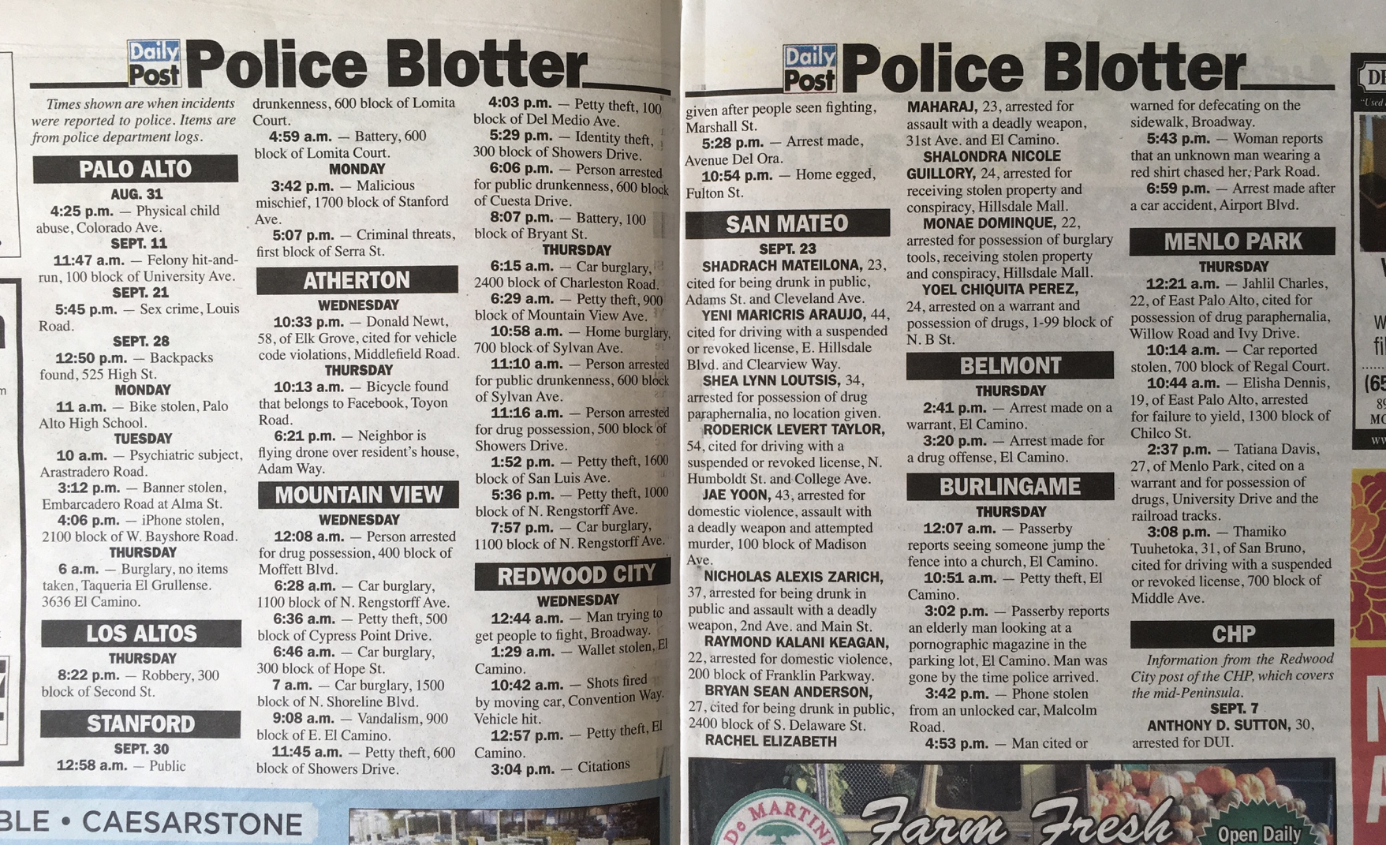
However, Threat Intel is hard to harness
Intensive domain knowledge required
Too much or too little
Hard to automate
False positive/false negative

Slide 15
Close loop Operation is critical to refine Threat Intel
Privacy & liability
Fear of revealing the breach incident(s)
No visible return value to share/feedback

Slide 16
In short, Threat Intel is not silver bullet
Threat Intel is sort of ”middleware”, particularly for tactical TI. Maturity and service delivery are critical.
TI is not “silver bullet”. There is always imperfect with any Intelligence, therefore experts and “professional analytical operations are always needed to realize value.
Considering counter-intelligence, TI should be classified, e.g. Advanced Threat Intelligence(ATI), TI, won’t and should not be shared and distributed 100% openly.
For many organizations without a strong dedicated security operations team, TI/reputation-enhanced products/services are better choices.
ATI Enhanced Products
ATI Enhanced Services
ATI Enhanced Reports/Feeds
CII and Giant
organization
TI Enhanced Products
TI Enhanced Services
Large
Organization
Reputation Enhanced Products
Reputation Enhanced Services
SME/SMB
"Distrust and caution are the parents of security" - Benjamin Franklin

Slide 17
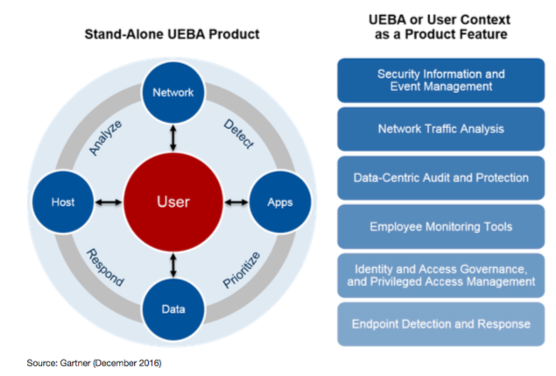
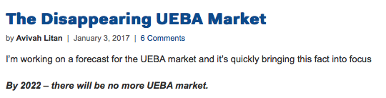
UEBA and Profiling are other important means to fight unknowns
UEBA:: User and Entity Behavior Analytics offers profiling and anomaly detection based on a range of analytics approaches, usually using a combination of basic analytics methods (e.g., rules that leverage signatures, pattern matching and simple statistics) and advanced analytics (e.g., supervised and unsupervised machine learning).
a cybersecurity process about detection of insider threats, targeted attacks, and financial fraud
Source: https://en.wikipedia.org/wiki/User_behavior_analytics
Notes:
UEBA is widely accepted as powerful weapon to fight insider threats, and lateral movement after compromise. No matter UEBA is deliver as integrated part of the SIEM or other security products, or stand alone products, from technological perspective, UEBA builds profiling and anomaly detection leveraging advanced analytics. It’s very powerful. Both threat hunting and UEBA take advantages of threat intel.

Slide 18
The world is categorized into black, white and grey in eye of UEBA/Profiling analyst
Black
White
Grey
Alexa ranking
DNS access ranking
IP access ranking
Historical alerts
External reputation
Historical vulnerabilities
Historical threat levels
Associated entity reputation

Slide 19
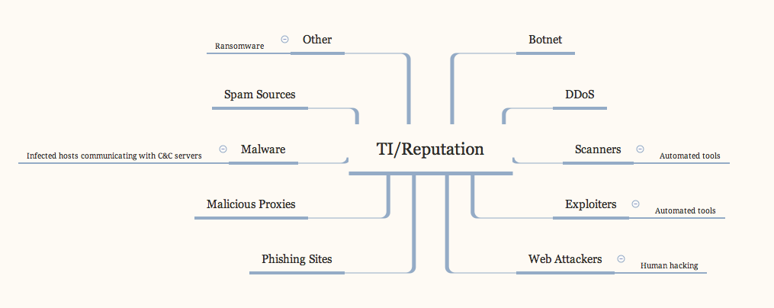
REPUTATION & Profiling in practice
IP addresses can be in more than one reputation category, such as being both Phishing and Spam Source.
Categorization of IP addresses can change over time based on behavior.
  For example, as additional data is collected an IP address could move from DDoS (a more general category) to Botnets (a more specific behavior category).
 | Jan |  | Jul |  | Aug |  | Sep
Type | Count | % Match | Count | % Match | Count | % Match | Count | % Match
Botnets | 11,366,418 | 86.4476% | 11,703,662 | 66.6832% | 14,997,560 | 63.7386% | 15,553,771 | 62.3452%
DDoS | 1,116,979 | 8.4952% | 1,382,291 | 7.8758% | 3,500,212 | 14.8757% | 3,998,571 | 16.0277%
Other | 27 | 0.0002% | 2,937,700 | 16.7380% | 3,409,392 | 14.4897% | 3,305,714 | 13.2505%
Scanners | 424,930 | 3.2318% | 1,036,679 | 5.9066% | 1,150,699 | 4.8904% | 1,319,770 | 5.2901%
Spam Sources | 81,013 | 0.6161% | 192,114 | 1.0946% | 155,088 | 0.6591% | 344,310 | 1.3801%
Exploits | 107,753 | 0.8195% | 205,188 | 1.1691% | 215,490 | 0.9158% | 330,684 | 1.3255%
Malware | 10,307 | 0.0784% | 38,731 | 0.220675% | 40,652 | 0.1728% | 36,593 | 0.1467%
Proxy | 15,880 | 0.1208% | 27,360 | 0.1559% | 32,925 | 0.1399% | 36,532 | 0.1464%
Phishing | 25,012 | 0.1902% | 24,797 | 0.1413% | 24,531 | 0.1043% | 17,665 | 0.0708%
Web Attacks | 17 | 0.0001% | 2,606 | 0.0148% | 3,236 | 0.0138% | 4,210 | 0.0169%
Total | 13,148,336 |  | 17,551,128 |  | 23,529,785 |  | 24,947,820

Slide 20
IP‘s country info matters

Slide 21
ASN has its reputation as well
Pay more attention for traffic with those ASNs above this bar
Oops, something weird?

Slide 22

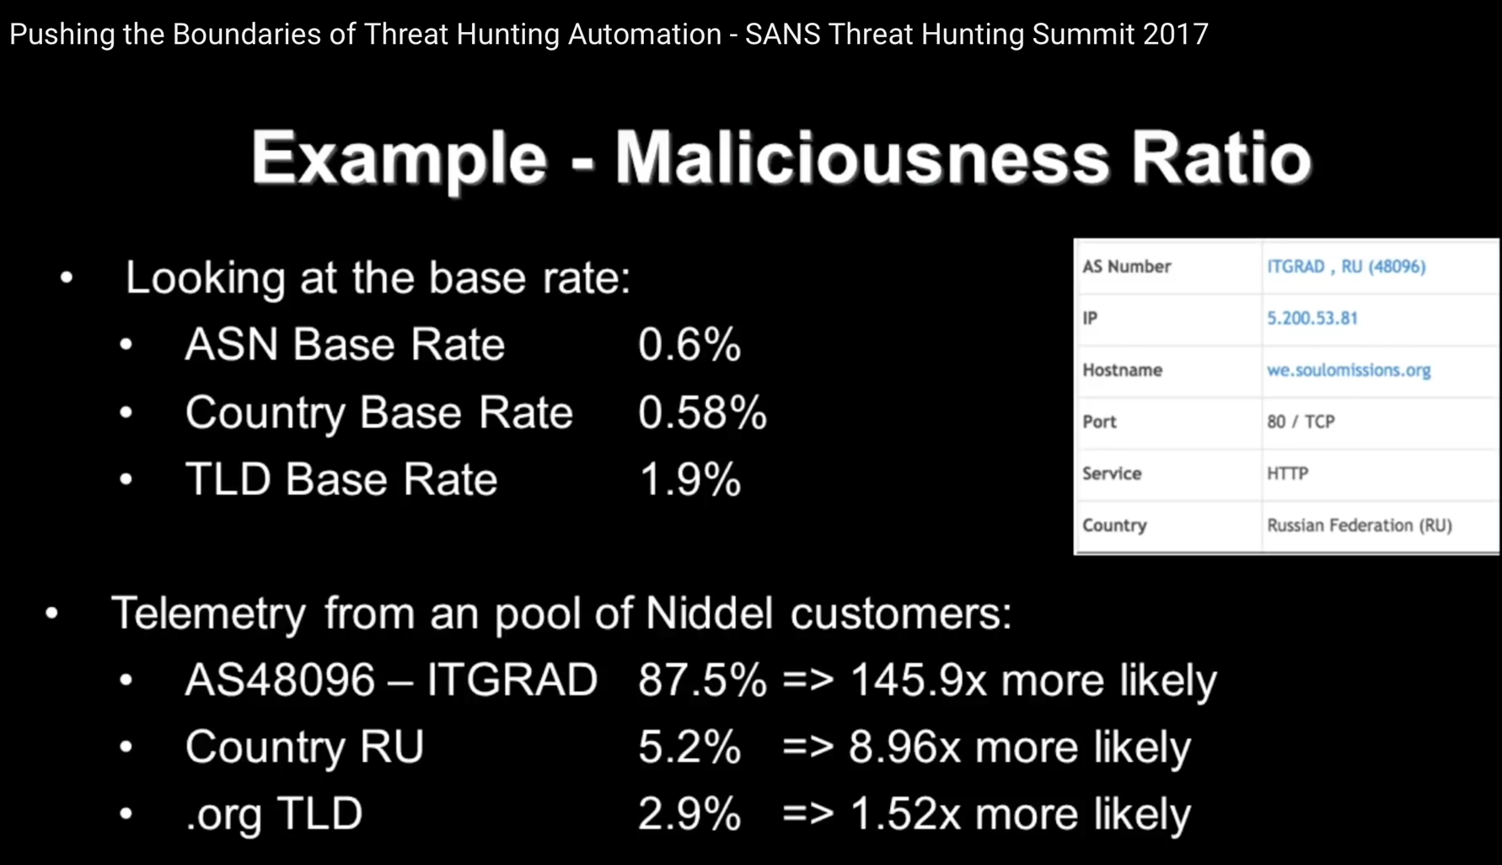
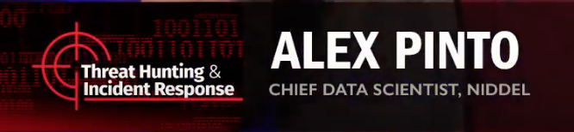
Anomaly detection based on profiling
You must build and maintain profiles of:
Network access
User behavior
Event distribution
…
Source: https://www.youtube.com/watch?v=8gdtTiMt88w

Slide 23


Fight with inference crossing dimensions
Tactic, Technique, Procedure
KNOWN
KNOWN UNKNOWN/
To Be Trained/Hunted
U
K
K
Notes:
Besides the profiling and anomaly detection, we can do inference and reasoning, crossing the dimensions, to learn unknowns from knowns, because the threat actors reuse their infrastructure and weapons.

Slide 24
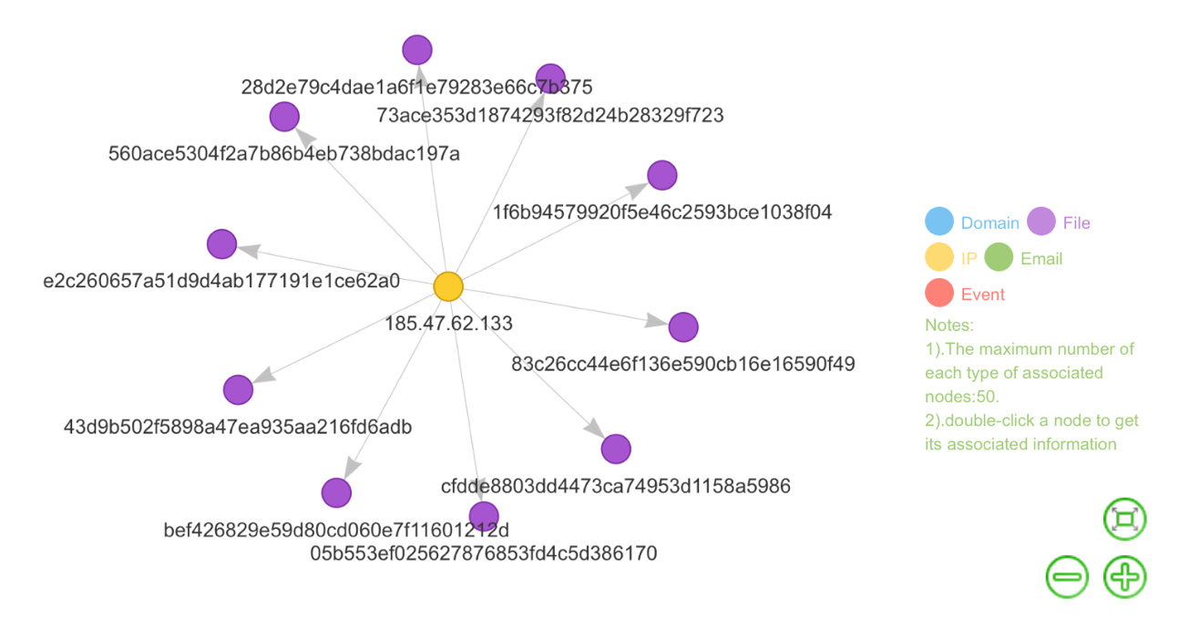
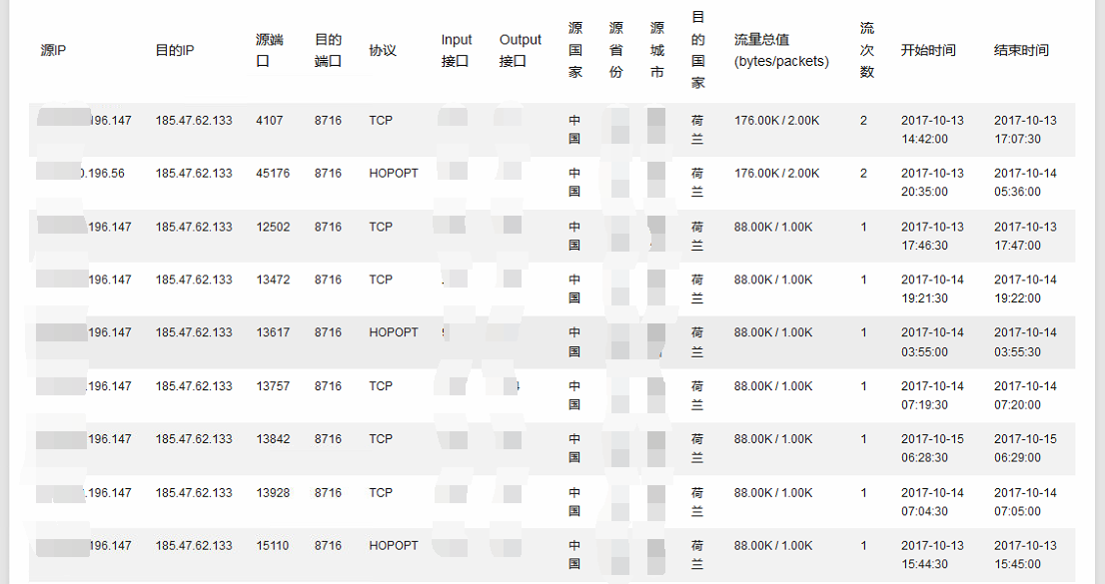
TI/Reputation Based Threat hunting/Attribution
Malware->C2->Bot…
  Sandbox the malware to extract C2 (Command and Control)
  Detect/hunt through DFI/DPI (Deep Flow Inspection/Deep Packet Inspection)
  Verify the “bots” detected
  Correlate with IP/domain reputation
  Update the reputation database
  Release to whole ecosystem
Notes:
E.g.

Slide 25


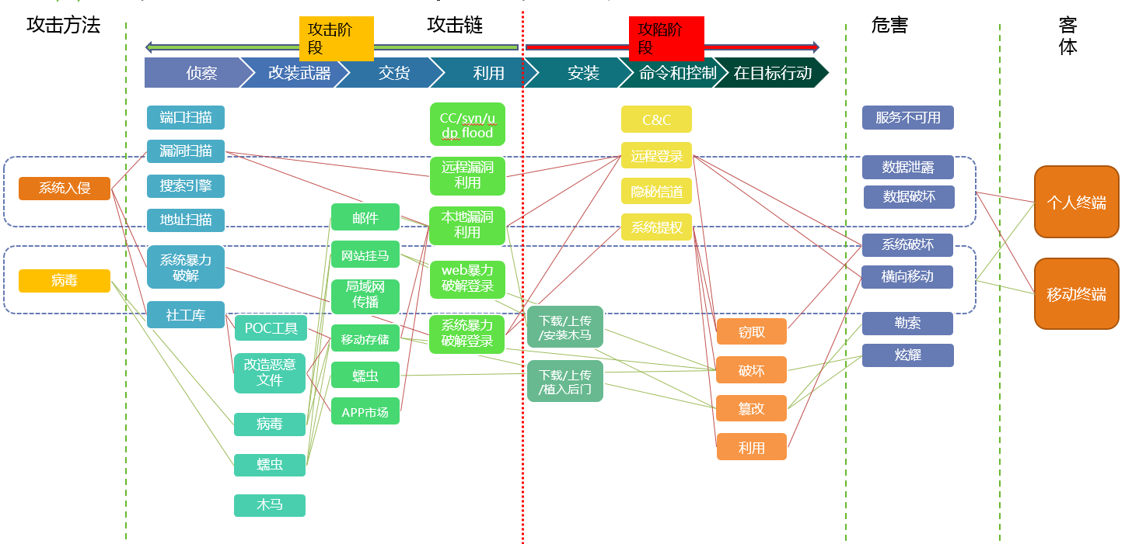
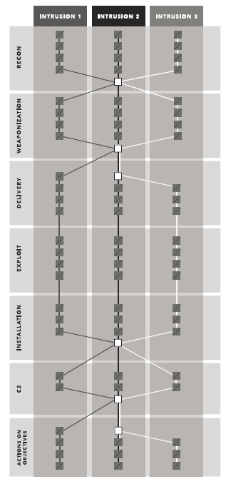
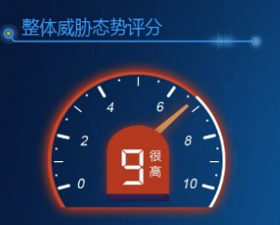
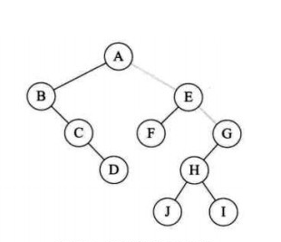
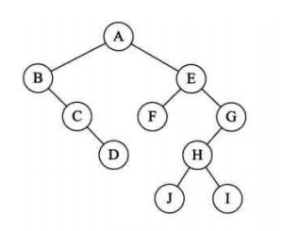
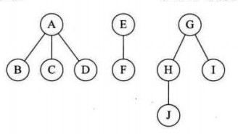
Cyber Kill Chain can be introduced to automate Inference
Inference Method Base
Same-Source Inference
Offense-Defense Tree
Visualization of the Kill Chain
Offender Profiling
Based on the attack target and the inference method base, make inferences after gaining insight into security events generated by the engine and correlate individual security events to generate complete kill chains.
For cases where an attacker attacks one target by using various means, integrate kill chains to generate more accurate kill chain information.
After the first two phases of inference regarding security events, generate a complete attack-defense tree and present information in the attack and defense angles.
Based on the generated attack-defense tree, mine and visualize the information about the attack target and attacker.
Match the attacker with the intelligence provided by the attacker profile database to enrich the attacker profile and predict actions likely to be taken by the attacker.
Chain
Tree
Forest
Offense Method/Vectors
Offender
Offender Group

Slide 26
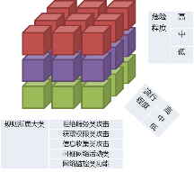
Develop Inference engines into practicable
Correlation with Cloud-side Intelligence
Log
Event
ML
Static Understanding
Incident
Event Gen
Profile (reasoning)
Pre-Warning
IOC-based pre-warning
Multi-source logs
Update offender/group
Update IOC
Multi-source data deduplication
Kill chain Inference
Incident Gen
Kill Chain Presentation
Profile
Offender Profile
Offender Group Profile
Offense Scenario Reproduction
Visualization of Original Logs
Understanding Engine
Inference
Engine
Behavior
Revision
Merging
IOC Extraction
Target-Based Inference
Same-Source Inference
Profile Generation
Security Event Generation
Kill Chain Model
Botnet Tracking Model
Data
Threat Event
Data Cube
Audit Event
On-Premise Security Devices
Notes:
A number of sub-systems and integration development are needed to make those inference engines, hunting, reasoning into a practicable operations. From this chart, data layer, behavior layer, and the profile layer

Slide 27
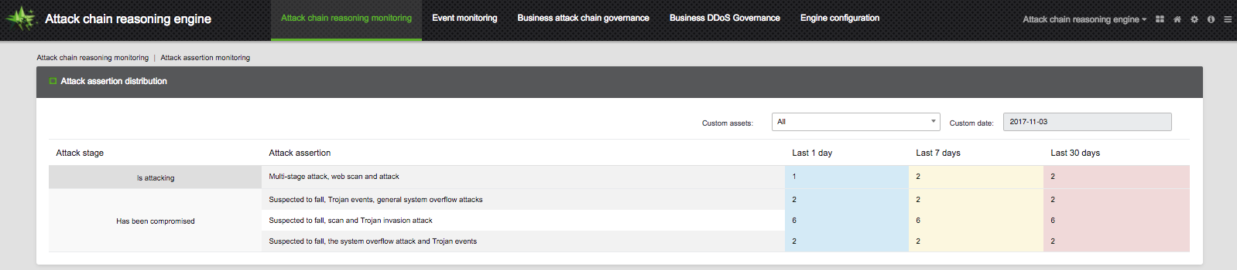
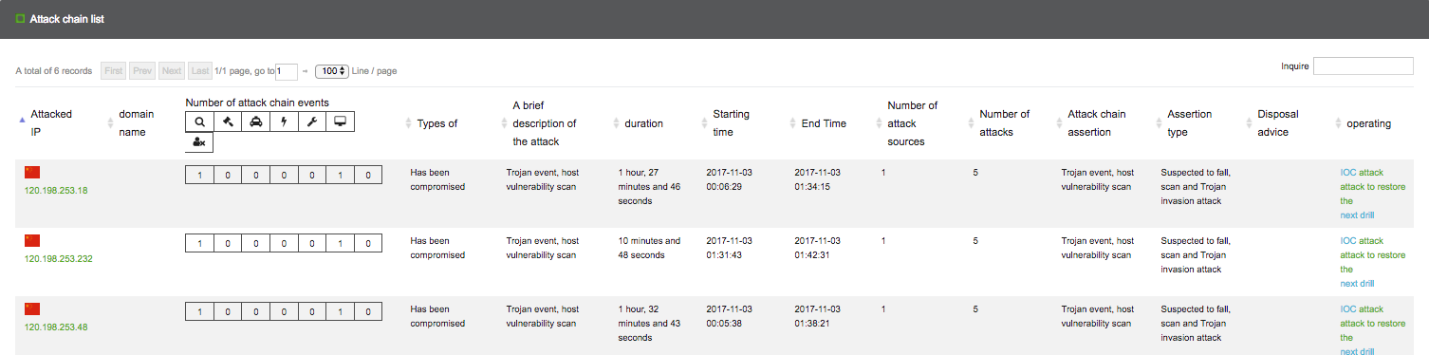
Develop Inference engines into practicable (con’t)
Kill Chain reasoning
Attacking
Compromised

Slide 28
Besides complexity and resources needed, Scalability is very hard
5.0 Tb/s
600,000 fps
200 GB/h
Bandwidth
Traffic speed
Storage

Slide 29
The important things are always simple. The simple things are always hard. The easy way is always mined.
-Murphy‘s Laws of Enterprise Information Security.
Source: http://www.murphys-laws.com/murphy/murphy-war.html
Notes:
So is there any way to make the life simpler? Just as the Murphy’s laws mentioned. Where is it? Let’s check if it’s hard and if it’s mined.

Slide 30

Find out “big rocks” Of security operations
Credit: Rocks and Sand — Doing the Simple Things Well Has Never Been More Important, Craig Lawson, @craiglawson, 2016
http://www.rogerknapp.com/inspire/rockssand.htm
Notes:
This is a good analogy. The perception of significance of the advanced targeted unknown threats has changed quite a bit in the past 3 years, where this red number from DBIR betrays the fact that most of the enterprise security operations teams

Slide 31
Long tail from Security operations angle
Number of Incidents per hour
TOP Exploitations
TOP Malwares
TOP Attackers
TOP Targets
TOP …
Minor Events
Exploitations
Malwares
Attackers
Login Failure
Abnormal Behavior
…
Attack surface/vectors
Notes:
Which part will hurt us the worst? Of course, if we can not handle the TOPs, we are not qualified to talk the minors.

Slide 32
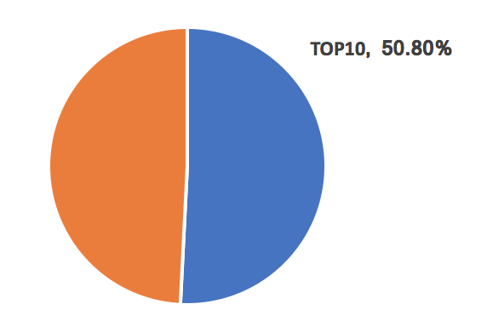
Not just Known, Even old
Top 10 vulnerability exploited detected by IPS in 2017H1
Data Source: NSFOCUS Security Labs. 2017

Slide 33
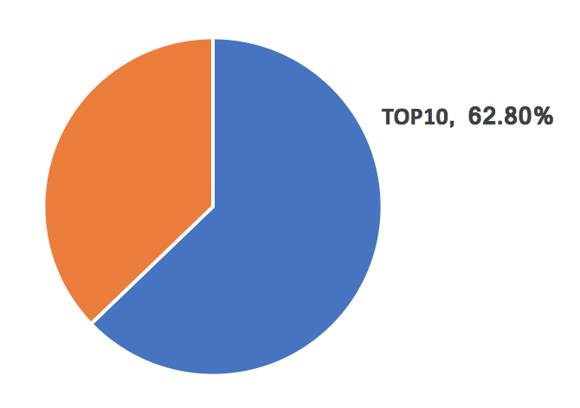
Web attacks as well
Top 10 vulnerability exploited detected by WAF in 2017H1
Data Source: NSFOCUS Security Labs. 2017

Slide 34
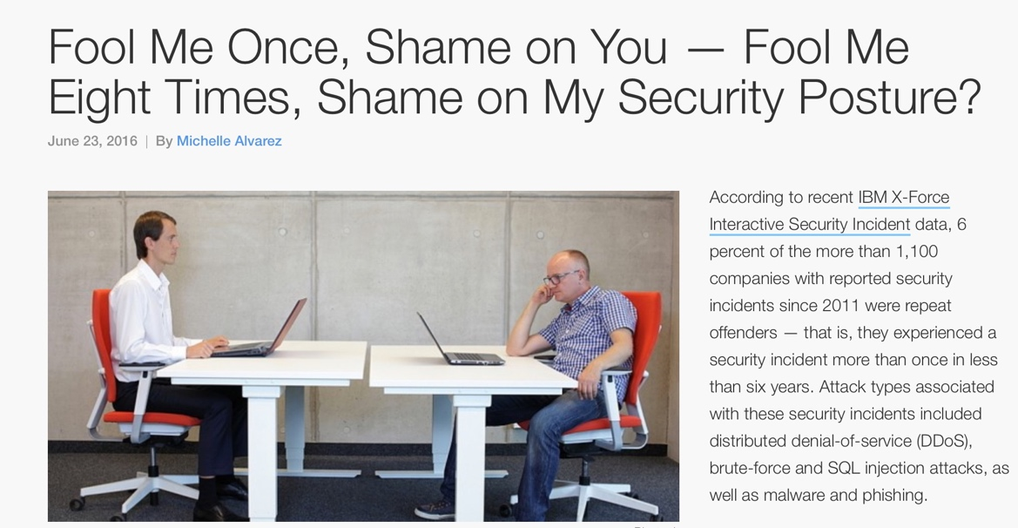
Repeat Offenders - typically untargeted
Typically untargeted
Reuse of known infrastructure and weapons
Repeat Offenders :: an offender that attacked or is attacking more than one victim.
A repeat offender is a person who has already been convicted for a crime, and who has been caught again for committing the crime and breaking the law for which he had been prosecuted earlier
Credit: https://securityintelligence.com/fool-me-once-shame-on-you-fool-me-eight-times-shame-on-my-security-posture/

Slide 35


Repeat offenders in different view
Global view of a provider, based on IPS logs in 7days covering tens of enterprises
Local view of an enterprise, based on IPS logs in 15days

Slide 36
Follow the offenders’ thinking, avoid being low-hanging fruit
M
Total
Revenue
N
Size of
Network Nodes
B
Revenue
Per Node
C
Cost
Per Node
Notes:
Automation is one of the favorite topics of the industry for more than one decade. Roughly, from security operations perspectives, there are at least three advantages that automation can bring over: firstly, automation can enable the team do many things previously impractical without automation. Secondly automation can help shorten the threat response time windows greatly. Thirdly, automation means data, that is, automated processes help generate a lot of data than operations team can mine them to optimize their operations. Interestingly, this picture also works for the offenders. Automation of the scanning, hacking, privilege escalation, data exfiltration, refining the data collected, etc. help the hackers lower the cost of node, improve the revenue of node. They also would like to choose their targets that are easier for them to automate the above operations. So the installation base matters.

Slide 37
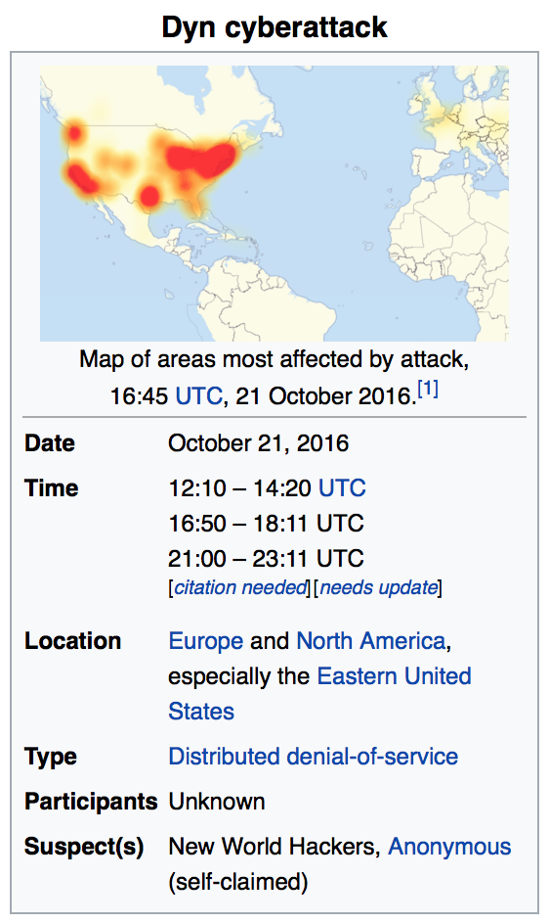
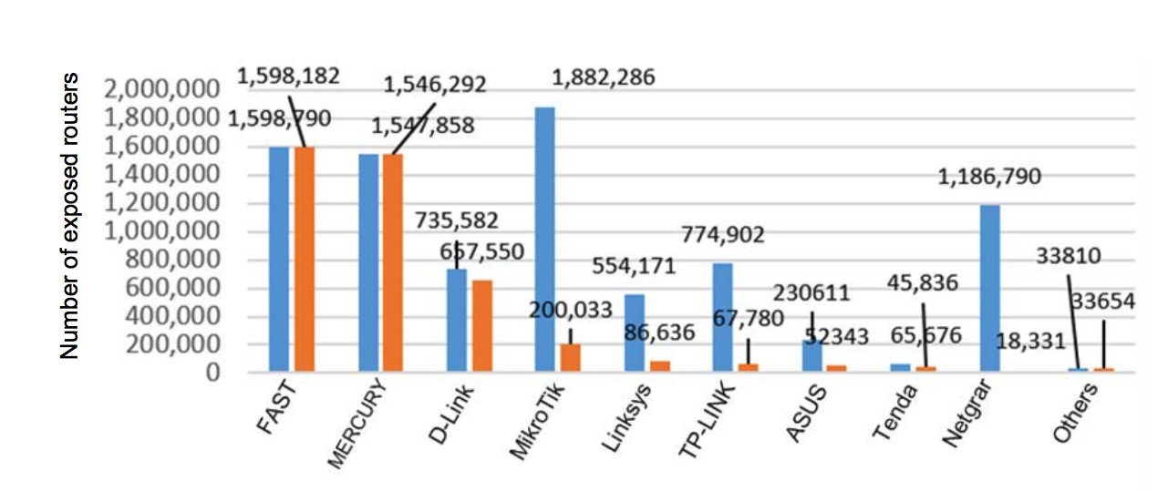
Numbers matter to both sides
Number of Routers Exposed at Internet
October 21, 2016
©NSFOCUS Security Labs, blog.nsfocusglobal.com
Notes:
Basically no IT products are immune to security vulnerabilities, just when, how many, how severe, also depending on how many vulnerability miners are working on that. The number of miners also depends on the economic interests. Higher popularity means bigger number of install, i.e. high potential for the attackers to harvest.
The blue bar means the number of that routers exposed to the Internet globally, while the green bar is the number of routers in China. MikroTik, Fast, Mercury, Netgear, etc.
Reversely, the popularity of your info assets that exposed to the internet is very important to the security operations team. It’s very valuable to monitor your info assets that are exposed to the internet.
This equation help explain the dynamics behind many threat outbursts, e.g. Dyn, WannyCry…

Slide 38

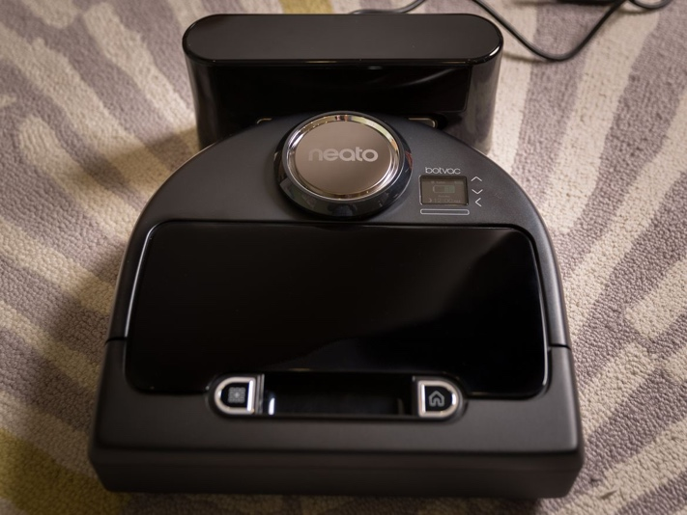

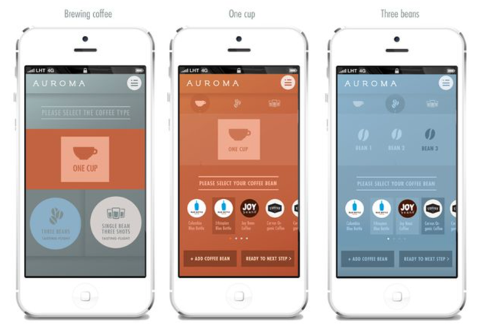
Internet of Things or Threats of Things
the Botvac Connected, $700 (or £549 in the UK)
The Haiku H Series -- a $1,045 smart ceiling fan.
1
2
3
1. https://www.cnet.com/news/why-smart-coffee-makers-are-a-dumb-but-beautiful-dream/
2. https://www.cnet.com/pictures/neatos-new-robot-vacuum-adds-in-app-enabled-smarts-pictures/2/
3. https://www.cnet.com/news/connected-ceiling-fans-in-the-cnet-smart-home/
Notes:
That equation also bring the fact that those low security level things is reshaping the threat landscape.

Slide 39
Overlay operations with Multi-purpose bots
Targeted tunneling
Targeted data
Targeted smoke screen
…
Notes:
Nowadays, the Bots are becoming software defined as well, remotely updateable, plugin/payload enabled. Those technologies also enables new business models.
There are other ways to improve the potential revenue per node, e.g. refining the data collected, data on demand or calling it targeted data, renting service of the tunneling, or calling it targeted tunneling, etc. For the Bot operators, it’s very natural to develop those new services as value added services.

Slide 40
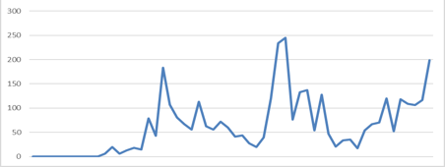
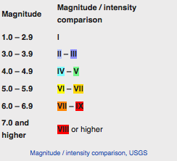
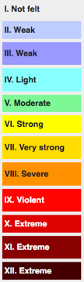
Why Heat matters to understand threat
Heat :: to measure the popularity of an ongoing attack, counting percentage of the attack incidents out of total incidents and number of victims in a certain time period. TOP-Ns are popular means to visualize “heat” threat intel.
Later means less!
Intensity :: to measure the severity of the attacks that a victim suffered and is suffering, e.g. number of attackers, attack counts, strength of the attack method, etc. in a certain time period.
https://en.wikipedia.org/wiki/Mercalli_intensity_scale
(CVE-2017-0144 / MS17-010)
Notes:
This equation also help us understand why the threats often come in waves. We introduce the concept of Heat to measure the popularity of threats. In practice, the threat intel of Heat may use TOPN charts.

Slide 41
Know yourself, know your enemy,…
“If you know the enemy and know yourself, you need not fear the result of a hundred battles. If you know yourself but not the enemy, for every victory gained you will also suffer a defeat. If you know neither the enemy nor yourself, you will succumb in every battle.”
― Sun Tzu, The Art of War
Notes:
That’s well accepted motto for security practitioners. Tough it’s not easy to know ourselves, it’s doable. Web framework fingerprinting, DevOps integration, etc. a lot of new technologies have been used to enhance that part. Know your enemy, it’s easy to say, but very hard to do, let alone to know peers. Without those intel, the defense is doomed to fail. The general threat intel of tons of indicators can not help too much.

Slide 42
Crowd defense in cyber security
Crowd Defense:: Multiple defenders mutually share threat situational intelligence and hunting results to enhance defense. Bi-directional intelligence, MDR are also some sorts of crowd defense.
We can do more to organize in the face of an attack so that all defenders are on the same page to defend effectively.
Courtesy: https://reloadone.com/crowd-defense-group-defense-in-response-to-attacks/

Slide 43
Combine crowd/global and local
Know what happening/happened in neighbors
TOPNs matter, particular the Fast Growth, which betrays the dynamics of the threat frontline.
Better triage, better hunting
Once hunted, new threat intel turns the UNKOWN into KNOWN, immunizing the “crowd”
Crowd/Global
Enterprise/Local
Enterprise/Local
……
Enterprise/Local
Partner 1
Partner 2
Partner N
Notes:
crowd defense means some mechanism to help defense team know what’s happening or happened at neighbors, i.e. where and what the threat actors are heading, that means you might be under the similar attacks. so that the defense team can make more accurate hypothesis for hunting if the resources allow or directly enhance the security controls with corresponding workarounds with a better aligned prioritization.
Let’s get back to the starting story of Equifax, if the security operations team got to know the context intel of that Struts vulnerability, the fast growth curve, not only just a vulnerability info, I believe, they could have made a better triage and decision, e.g. to deploy some smart rules at their WAF, IDS, to check the file integrity monitoring system more frequently before the regular patching is done.

Slide 44
Takeaways
Threat hunting, UEBA, threat intel are powerful, but complicated and expensive
Crowd defense helps know your enemy and peers.
Crowd defense leads to triage combining global and local, i.e. better usage of the scarcest resources - human experts.
Notes:
Threat hunting, UEBA, threat intel, etc. are not silver bullets, particularly they are very expensive, even not affordable for most of enterprises. TI enhanced, ML enhanced security products and platforms are still the most efficient means to protect, leveraging the sharing, cost sharing of the hunting, reasoning and threat intel,

Slide 45


www.nsfocus.com
Richard.zhao@nsfocusglobal.com
  https://www.linkedin.com/company/nsfocus
  https://www.linkedin.com/in/zhaol/
  https://www.facebook.com/nsfocus/
  https://twitter.com/NSFOCUS_Intl
  https://twitter.com/zhaol

