Slide 1
Be Event Driven. And Do It Successfully.
Leah Robert
System Engineer
Email: Leah.Robert@solace.com

Slide 2
Our Lives are
Event Driven
E
Notes:
- Event Driven is certainly technical
- Events are also business or personal

Slide 3
A credit card is swiped…
Available Credit…
E
E
E
E
Fraud?
In-Store Offers?
Notes:
- How do we key into these events as a business?

Slide 4
A flight is delayed…
Notify Passengers…
E
E
E
E
Rebook Missed Connections?
Notify Partner Hotels?

Slide 5
A hotel keycard is used in an elevator…
Floor Correct…
E
E
E
E
Offer for the Bar?
Personalization?
Notes:
- Bar offer: maybe I was there last night, and you give me a 2for1 offer - Personalization to give me more incentive to stay at this hotel again Traveling for business sucks, but personalization makes it more unique

Slide 6
A larger than normal check is deposited…
Update Balance…
E
E
E
E
Increase Credit-Limit?
Offer Low Loan Rate?
Notes:
- Credit Limit so I spend more money - Study that says job/salary increase => buy new vehicle, so offer lower loan rate to incentivize my purchase

Slide 7
An event is…
a message sent by an app or device to signal the occurrence of an action
a change in state

Slide 8
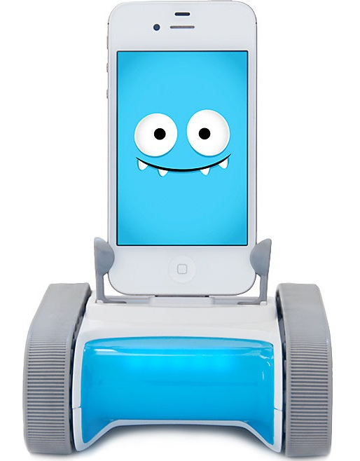
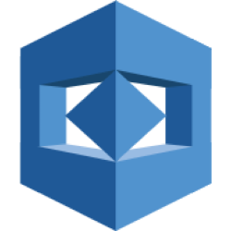
Demo Goal
Have Romo react to the emotion, as determined by Amazon Rekognition, in images captured by a Web Application
Romo the robot
Amazon Rekognition
Web Applications
IoT Device
MQTT Protocol
AWS Cloud Native Application
HTTP Protocol (REST)
JavaScript On-Premise Applications
Solace Message Format (SMF) Protocol

Slide 9
What Challenges do we Face?
Application Connectivity Issues
Multiple environments,
Multiple protocols
Lack of Event Documentation
No way to track relationships

Slide 10
How do we overcome these challenges and create an Event Driven Architecture?

Slide 11
Current Situation
Multiple Environments
On-Premise
Public Cloud
IoT Device
Multiple Protocols
MQTT
HTTP
SMF
HTTP/REST
SMF
MQTT
On-premise (laptop)

Slide 12
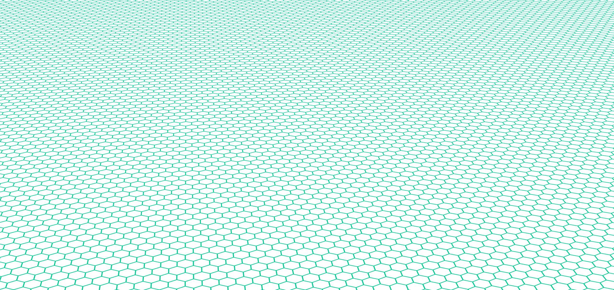
Use an Event Mesh
Multiple Environments
On-Premise
Public Cloud
IoT Device
Multiple Protocols
MQTT
HTTP
SMF
HTTP/REST
Event Mesh
SMF
MQTT
On-premise (laptop)

Slide 13
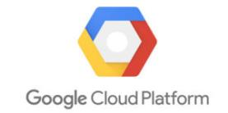
Event Mesh
Public Clouds
PaaS
API Gateway
Event Broker
Event Broker
Event Broker
Event Broker
JMS
MQ

Slide 14
Event Mesh Configuration
HTTP/REST
Event Broker
Event Broker
SMF
MQTT
On-premise

Slide 15
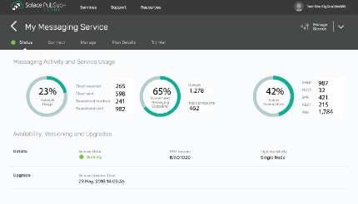
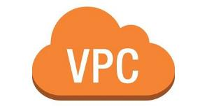
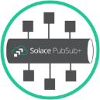
How do we manage the Event Mesh?
Console
Notes:
Manage our event mesh through one pane of glass

Slide 16
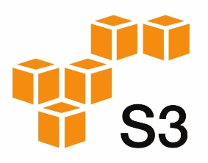
Full Architecture
APIs/Protocols
We need some way to document all these relationships
MQTT
Wow. This is a lot to keep track of…
REST
Publish image data
SMF
Event Broker
Event Broker
IoT
Robot subscribes to commands in order to respond to emotion detected
Image capture and publish
Subscribe to image data
Publish emotion reaction commands
Subscribe to image data
On-premise

Slide 17
We need to answer the …
WHO do you contact to learn more about events and their context/purpose?
WHERE do you discover events/topics and the schema definition that defines the payload?
WHAT logical event address (topic) do you subscribe to in order to receive just the events you want to do something with?
WHY does a given event exist, i.e. what is its context and purpose?
HOW do developers/Architects define their event-driven application interfaces, How do they generate code?
WHEN will a given event be available or deprecated?
Notes:
-

Slide 18
API Management Platforms Solved This for REST!
Documentation:
Discover
API Portal
Registration:
Govern
Analysis:
Improve
Monetize
API Gateway
Internal, Partner & Third-Party
Architects and Developers
Community:
Collaborate
Answers the Who, What, When, Where, Why and How
For RESTful APIs… But what about Events?
Notes:
- API Management has solved this issue for a lots of event - API Portal is where you do your documentation, registration, analysis, etc - this is great for RESTful APIs

Slide 19
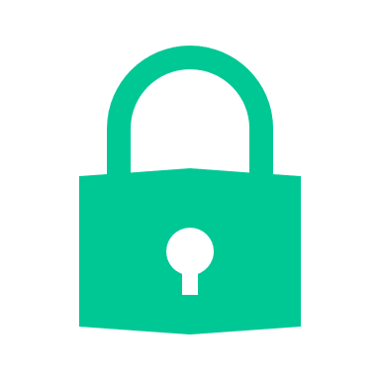
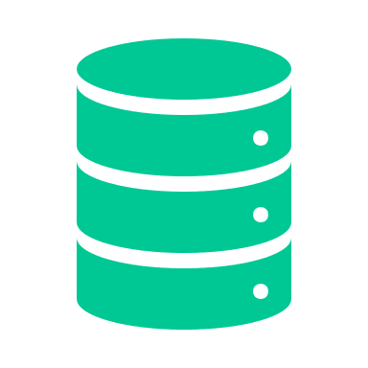
Lack of Event Documentation, meet the Event Portal
Event Driven App
Design, Development
& Management
Documentation:
Discover
Event Portal
Registration:
Govern
Internal, Partner & Third-Party
Architects and Developers
Analysis:
Improve
Monetize
Community:
Collaborate
Runtime Event Mesh
Event Sinks
Security
Event Source
Event Broker
Persistence
Protocol Translation
1..Many Distribution
Notes:
- From our perspective, we have been providing event brokers for over a decade - The event mesh connects sources and sinks all across the world to exchange information in real time - We, and the industry, have completely ignored the design, development and management time from an API / Event Driven perspective - We have created something that will do the same as an API Portal in terms of design, management, etc but tailored towards the Event Driven, async domain

Slide 20
Event Portal Elements
Event Portal Foundational Elements
Application Domains: decomposes enterprise
Schema: payload object definition. JSON, Avro, XML schema
Event: topic address + metadata. References a payload schema
Application: consumes and/or produces events
Tracking relationships between elements is key!
Event Portal
Application Domain
event
application
event
consumes
produces
payload
schema
payload
schema
Notes:
App Domain: Lines of business; in bank wealth management vs securities
Event has business context

Slide 21
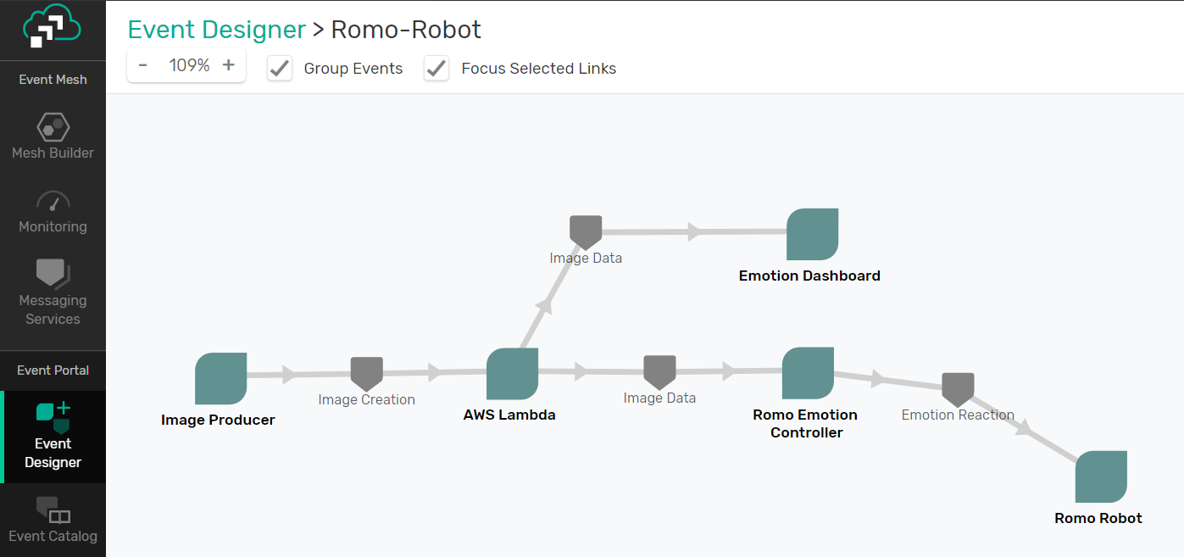
Document and Configure
APIs/Protocols
MQTT
REST
Publish image data
SMF
Event Broker
Event Broker
IoT
Robot subscribes to commands in order to respond to emotion detected
Image capture and publish
Subscribe to image data
Publish emotion reaction commands
Subscribe to image data
On-premise

Slide 22
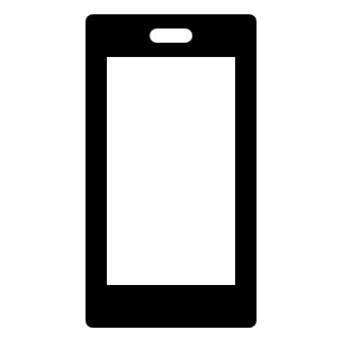
Add New Microservices
APIs/Protocols
MQTT
REST
Publish image data
IoT
Publish movement commands
SMF
…
Event Broker
Event Broker
IoT
Robot subscribes to commands in order to respond to emotion detected
Image capture and publish
Subscribe to image data
Publish emotion reaction commands
Subscribe to image data
On-premise

Slide 23
For the Developers
Export AsyncAPI Spec
Choose Event Broker to run against
Provides payload schema definitions
Provides connectivity to chosen Event Broker
Spring Cloud Stream Generator
Generates Maven project
Only requires Business Logic

Slide 24
How did we Overcome the Challenges?
Application Connectivity Issues
Use an Event Mesh
Lack of Event Documentation
Use the Event Portal

Slide 25
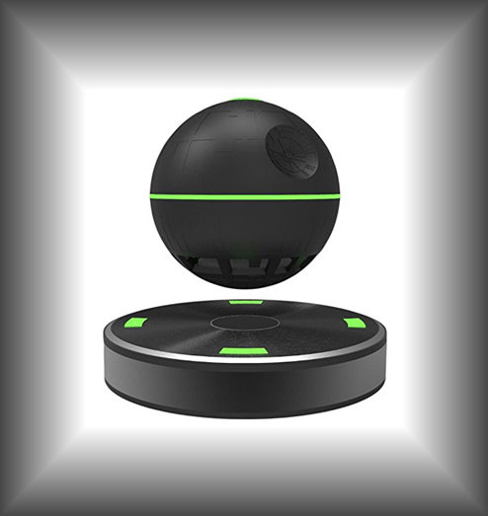
That’s Possible
Leah Robert
Come by our Booth
on the Pacific Level
System Engineer
Email: Leah.Robert@solace.com
Floating Bluetooth
Speaker Raffle

