Slide 1
Debugging microservices
Idit Levine
solo.io

Slide 2

About me
Idit Levine
Founder and CEO of solo.io
@Idit_Levine
@ilevin

Slide 3
Debugging microservices applications is hard
The problem:

Slide 4
The problem
A monolithic application consists of a single process
An attached debugger allows viewing the complete state of the application during runtime
A microservices application consists of potentially hundreds of processes
Is it possible to get a complete view of the state of a such application?!

Slide 5
The problem

Slide 6
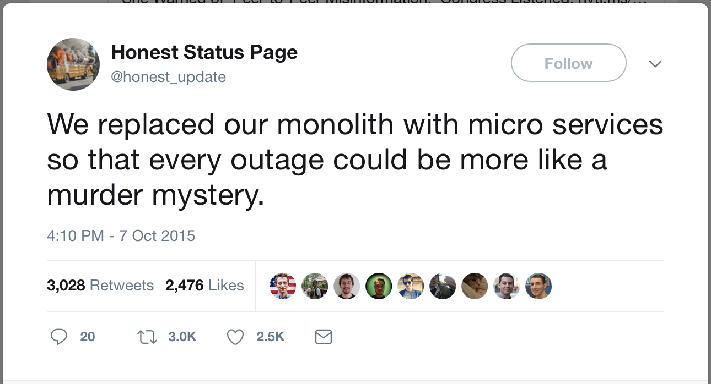
The problem

Slide 7
OpenTracing
Solution I

Slide 8
OpenTracing
assign a unique identifier to each request at the edge service
store it in a context object, along with other metadata
propagate the context across process boundaries (in-band)
baggage is arbitrary K/V
capture timing, events, tags and collect them out of band (async)
re-assemble the call tree from the storage for the UI
Edge service
Unique ID → {context}
A
{context}
{context}
B
E
{context}
{context}
C
D

Slide 9
OpenTracing
Edge service
Unique ID → {context}
A
A
{context}
B
{context}
B
E
TRACE
C
{context}
{context}
D
C
D
E
SPANS

Slide 10
OpenTracing Architecture
spans - basic unit of timing and causality. can be tagged with key/value pairs. logs - structured data recorded on a span.
span context - serializable format for linking spans across network boundaries. carries baggage, such as a request and client IDs.
tracers - anything that plugs into the OpenTracing API to record information. zipKin, jaeger & lightstep. but also metrics (Prometheus) and logging.

Slide 11
OpenTracing
OpenTracing is a consistent, expressive, vendor-neutral APIs for popular platforms, OpenTracing makes it easy for developers to add (or switch) tracing implementations with an O(1) configuration change.

Slide 12
OpenTracing Demo

Slide 13
OpenTracing uses
logging - easy to output to any logging tool, even from OSS components.
metrics/alerting - measure based on tags, span timing, log data.
context propagation - use baggage to carry request and user ID’s, etc.
critical path analysis - drill down into request latency in very high fidelity.
system topology analysis - identify bottlenecks due to shared resources.

Slide 14
OpenTracing limitations
openTracing does not provide run-time debugging
openTracing requires wrapping and changing the code
no holistic view of the application state – can only see what was printed
the process (repeatedly modify the application and test) is expansive
Impossible to change variable values in runtime
logging and printing results in performances overhead

Slide 15
Squash
Solution II

Slide 16

Squash brings the power of modern popular debuggers to developers of microservices apps that run on container orchestration platforms.
Squash bridges between the orchestration platform (without changing it) and IDE.
With Squash, you can:
Live debugging cross multi microservices
Debug container in a pod
Debug a service
Set breakpoints
Step through the code
View and modify values of variables
and more ...

Slide 17
Squash Demo

Slide 18
Squash Architecture
Squash server: holds the information about the breakpoints for each application, orchestrates and controls the squash clients. Squash server deploys and runs on Kubernetes
Squash client: deploys as daemon set on Kubernetes node. The client wraps as docker container, and also contains the binary of the debuggers.
Squash User Interface: squash uses IDEs as its user interface. After installing the Squash extension, Squash commands are available in the IDE command palette.
What vegetable scares all the bugs? Squash!”
one of my 8-year old daughter's favorite riddles

Slide 19
Squash Architecture: vs code extension
vs code extension ➜ kubectl to present the user pod/container/debugger options
vs code extension ➜ Squash server with debug config (pod/container/debugger /breakpoint) ➜ waits for debug session
vs code extension ➜ connects to the debug server & transfers control to the native debug extension.

Slide 20
Squash Architecture: Squash Server
vs code extension ➜ Squash server
Squash server ➜ relevant Squash client with debug config (pod/container/debugger /breakpoint)
Squash server ➜ waits for debug session

Slide 21
Squash Architecture: Squash Client
Squash server ➜ Squash client
Squash client ➜ container runtime interface (to obtain the container host pid)
Squash client ➜ runs the debugger, attaches it to the process in the container, and sets the application breakpoints
Squash client ➜ return debug session.

Slide 22
Squash high level Architecture
Platforms
IDEs
Debuggers

Slide 23
Squash high level Architecture
Platforms
IDEs
Debuggers

Slide 24
Service mesh
Solution III

Slide 25
Service Mesh
Service mesh data plane:
Touches every packet/request in the system. Responsible for service discovery, health checking, routing, load balancing, authentication/authorization, and observability.
Service mesh control plane:
Provides policy and configuration for all the running data planes in the mesh. Does not touch any packets/requests in the system. The control plane turns all of the data planes into a distributed system.

Slide 26

Envoy – data plane
The network should be transparent to applications. When network and application problems do occur it should be easy to determine the source of the problem.
Out of process architecture: developers to focus on business logic
Modern C++11 code base: Fast and productive.
L3/L4 filter architecture: Can be used for things other than HTTP (TCP proxy at its core)
HTTP L7 filter architecture: Make it easy to plug in different functionality.
HTTP/2 first! (Including gRPC and a nifty gRPC HTTP/1.1 bridge).
Service discovery and active health checking.
Advanced load balancing: Retry, timeouts, circuit breaking, rate limiting, shadowing, etc.
Best in class observability: stats, logging, and tracing.
Edge proxy: routing and TLS.

Slide 27
Istio – control plane
Pilot: responsible for the lifecycle of Envoy instances deployed across the Istio service mesh. Pilot exposes APIs for service discovery, dynamic updates to load balancing pools and routing tables.
Mixer: provides Precondition Checking (authentication, ACL checks and more), Quota Management and Telemetry Reporting.
Istio-Auth enhance the security of microservices and their communication without requiring service code changes.

Slide 28
Service mesh, OpenTracing, and Squash
Towards an integrated solution

Slide 29

The whole solution
1
Step 1:
vs code extension ➜ Squash server pulling & waiting for debug config (service & image) with debug session to connect.
vs code extension ➜ connects to the debug server & transfers control to the native debug extension.
Step 2:
envoy gets a curl request with squash header
Step 3:
➜ envoy initiate debug config
➜ Squash server
➜ envoy wait for debug session.
4
3
5
2

Slide 30
The whole solution
1
Step 4:
Squash server ➜ Squash client
Squash client ➜ container runtime interface (to obtain the container host pid)
Squash client ➜ runs the debugger, attaches it to the process in the container, and sets the application breakpoints
Squash client ➜ return debug session.
Step 5:
envoy resume traffic to the app
4
3
5
2

Slide 31
Service Mesh Demo

