Slide 1
Yes, You Can Build a Search Engine in .Net!
Lessons learned building the world’s largest .Net application
Ben Watson
Principal Software Engineer, Microsoft
Author, Writing High-Performance .NET Code
Notes:
I’m sure much of what I will say applies to Java.

Slide 2
About me
Ben Watson
@benmwatson
Principal Software Engineer, Microsoft
At Bing since 2008 (before it was Bing)

Slide 3
Capability
Notes:
This talk is about capability.
Despite managed platforms such as Go, Java, and .Net taking over the corporate world for many things, I believe we chronically undersell the capabilities of managed platforms.
The reality is that, with strong engineering teams, they are capable of workloads beyond what we realize.

Slide 4
A Story in Three Acts
Notes:
Today, I want to describe a little bit of our journey from C++ to .Net and the goals and challenges we had along the way.

Slide 5
Architecture vPrev

Slide 6
Aggregator
Web
Ads
Speller
Finance
Commerce
Ranker
Query Understanding
News
Multimedia
Sports
Notes:
We had a very familiar hub and spoke model in our aggregation tier. There were actually about 100 nodes surrounding the aggregator.
I have fewer just to show you the names of the types of components we had.
There are some weaknesses to this model… (NEXT)

Slide 7
Aggregator
Web
Ads
Speller
Finance
Commerce
Ranker
Query Understanding
News
Multimedia
Sports
Notes:
There is significant network time and serialization time on all these borders.
But it’s worse than that…

Slide 8
Aggregator
Web
Ads
Speller
Finance
Commerce
Ranker
Query Understanding
News
Multimedia
Sports
Notes:
Each of these is a fairly monolithic app, with a high dev and maintenance cost.
Each one of these pieces of functionality each had their own release train.
An enormous amount of wasted effort and overlap.
So we set about … (NEXT)

Slide 9
Rearchitecting

Slide 10
Aggregator
Web
Ads
Speller
Finance
Commerce
Ranker
Query Understanding
News
Multimedia
Sports
Notes:
Starting with this basic structure, we identified pieces of this that we did like, and some goals we wanted going forward.
For example: (NEXT)

Slide 11
Aggregator
Web
Ads
Speller
Finance
Commerce
Ranker
Query Understanding
News
Multimedia
Sports
Notes:
We want to maintain the isolation we had. A problem with one service should not affect the others.

Slide 12
Aggregator
Web
Ads
Speller
Finance
Commerce
Ranker
Query Understanding
News
Multimedia
Sports
Notes:
We wanted to improve the agility of each team.

Slide 13
Aggregator
Web
Ads
Speller
Finance
Commerce
Ranker
Query Understanding
News
Multimedia
Sports
Notes:
Bring more of these nodes inside the process space. Keep data separate, yes, but all of the pure processing can be done with in-memory communication.

Slide 14
Aggregator
DevOps
Web
DevOps
Ads
DevOps
Speller
DevOps
Finance
DevOps
Commerce
DevOps
Ranker
DevOps
Query Understanding
DevOps
News
DevOps
Multimedia DevOps
Sports
DevOps
Notes:
DevOps

Slide 15
DevOps
Aggregator
Web
Ads
Speller
Finance
Commerce
Ranker
Query Understanding
News
Multimedia
Sports
Notes:
Single DevOps team

Slide 16
Aggregator
Web
Ads
Speller
Finance
Commerce
Ranker
Query Understanding
News
Multimedia
Sports
Notes:
Starting with these nodes, we wanted to scale up…(NEXT)

Slide 17
Aggregator
Web
Ads
Speller
Finance
Commerce
Ranker
Query Understanding
News
Multimedia
Sports
Service
Service
Service
Service
Service
Service
Service
Service
Service
Service
Service
Service
Service
Service
Service
Service
Service
Service
Service
Service
Service
Service
Service
Service
Notes:
…by 10x.

Slide 18
Difficult to accomplish in C++…
Notes:
We knew that our goals would be difficult to accomplish in C++, so…

Slide 19
Enter: .Net!
Notes:
Let’s do it in .Net! It provides a lot of these safety and isolation features already.
However, then enter those who says…

Slide 20
“You can’t do that.”

Slide 21
Notes:
“.Net is untried at this scale.” Told we can’t build big things.
Photo Credit: Allie_Caulfield, https://www.flickr.com/photos/wm_archiv/6143050668/in/photolist-amQJWG-8qRgmy-TaD3eo-fjADFf-p7XbjM-8Jp5kb-cpVRZL-qJSBuU-egNutZ-dTd8F9-8YAnA6-cpYsBd-byhua4-d5B1ro-9vgPWt-fFKM6b-FNeDfc-p7Yn7z-c6V1Fy-3qEN-dT7tV6-UFUynK-5RP9G2-oG7pT-ePD342-9vjSBm-b9NPmi-5kGLad-ddJEi5-6aZxa3-ppbekg-dVzway-5AGZZs-fcgNCk-35qee-iAMqmb-GbzqHV-eji13W-oagVY5-cbJf2b-c6V1uj-R8mmn2-jHgCTV-7mQNfG-3fHNr2-eyhFqb-bLtYw4-b9NDNc-YVDoZc-bxzdZb

Slide 22
Notes:
Managed languages are more appropriate for things about this size.
Photo Credit. SarahTz https://www.flickr.com/photos/120420083@N05/16776749261/in/photolist-ryve4B-Ws2RXs-XYxY1T-VFKMKj-YEoQYx-YX2wbd-csrUMo-9kM3Hi-bQKkMX-pZY7ZU-o13UGX-XTwzcQ-as14Q4-Y9z12p-YZMyCM-Va6B5m-bBQBqu-5kCPL1-9ea3N5-8AmP3o-mDK71o-q5uw7e-2j69vU-bQKon2-97iaUp-YZMiFx-YLSyCd-cPM3vQ-YVyDNm-6b2KKd-YUrMn9-bd8PqH-XDcGKr-YwyeXs-7GJsZZ-YeKj8m-c86Xou-c1gorW-Zb2QkF-Zb2X8P-YUszFS-Y6is3o-L5kDXQ-8pqwuK-T35P42-qZqf6U-KKrZQ-YB2n29-74gtuw-7ZPD8P

Slide 23
“C++ is better. C++ is what I know.” – Senior Management
Notes:
Senior management built the first iteration of Microsoft’s search engine on C++. Then they were promoted to Partner and VP level for it.
Good for them, I’m happy for them. It doesn’t mean they’re right, or they’re seeing the forest for the trees.

Slide 24
“.Net is slow.”
Notes:
This is the root concern, really. Back in 2010, it’s what everybody had heard.
Let’s dig into the .Net is too slow complaints.
They generally fall into two categories:

Slide 25
“.Net is slow” fears
Myth
Code Execution is Slow
Reality
JITted code is machine code
Runs natively, not virtually
JITted code has better locality
Compiler is always improving
Hardware is always improving

Slide 26
Notes:
Here is a very precise and technical graph of one reason why this discussion doesn’t matter as much as some think.
We’re 4 generations of hardware beyond where we started. Given the right architecture, that makes a bigger difference than most other things.

Slide 27
“.Net is slow” fears
Myth
Overhead is Too High
Reality
Bounds checking → Safe memory access
Garbage collection → delete, fast memory allocation, safe pointer access
Type overhead → Type safety, rich metadata, reflection, exception handling, debugging, static analysis

Slide 28
You WANT the benefits of that overhead.
Notes:
In many cases, you can avoid the worst costs of that overhead, and still take advantage of the benefits.

Slide 29
Benefits
Memory safety
Type safety
Fast allocations
Debugging is MUCH better
Better static code analysis
Code locality
Costs
JIT
Garbage Collection
Bounds checking, type checking
Hidden code
Notes:
Here’s how you should think about the costs and benefits of .Net: You have to decide whether these benefits are worth it to you. Of course you pay for them.
These aren’t the only benefits, though…

Slide 30
Benefits
Memory safety
Type safety
Fast allocations
Debugging is MUCH better
Better static code analysis
Code locality
Less down-time
No Access Violations
Developer Agility
Robust Libraries
Costs
JIT
Garbage Collection
Bounds checking, type checking
Hidden code
Education
Notes:
There are “softer” benefits, which are in many ways more important to the practice of software engineering.
We found out that the costs were far less than the benefits in practice.
But there’s also a new cost: Education

Slide 31
Different costs, not worse costs.

Slide 32
Is Managed vs. Unmanaged performance always equivalent?
Notes:
Of course not. There are situations that do mandate specific performance characteristics that only unmanaged code can bring, but I submit these are fewer than you think.

Slide 33
Learn where your costs are
Notes:
It’s often not in raw CPU execution speed.

Slide 34
“Managed code lets mediocre developers write lots of bad code really fast.”
Notes:
I attribute this to my mentor when I was a more junior developer.
Story 1 – Mediocre developers – Reviewing another team’s code and saw that they were iterating through a dictionary checking each key to see if it was the one they wanted. Obviously, this isn’t a .NET problem, but I think the ease of the foreach syntax seduced them into taking the “easy” way out.
Story 2 – One very common thing to see is “stupid string tricks” – using string’s convenience methods to extract information from a large string, when you don’t actually need the sub strings. For example, splitting a string by commas, and counting the resulting substrings.

Slide 35
Performance Isn’t Free
Notes:
* Managed, Unamanaged – doesn’t matter. Performance doesn’t come free. Not in .Net, not anywhere.
* It requires hard work

Slide 36
Become Expert
Notes:
We had to become experts in .Net—very deep experts, understanding exactly how .Net works under the hood. In many cases, we had to learn things that were not public knowledge (or at least not very well known).
We had to be come deep experts in how the GC works in particular, which takes me to the next topic…

Slide 37
Performance Myths
Notes:
3 specific myths of .Net performance engineering.
Many of these can be applied across frameworks and languages, but I am going to talk about my experience with .Net

Slide 38
Myth 1: “You can’t control GC.”

Slide 39
It’s very easy to build a system that spends an extraordinary amount of time in GC. This is not inherent to the CLR!
Notes:
Unfortunately, most people seem to fall into the lazy way of coding in C#, which does typically involve a ton of memory allocations an inefficient API code.

Slide 40
It is extremely difficult to build a low-latency, high-performance server without taking GC into account from the beginning.

Slide 41
You need to understand the inner workings of the GC, just like you would any memory allocator.
Notes:
* Reminder: We are talking about high-performance systems here. This isn’t regular software!

Slide 42
The One Rule: Objects must die in a gen0 GC - or – They must live forever in gen2.
Notes:
This is one of the most important things to learn. If you learn NOTHING else, remember this one.
This is how the GC is designed.
The point of this is to avoid promotion.
STORY: We once had a component that had to serialize XML, and we built up a set of XElements. We thought we’d be efficient and delay serialization until the last second to save time in the query.
Oops: this caused the XElements to be promoted to gen1, and sometimes gen2.
This caused more time in GC.
Better to just serialize as soon as possible into pooled buffers, and let the XElement objects be collected.

Slide 43
Pool objects with a long or unknown lifetime.
Notes:
Pros:
Save time in gen0/1 GCs
There is no further promotion.
It cuts your allocation rate and time spent in GC.
Risks to this strategy:
Gen2 will become very large (bigger working set)
Gen2 collections may become very long – you might have to mitigate this with other strategies (e.g., stopping processing)
More gen2 objects will have references to newer objects, causing gen0 and gen1 GCs to take a little longer.

Slide 44
Pool everything in the large object heap.
Notes:
True, if you find yourself allocating on the LOH regularly.
All LOH allocations are in gen2 automatically, so more of them will guarantee an expensive gen 2 GC.
More important when background GC is enabled because LOH allocations can block during some phases of background GC.

Slide 45
The cost of a GC is proportional to the number of surviving objects.
Notes:
This is vitally important. If you allocate a million objects, but their references go out of scope before the GC, they contribute NOTHING to the cost of that GC.
There is an important exception to this:
If you are allocating so much memory so fast that you hit the segment limit. At that point, you are guaranteed a GC.
STORY: This has actually happened to us. We started hitting upwards of 600 MB/sec in allocations. That guarantees some significant time spent in GC. There are no simple tricks here other than reducing the allocation rate.

Slide 46
You will usually want to optimize for as little memory allocation as possible.
Notes:
* This almost goes without saying. The less you allocate, the less work the GC will have to do.
* One reason why this may not apply is with anything pooled—that memory lives forever, so while the initial allocation is potentially large, the net effect will be less overall allocation.

Slide 47
You CAN control the GC
Notes:
Myth busted. You can control the GC. The knobs are just more subtle than we’re used to, but they’re there.

Slide 48
Myth 2: “I’m the Framework Class Library, you can trust me!”

Slide 49
The higher your performance requirements, the less you trust others’ code.
Notes:
This only matters for critical areas of code.

Slide 50
How would you implement Enum.HasFlag()?
Notes:
Think about this for a second.
(PAUSE)

Slide 51
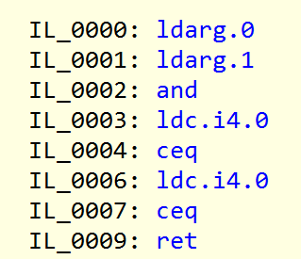
Notes:
8 IL instructions. It’s probably fewer x64 instructions.
Let’s see what it actually looks like…

Slide 52
Notes:
Uh oh…. A call to some type functions…
Any guesses on how expensive this all is?

Slide 53
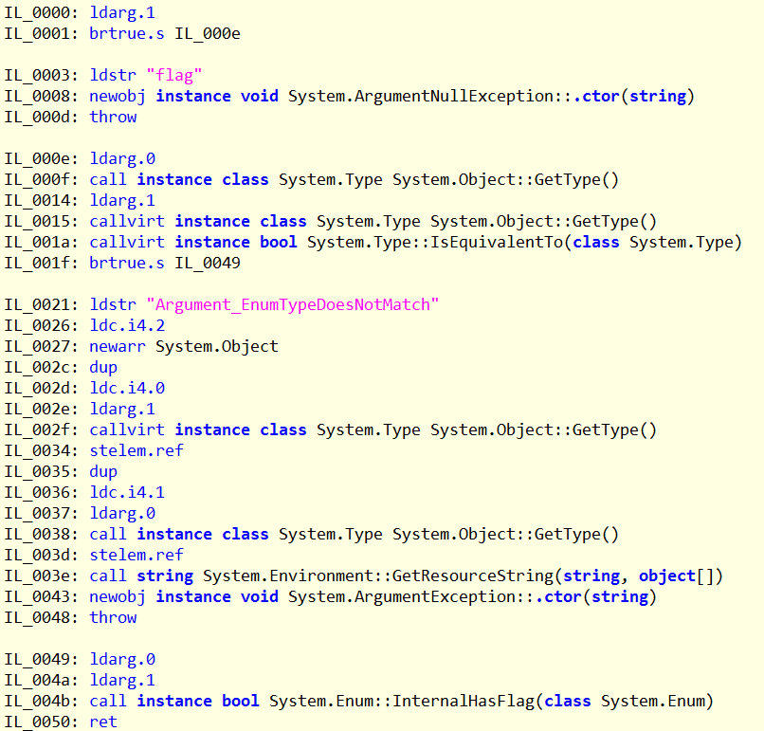
Notes:
Ignoring the exception throwing code, there are:
12 IL instructions, none of which actually compare the numeric values.
2 calls and 2 virtual calls
STORY: I discovered this after seeing it show up in a system profile—and I thought to myself, “How in the world is this possible, even if we’re calling it this much?”
This code is correct
It is more robust than my solution. It checks types, after all.
It is a general-purpose solution, with general-purpose performance.
BUT: In my app, I have more information. I can make assumptions about the types, and get better performance. I just have to implement it myself.

Slide 54
Read the Source
Notes:
There’s no getting around this. If performance is critical, you have to read the source of all the code you didn’t write.
Otherwise, you’ll be surprised when you start looking at profiles.
* One example of why its important to read the source: (NEXT SLIDE)

Slide 55
Quiz: How many different XML serialization options ship with .NET?

Slide 56
LINQ-to-XML
XmlTextReader
XmlValidatingReader
DataContractSerializer
XmlSerializer
XDocument
XPathNavigator
XPathDocument
Notes:
Each of these are different.
Lots of options, each with their own quirks and performance characteristics. You have to study them and decide which is best in your situation.
* (Someone in here knows some I’ve left out)

Slide 57
Methods that throw exceptions in normal conditions.
Notes:
Exceptions really are expensive. More expensive in .NET than normal Windows exceptions.
HttpWebRequest throws exceptions on non-200 responses.
All of the Int.Parse-style methods
Don’t let your methods be one of these!

Slide 58
Methods that do more than you need
Notes:
There are many examples of this.
Example: Activator.CreateInstance is a method to create an instance of an object

Slide 59
Activator.CreateInstance
// System.RuntimeType [SecurityCritical] internal object CreateInstanceImpl(BindingFlags bindingAttr, Binder binder, object[] args, CultureInfo culture, object[] activationAttributes, ref StackCrawlMark stackMark) { this.CreateInstanceCheckThis(); object result = null; try { try { if (activationAttributes != null) { ActivationServices.PushActivationAttributes(this, activationAttributes); } if (args == null) { args = EmptyArray<object>.Value; } int num = args.Length; if (binder == null) { binder = Type.DefaultBinder; } if (num == 0 && (bindingAttr & BindingFlags.Public) != BindingFlags.Default && (bindingAttr & BindingFlags.Instance) != BindingFlags.Default && (this.IsGenericCOMObjectImpl() || base.IsValueType)) { result = this.CreateInstanceDefaultCtor((bindingAttr & BindingFlags.NonPublic) == BindingFlags.Default, false, true, ref stackMark); } else { ConstructorInfo[] constructors = this.GetConstructors(bindingAttr); List<MethodBase> list = new List<MethodBase>(constructors.Length); Type[] array = new Type[num]; for (int i = 0; i < num; i++) { if (args[i] != null) { array[i] = args[i].GetType(); } } for (int j = 0; j < constructors.Length; j++) { if (RuntimeType.FilterApplyConstructorInfo((RuntimeConstructorInfo)constructors[j], bindingAttr, CallingConventions.Any, array)) { list.Add(constructors[j]); } } MethodBase[] array2 = new MethodBase[list.Count]; list.CopyTo(array2); if (array2 != null && array2.Length == 0) { array2 = null; } if (array2 == null) { if (activationAttributes != null) { ActivationServices.PopActivationAttributes(this); activationAttributes = null; } throw new MissingMethodException(Environment.GetResourceString("MissingConstructor_Name", new object[] { this.FullName })); } object obj = null; MethodBase methodBase; try { methodBase = binder.BindToMethod(bindingAttr, array2, ref args, null, culture, null, out obj); } catch (MissingMethodException) { methodBase = null; } if (methodBase == null) { if (activationAttributes != null) { ActivationServices.PopActivationAttributes(this); activationAttributes = null; } throw new MissingMethodException(Environment.GetResourceString("MissingConstructor_Name", new object[] { this.FullName })); } if (RuntimeType.DelegateType.IsAssignableFrom(methodBase.DeclaringType)) { new SecurityPermission(SecurityPermissionFlag.UnmanagedCode).Demand(); } if (methodBase.GetParametersNoCopy().Length == 0) { if (args.Length != 0) { throw new NotSupportedException(string.Format(CultureInfo.CurrentCulture, Environment.GetResourceString("NotSupported_CallToVarArg"), Array.Empty<object>())); } result = Activator.CreateInstance(this, true); } else { result = ((ConstructorInfo)methodBase).Invoke(bindingAttr, binder, args, culture); if (obj != null) { binder.ReorderArgumentArray(ref args, obj); } } } } finally { if (activationAttributes != null) { ActivationServices.PopActivationAttributes(this); activationAttributes = null; } } } catch (Exception) { throw; } return result; }
public static object CreateInstance(Type type, BindingFlags bindingAttr, Binder binder, object[] args, CultureInfo culture, object[] activationAttributes) { if (type == null) { throw new ArgumentNullException("type"); } if (type is TypeBuilder) { throw new NotSupportedException(Environment.GetResourceString("NotSupported_CreateInstanceWithTypeBuilder")); } if ((bindingAttr & (BindingFlags)255) == BindingFlags.Default) { bindingAttr |= (BindingFlags.Instance | BindingFlags.Public | BindingFlags.CreateInstance); } if (activationAttributes != null && activationAttributes.Length != 0) { if (!type.IsMarshalByRef) { throw new NotSupportedException(Environment.GetResourceString("NotSupported_ActivAttrOnNonMBR")); } if (!type.IsContextful && (activationAttributes.Length > 1 || !(activationAttributes[0] is UrlAttribute))) { throw new NotSupportedException(Environment.GetResourceString("NotSupported_NonUrlAttrOnMBR")); } } RuntimeType runtimeType = type.UnderlyingSystemType as RuntimeType; if (runtimeType == null) { throw new ArgumentException(Environment.GetResourceString("Arg_MustBeType"), "type"); } StackCrawlMark stackCrawlMark = StackCrawlMark.LookForMyCaller; return runtimeType.CreateInstanceImpl(bindingAttr, binder, args, culture, activationAttributes, ref stackCrawlMark); }
☹
Notes:
This is a method that allocates objects dynamically—you give it a type and some arguments, and it will try to call the right constructor.
It’s incredibly expensive. It allocates a copy of the arguments array you pass, it gets type information for each argument. It’s not a cheap thing to call.
800 bytes of IL code, not including the methods these two methods call.
If you’re going to call this every so often, then its fine.
But what if dynamic object invocation is at the core of your architecture?

Slide 60
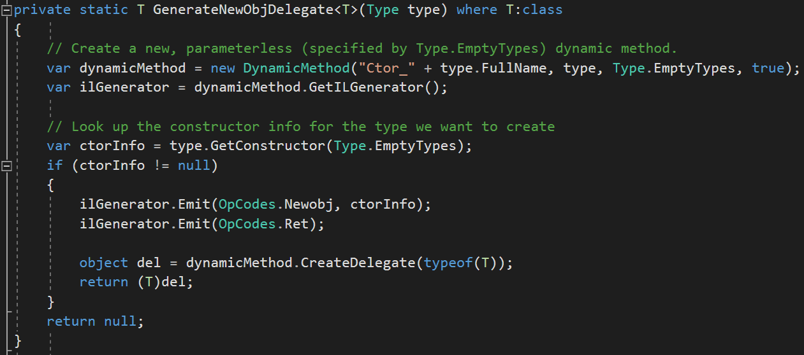
Generate code dynamically!
Notes:
We know that a lot of our allocations follow the same pattern, so let’s codegen our way out of this.
Instead of pages of code, we now have about 12 bytes of IL.
64x faster than Activator.CreateInstance.
Same trick for MethodInfo.Invoke (invoking of arbitrary methods)

Slide 61
Myth 3: “Premature optimization is the root of all evil.”
Notes:
Attributed to Donald Knuth.
This can apply to micro optimizations, but it does not apply to optimization as a whole.

Slide 62
Notes:
If we’re building a simple structure, we don’t have to think much beyond 4 walls and a ceiling. Everything else can be worked in as needed. This is fine if that’s what we’re interested in.
Creative Commons, Photo Credit: Andy Atzert, https://www.flickr.com/photos/andyatzert/7777578900/in/photolist-cRh8eW-7kF8SF-4rP8v-9v9X8o-mjzghd-8DqqLF-DJ5vkU-9vNrJi-ks8vMM-pzAvXU-e8Hcai-dEULB-74Y9X4-fdBDkL-S5VG3i-9E6UAx-3LiRz-o9rySp-7aLAB-cfnMZh-cmjr67-cKgf7h-fQnU4a-q1TZKw-7aLyo-dEunhz-bthGuh-4WuF11-aKQAAz-prBBds-ftKaMg-okzmA6-dc83Am-8jaVDY-8T195u-ojicG2-84c1mv-av8z6M-dt3V9a-7aNLTB-86dbNr-aGwfpi-w7p2rK-ay6yT-5NPkNG-fwR4PM-GuhAFz-eZKujS-9wu1cH-q1TYkC

Slide 63
Notes:
If this is what you want to build, then you can’t wait until the first floor is built to switch to steel beams when you started with wood.
Photo Credit: Creative Commons, Mathias Apitz (München), https://www.flickr.com/photos/abzisse/12243598854/in/photolist-jDVDnY-ezJjH-cmYUGW-bhQgC2-d4eBE1-6XaWDH-d4eioU-r6Th6N-rhiLDP-d4eyJu-7r7WSU-oPwVpU-f8KPxc-jDUWvM-jDWhPm-jEUZLk-9qmFpq-cmZeyU-roMjRs-5XahWn-qPoiy7-fvunXa-qrT5fJ-hMEn1-d4erhC-qPofe1-d4eiVJ-iyz9Rg-ogCx8S-8CbPbL-dzMsvW-r6U26e-bJG7FT-qYZZQz-aBEuxK-qSuAMt-C3JgLU-8F3WuH-rZdJVD-b7aYZV-iPNAqZ-e7cztS-qYZZgD-qs5QGr-impFQ3-nREFT9-aZh9Qx-4EmLZT-TN3Pim-a2NXv8

Slide 64
Understand the performance environment before you start.
Notes:
Where is it likely to be a significant factor?
What strengths and weaknesses does your architecture have?
What kinds of choices do you need to make to ensure good performance?
What are the strengths and weaknesses of the platform you are building on?

Slide 65
Results

Slide 66
Latency: 50% Reduction
Notes:
Because our architectural decisions made the biggest difference

Slide 67
Stability
Notes:
Fewer crashes.
Most instability in the system comes from unported unmanaged components.

Slide 68
Time to Debug
Notes:
No more poring through native heap dumps.
No more mystery double deletes
The few crashes are trivial to debug.

Slide 69
Availability
Notes:
Higher than ever before.
Year over year, our availability requirements have been ratcheted up.

Slide 70
Team Performance
Notes:
We do a LOT more with less.
There used to be over 80 developers doing what is now handled by only 30, with orders of magnitude more traffic, customers, internal partners, and system complexity.
We have more code, more products, more customers.

Slide 71
Aggregator
Web
Ads
Speller
Finance
Commerce
Ranker
Query Understanding
News
Multimedia
Sports
Service
Service
Service
Service
Service
Service
Service
Service
Service
Service
Service
Service
Service
Service
Service
Service
Service
Service
Service
Service
Service
Service
Service
Service
Notes:
At the beginning I mentioned that our goal was to scale by 10x…
We didn’t do that…

Slide 72
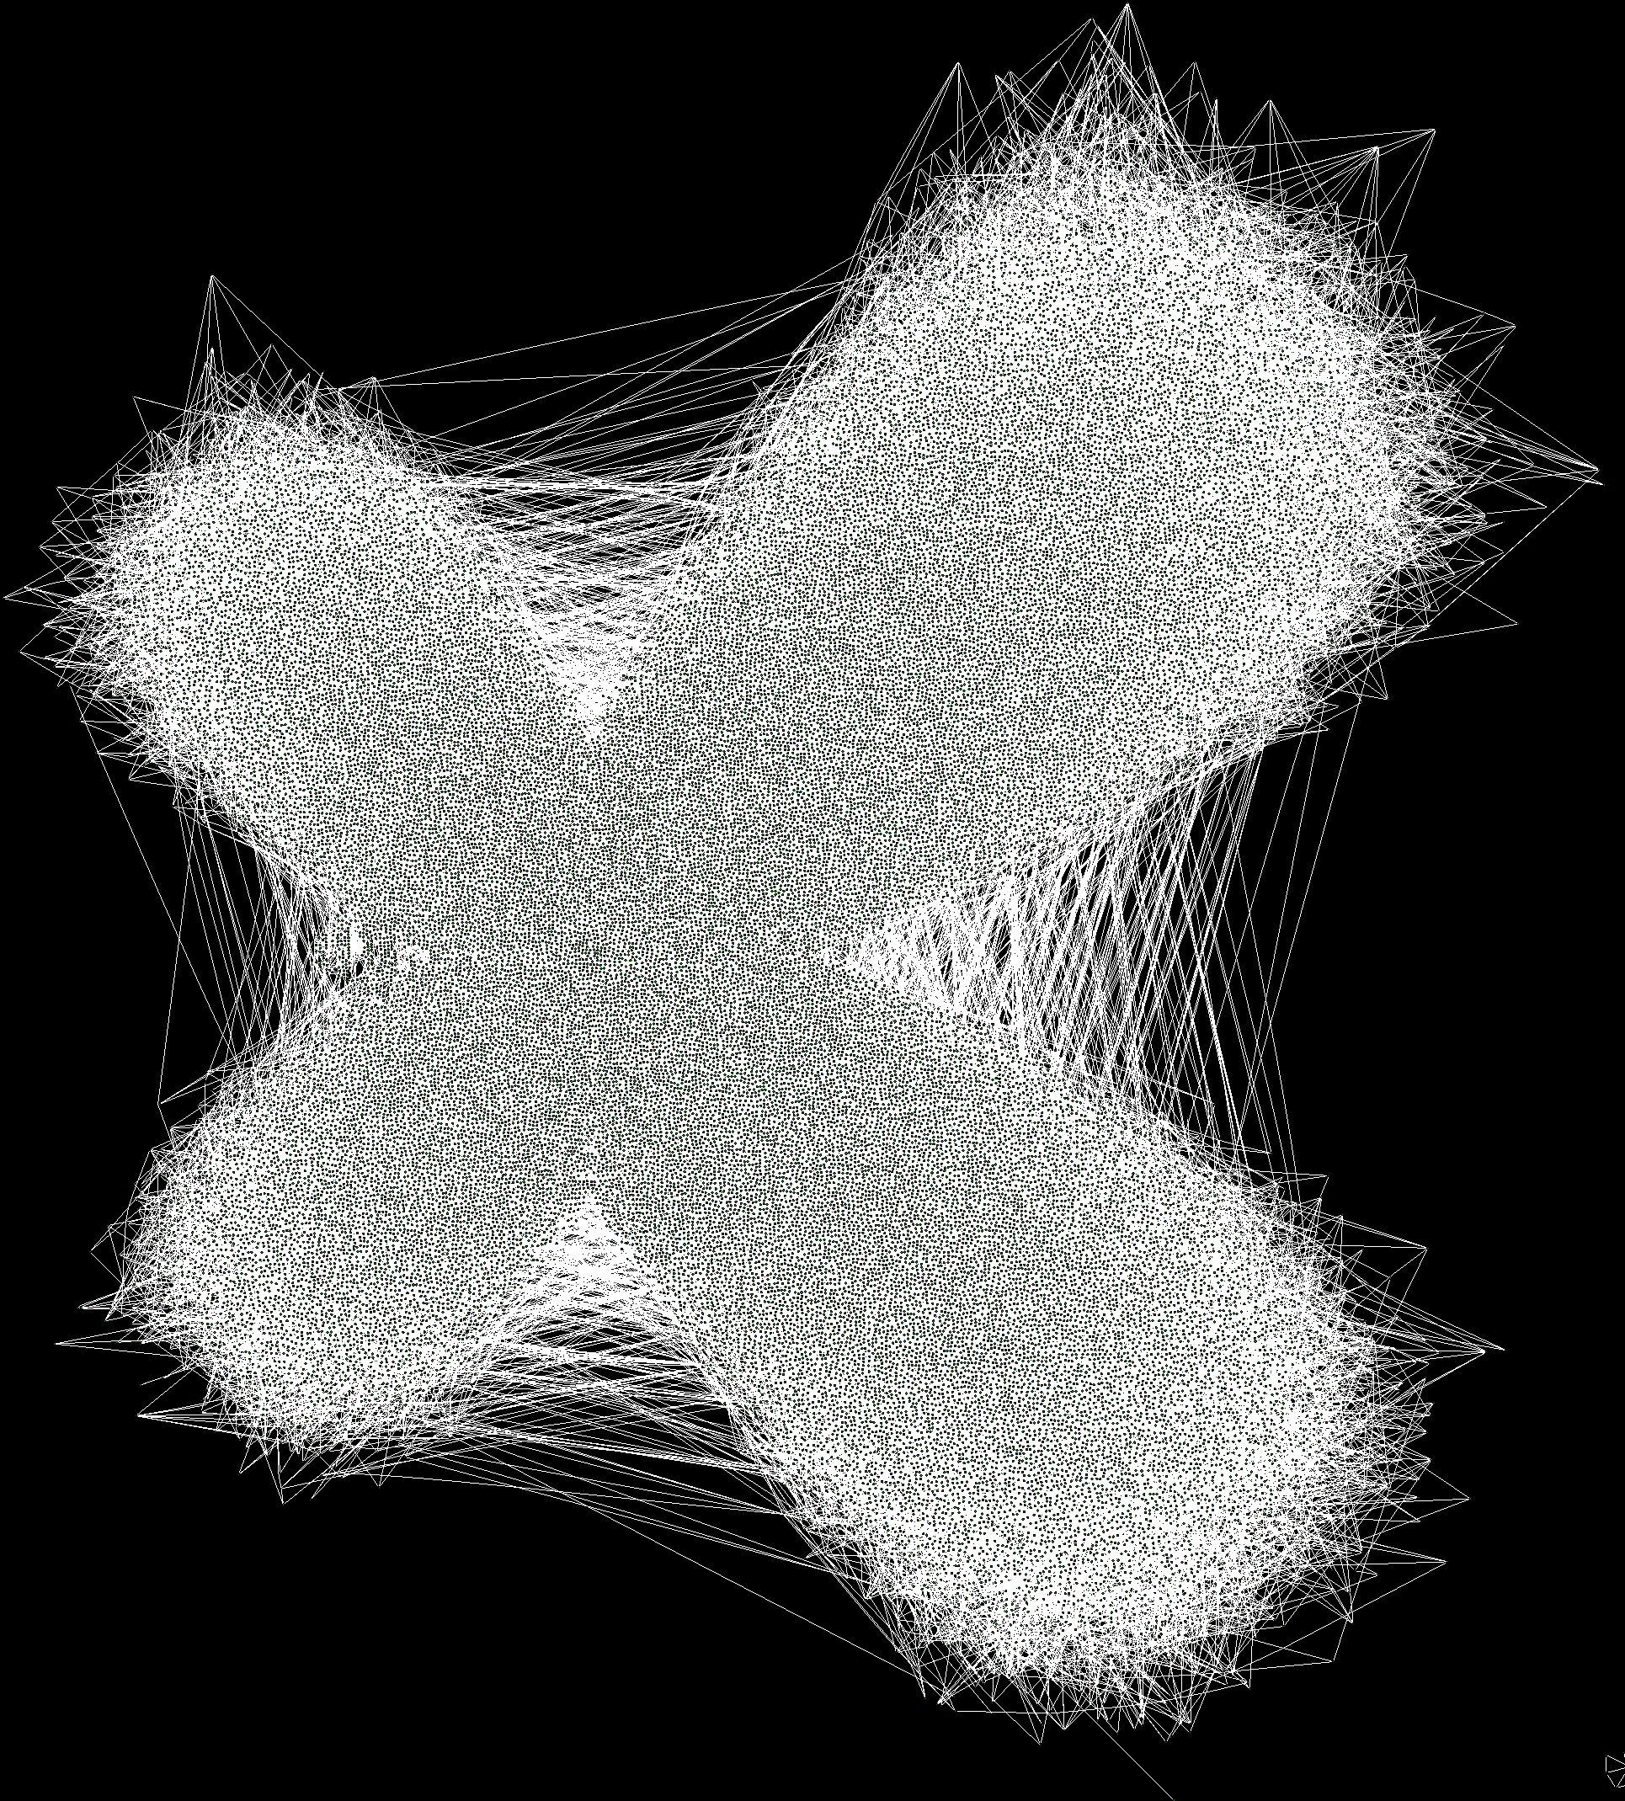
Notes:
Measured by the number of components in our system, our scale factor was, conservatively, more than 400x.
The components are smaller, yes.
I hope that I’ve conveyed to you that the limitations aren’t in the managed code or framework. The only limitation is your imagination and the amount of engineering effort you are willing to put in to it.
Thank you very much.

Slide 73
1:40pm - Performance Mythbusting Panel – Bayview AB
2:55pm - .NET AMA w/ Mads Torgersen & Ben Watson – Waterfront CDE

